Slide 1
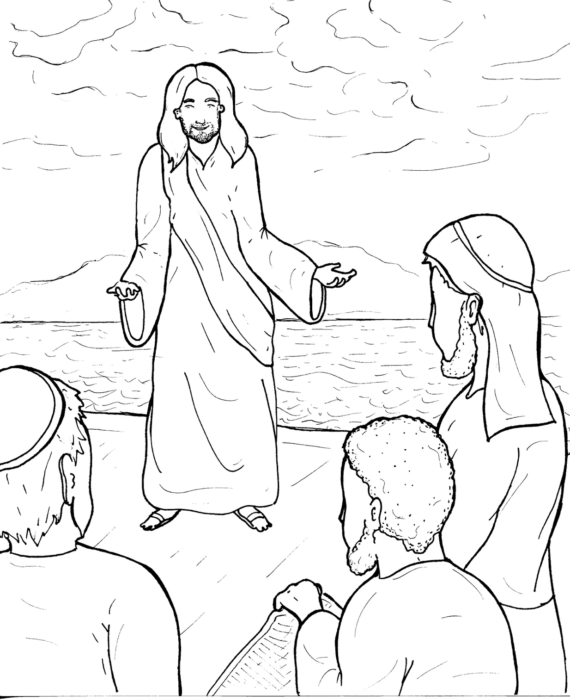
10. Jesus Calls Followers
Part 4
Story in Easy Read English
Questions
Story in Phrases

Slide 2
Jesus was walking beside the Sea of Galilee.

Slide 3
Simon Peter and Andrew were fishermen.

Slide 4
These brothers were throwing a net into the lake.

Slide 5
“Come, follow me," Jesus said.

Slide 6
At once, they left their nets and followed him.

Slide 7
Two other brothers were in the boat.

Slide 8
Jesus called to James and John, "Come, follow me."

Slide 9
They also left their nets and followed Jesus.

Slide 10
Jesus met Levi.

Slide 11
He collected money for taxes.

Slide 12
He was sitting in his booth.

Slide 13
"Come, follow me," Jesus said.

Slide 14
Levi got up, left his money,
and followed Jesus.

Slide 15
Jesus went up to a mountain.

Slide 16
He spent the whole night praying.

Slide 17
The next day, he called 12 men to follow him.

Slide 18
They were called his disciples.

Slide 19
They were: Peter, Andrew, James, John, Philip, Simon, Bartholomew,

Slide 20
Matthew, Thomas, James, Thaddeus, and Judas.

Slide 21
His disciples followed Jesus from town to town.

Slide 22
He sent them out two by two.

Slide 23
They healed many.

Slide 24
They sent evil spirits out of people.

Slide 25
They said, "Turn from your sins."

Slide 26
The disciples returned full of joy.

Slide 27
They followed Jesus until
he died.

Slide 28
Then, they took his message of love around the world.

Slide 29
Question 1
How did Jesus get his 12 disciples?

Slide 30
Question 2
What does a disciple do?

Slide 31
Question 3
Jesus still invites us, "Come, follow me." Have you become a disciple?

Slide 32
Question 4
The disciples left everything to follow Jesus. What might you have to leave to follow Jesus?

Slide 33
Prayer
Dear Jesus,
I have decided to follow you. Thank you for calling me to be a disciple. Please help me to turn from my sins, love others, share your message, and follow you.
Amen

Slide 34
Jesus Calls Followers
Phrased for Fluency

Slide 35
Jesus
was walking
beside the Sea
of Galilee.

Slide 36
Simon Peter
and Andrew
were fisherman.

Slide 37
These brothers
were throwing a net
into the lake.

Slide 38
“Come,
follow me,”
Jesus said.

Slide 39
At once,
they left
their nets
and followed him.

Slide 40
Two other brothers
were in the boat.

Slide 41
Jesus called
to James and John,
"Come,
follow me."

Slide 42
They also
left their nets
and followed Jesus.

Slide 43
Jesus met Levi.
He collected money
for taxes.

Slide 44
He was sitting
in his booth.

Slide 45
“Come,
follow me,”
Jesus said.

Slide 46
Levi got up,
left his money,
and followed Jesus.

Slide 47
Jesus went up
to a mountain.

Slide 48
He spent
the whole night
praying.

Slide 49
The next day,
he called 12 men
to follow him.

Slide 50
They were called
his disciples.

Slide 51
They were: Peter,
Andrew,
James,
John,
Philip,
Simon,
Bartholomew,

Slide 52
Matthew,
Thomas,
James,
Thaddeus,
and Judas.

Slide 53
His disciples
followed Jesus
from town to town.

Slide 54
He sent them out
two by two.

Slide 55
They healed
many.

Slide 56
They sent evil spirits
out of people.

Slide 57
They said,
“Turn from your sins."

Slide 58
The disciples
returned
full of joy.

Slide 59
They followed Jesus
until he died.

Slide 60
Then,
they took
his message of love
around the world.

