Slide 1
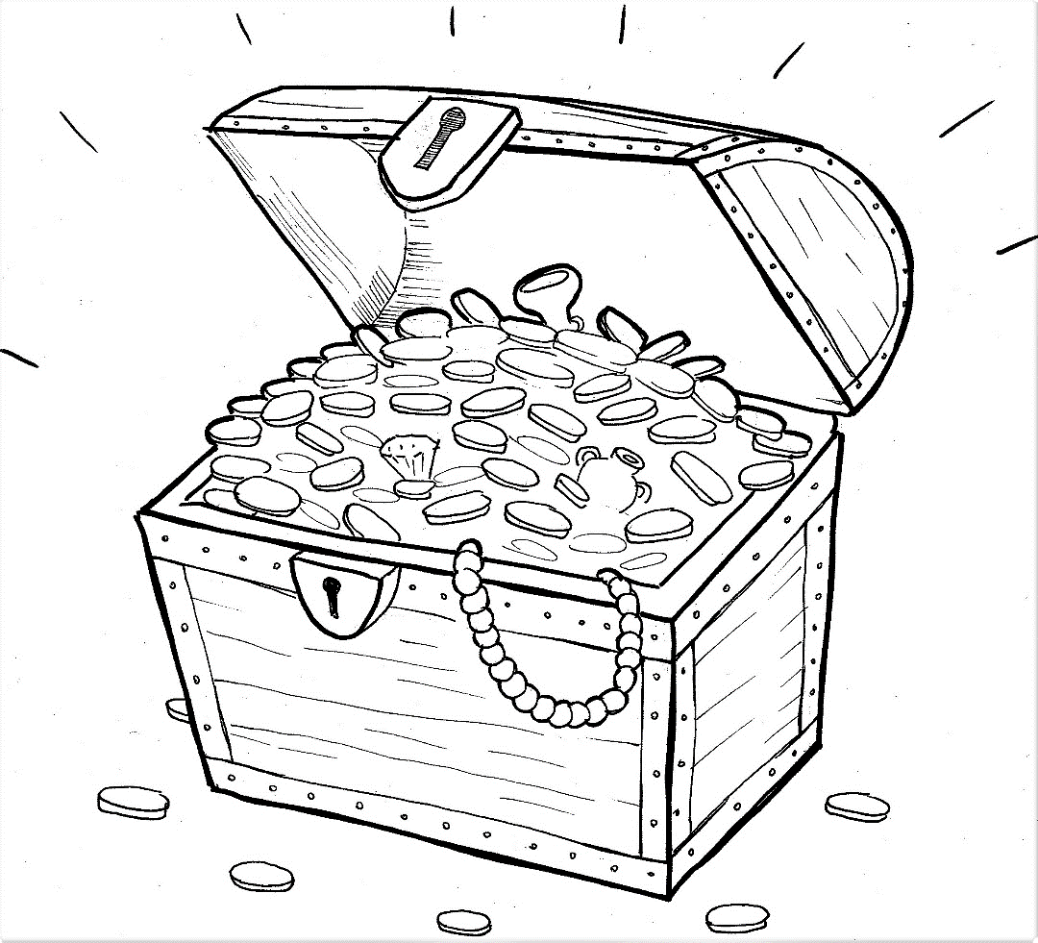
Part 4
21. Hidden Treasure and Priceless Pearl
Story in Easy Read English
Questions
Story in Phrases

Slide 2
What is the kingdom of God?

Slide 3
Jesus told two stories to help us
understand this world we cannot see.

Slide 4
A man found treasure buried in a
field.

Slide 5
It was hidden under the ground, but
very valuable.

Slide 6
He hid it again.

Slide 7
The man wanted that unseen
treasure, but the field cost a lot of
money.

Slide 8
Did he forget about it? No way!

Slide 9
He went home and sold his house,
his furniture, and his silver trays.

Slide 10
He sold everything.

Slide 11
With joy, he took that money and
bought the field.

Slide 12
He really bought it for the buried
treasure.

Slide 13
The kingdom of God is that hidden
gold.

Slide 14
We can’t see it, but it is priceless.

Slide 15
The kingdom of God is also like an
unseen pearl.

Slide 16
The jewel is hidden inside an oyster
under the water.

Slide 17
We can’t see the pearl, but it is
priceless.

Slide 18
A man found that oyster and knew
something special was hidden
inside.

Slide 19
He sold everything he had to buy
that one pearl of great price.

Slide 20
We can’t see God’s kingdom, but it
is priceless.

Slide 21
Would you give up everything to
have God’s kingdom inside your
heart?

Slide 22
Question 1
How are the treasure and the pearl like the kingdom of God?

Slide 23
Question 2
Why did the men in the story happily give up everything to get something they couldn’t even see?

Slide 24
Question 3
The Bible tells us that the unseen is what lasts forever. How is Jesus the truly priceless treasure?

Slide 25
Question 4
What would you give up, in order to follow Jesus into his unseen kingdom?

Slide 26
Prayer
Dear Jesus,
YOU are the unseen treasure. YOU are the
priceless pearl. I want to be a part of your
joyful kingdom.
Amen

Slide 27
Hidden Treasure
and
Priceless Pearl
Phrased for Fluency

Slide 28
What is
the kingdom
of God?

Slide 29
Jesus told
two stories
to help us understand
we cannot see.
this world

Slide 30
A man
found treasure
buried
in a field.

Slide 31
It was
hidden
under the ground,
but
very valuable.

Slide 32
again.
He
hid it

Slide 33
The man
wanted
that unseen treasure,
but
the field
cost a lot
of money.

Slide 34
Did he
forget about it?
No way!

Slide 35
He went home
and sold his house,
his furniture,
and
his silver trays.

Slide 36
He sold
everything.

Slide 37
With joy,
he took
that money
and bought
the field.

Slide 38
He really
bought it
for the buried treasure.

Slide 39
The kingdom of God
is
that hidden gold.

Slide 40
We can’t
see it,
but it is
priceless.

Slide 41
The kingdom of God
is also
like
an unseen pearl.

Slide 42
The jewel
is
hidden inside
an oyster
under the water.

Slide 43
We can’t see
the pearl,
but
it is priceless.

Slide 44
A man
found
that oyster
and knew
something special
was hidden inside.

Slide 45
He sold
everything he had
to buy
that one pearl
of great price.

Slide 46
We can’t see
God’s kingdom,
but
it is
priceless.

Slide 47
Would you
give up
everything
to have
God’s kingdom
inside your heart?

