Slide 1

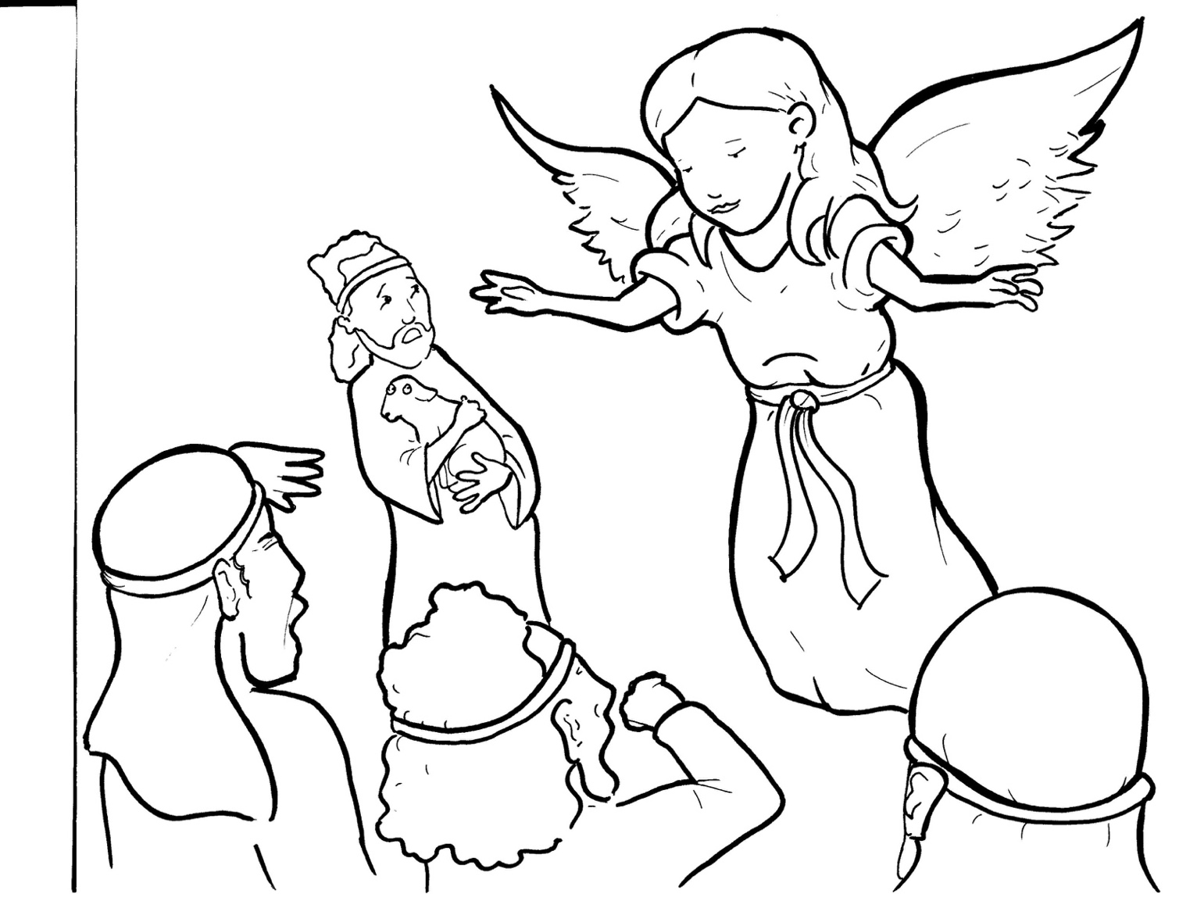
3. Shepherds Share the Good News
Part 3
Syllable Divisions

Slide 2
Dividing Words
Into Syllables

Slide 3
Rabbit Words
When you see two consonants
between two vowels,
divide between the consonants.
ra it
bb
rab bit

Slide 4
shep herds
shepherds

Slide 5
ar my
army

Slide 6
hap pen
happen

Slide 7

Tiger Words
When you see one consonant
between two vowels,
divide after the first vowel.
Try this pattern first.
ti er
g
ti ger

Slide 8
Sa vior
Savior

Slide 9
Je sus
Jesus

Slide 10
Jo seph
Joseph

Slide 11
ba by
baby

Slide 12
Camel Words
When you see one consonant
between two vowels,
divide after the first consonant.
Try this pattern second.
ca el
m
cam el

Slide 13
heav en
heaven

Slide 14
Mar y
Mary

Slide 15
Lion Words
If a word has two vowels together
that make two different sounds,
divide between the two vowels.
lion
li on

Slide 16
qui et
quiet

Slide 17

Anteater Words
These compound words are made up of two smaller words.
ant
eater
1
2
ant eater

Slide 18
out side
outside

Slide 19
every one
everyone

Slide 20
every where
everywhere

Slide 21

Foxes Suffixes
Focus on your base word.
fox es
fox es

Slide 22
pett ed
petted

Slide 23
joined
joined

Slide 24
glowed
glowed

Slide 25
appeared
appeared

Slide 26
happened
happened

Slide 27
sleep ing
sleeping

Slide 28
joy ful
joyful

Slide 29
bright ly
brightly

Slide 30
high est
highest

Slide 31
Other Syllable Divisions
Some words don’t fit so neatly
into standard syllable division patterns.
ang el
angel

Slide 32
Beth le hem
Bethlehem

Slide 33
a ppeared
appeared

Slide 34
a mazed
amazed

