Slide 1
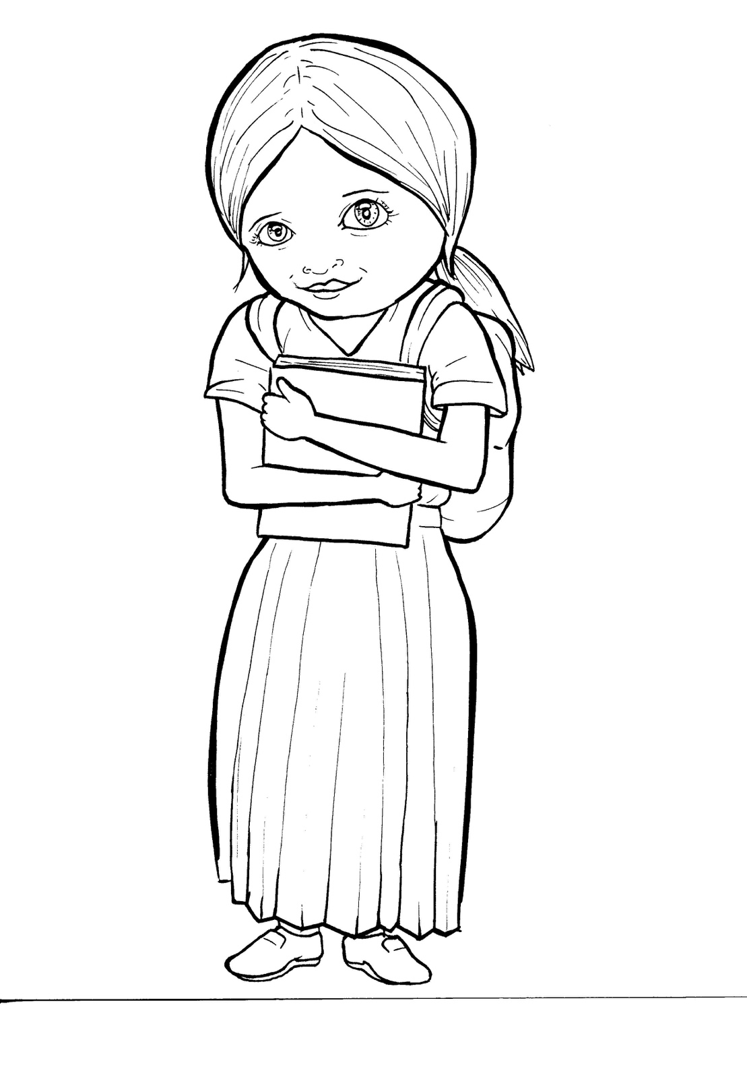
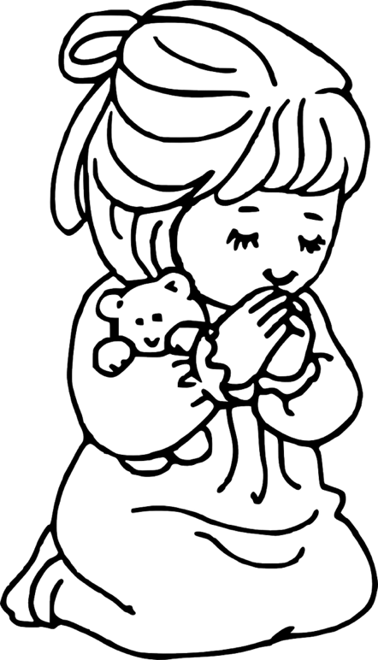
49. Growing as
a Christian
Part 1
Syllable Charts

Slide 2
Words in Syllable Types

Slide 3
Closed – Short Vowel
A closed syllable has one vowel
followed by one or more consonants,
and the vowel is short.
st
o
p
˘

Slide 4
can
-ab-
ask
plant

Slide 5
ef-
-ven
fresh
-pen
-dren
-lent

Slide 6
him
if
sis-
will
chil-
with

Slide 7
prob-
God

Slide 8
up
sun

Slide 9
Open – Long Vowel
An open syllable has one vowel
with no consonant after it,
and the vowel is long.
−
go

Slide 10
he
Je sus
be
e ven
be liever

Slide 11
Bi ble
si lent

Slide 12
go
o pen

Slide 13
my

Slide 14
need y
prob ab ly

Slide 15
Silent e – Long Vowel
A silent e syllable has one vowel,
followed by one consonant
and a silent e at the end.
The vowel is long.
−
ca
e
v

Slide 16
came
takes
share

Slide 17
these

Slide 18
like
shine
life
time

Slide 19
those
close

Slide 20
Vowel Teams – Long Vowel
Many vowel teams follow this rule:
When two vowels get together,
the first one names its letter.
So the first vowel will make its long sound,
and the second vowel is silent.
−
e
a
t

Slide 21
air
rain

Slide 22
day
pray
pray er

Slide 23
be liev ers

Slide 24
see
meet
need y

Slide 25
each
hear
teach es

Slide 26
grow
know

Slide 27
new

Slide 28
cool
too

Slide 29
Vowel Teams – Other Sounds
Sometimes vowel teams make other sounds.
oil

Slide 30
good
book

Slide 31
soil

Slide 32
with out
a bout

Slide 33
call

Slide 34
R - Controlled
R-controlled syllables have one or more vowels
followed by an “r.”
The “r” changes the sound of the vowel.
o
r
ange

Slide 35
start
Mark

Slide 36
pray er
believ ers
sis ters
teach ers

Slide 37
hurts
church

Slide 38
or
for
short

Slide 39
ef fort

Slide 40
Consonant – l-e
When you see consonant l-e at the end of a word,
count back three.
The “l-e” makes the /–le/ sound.
pur
p
l
e

Slide 41
Bi ble

Slide 42
Other Sounds – -nk/-ng
The “-nk” and “-ng”
change the sound of the vowel.
bank
thing

Slide 43
believ ing
grow ing

Slide 44
Other Sounds – schwa
The schwa syllable has an “a” that sounds
like the /u/ in banana.
The banana is even shaped like a short u.
ba nan a

Slide 45
a bout

