Slide 1
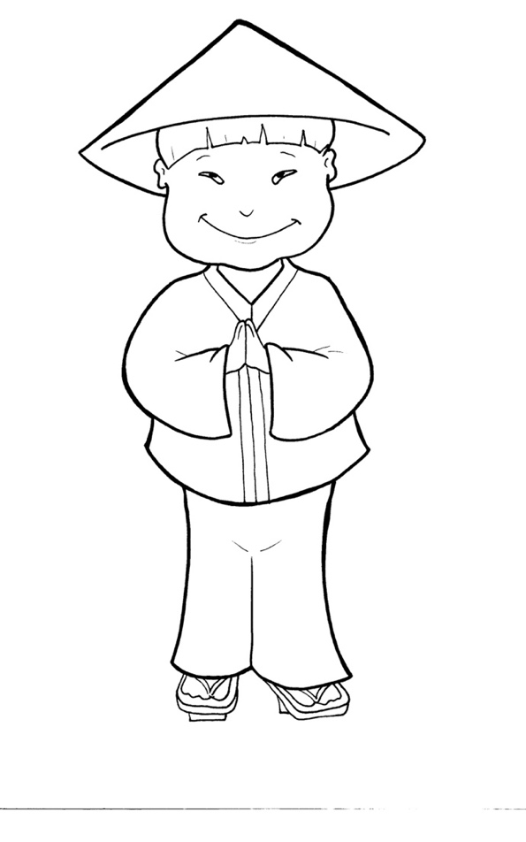
Timing
Box
53. I Am Alive: Tell the World
Part 1
Syllable Charts

Slide 2
Words in Syllable Types

Slide 3
Closed – Short Vowel
A closed syllable has one vowel
followed by one or more consonants,
and the vowel is short.
st
o
p
˘

Slide 4
Timing
Box
sad
shall
bap-
Acts
trav-
-sands

Slide 5
Timing
Box
tell
-en
them
-ness
went
-selves

Slide 6
Timing
Box
wi
th
will
sins
sick

Slide 7
Timing
Box
in-
-it
dis-
did
giv-
ship

Slide 8
Timing
Box
God
cross

Slide 9
Timing
Box
up
us
but
-sus

Slide 10
Open – Long Vowel
An open syllable has one vowel
with no consonant after it,
and the vowel is long.
−
go

Slide 11
Timing
Box
na tions
a ma zing

Slide 12
Timing
Box
be
be fore
be came
be liever
de mons
Pe ter

Slide 13
Timing
Box
go
ho ly
o bey

Slide 14
Timing
Box
I
dis ci ples

Slide 15
Timing
Box
by

Slide 16
Timing
Box
sor ry
ho ly

Slide 17
Silent e – Long Vowel
A silent e syllable has one vowel,
followed by one consonant
and a silent e at the end.
The vowel is long.
−
ca
e
v

Slide 18
Timing
Box
make
share
name
same
came

Slide 19
Timing
Box
bap tize
in side
time

Slide 20
Timing
Box
be fore
there fore

Slide 21
Vowel Teams – Long Vowel
Many vowel teams follow this rule:
When two vowels get together,
the first one names its letter.
So the first vowel will make its long sound,
and the second vowel is silent.
−
e
a
t

Slide 22
Timing
Box
day
pray
al ways

Slide 23
Timing
Box
raise

Slide 24
Timing
Box
they
o bey

Slide 25
Timing
Box
read
heal
leave
near

Slide 26
Timing
Box
be liev ers

Slide 27
Timing
Box
peo ple

Slide 28
Timing
Box
night

Slide 29
Timing
Box
news

Slide 30
Vowel Teams – Other Sounds
Sometimes vowel teams make other sounds.
oil

Slide 31
Timing
Box
all

Slide 32
Timing
Box
saw

Slide 33
Timing
Box
dead
death
hea ven

Slide 34
Timing
Box
foot
book
good

Slide 35
Timing
Box
our
a bout
thou sands

Slide 36
Timing
Box
crowd
pow er

Slide 37
R - Controlled
R-controlled syllables have one or more vowels
followed by an “r.”
The “r” changes the sound of the vowel.
o
r
ange

Slide 38
Timing
Box
far

Slide 39
Timing
Box
for
for given

Slide 40
Timing
Box
Pe ter
pow er
believ ers
won der ful

Slide 41
Timing
Box
church

Slide 42
Timing
Box
earth

Slide 43
Timing
Box
work
world

Slide 44
Timing
Box
Spir it

Slide 45
Consonant – l-e
When you see consonant l-e at the end of a word,
count back three.
The “l-e” makes the /–le/ sound.
pur
p
l
e

Slide 46
Timing
Box
peo ple
dis ci ples

Slide 47
Timing
Box
trav el

Slide 48
Timing
Box
won der ful

Slide 49
Other Sounds – Long Vowel
These syllables or words are closed,
so the vowel should be short,
but the vowel is long.
−
cold

Slide 50
Timing
Box
told

Slide 51
Other Sounds – -nk/-ng
The “-nk” and “-ng”
change the sound of the vowel.
bank
thing

Slide 52
Timing
Box
sprang

Slide 53
Timing
Box
a ma zing

Slide 54
Timing
Box
Common endings
na tions

Slide 55
Other Sounds – schwa
The schwa syllable has an “a” that sounds
like the /u/ in banana.
The banana is even shaped like a short u.
ba nan a

Slide 56
Timing
Box
a bout
a ma zing

Slide 57
Timing
Box
won der ful
Son
de mons

