Slide 1

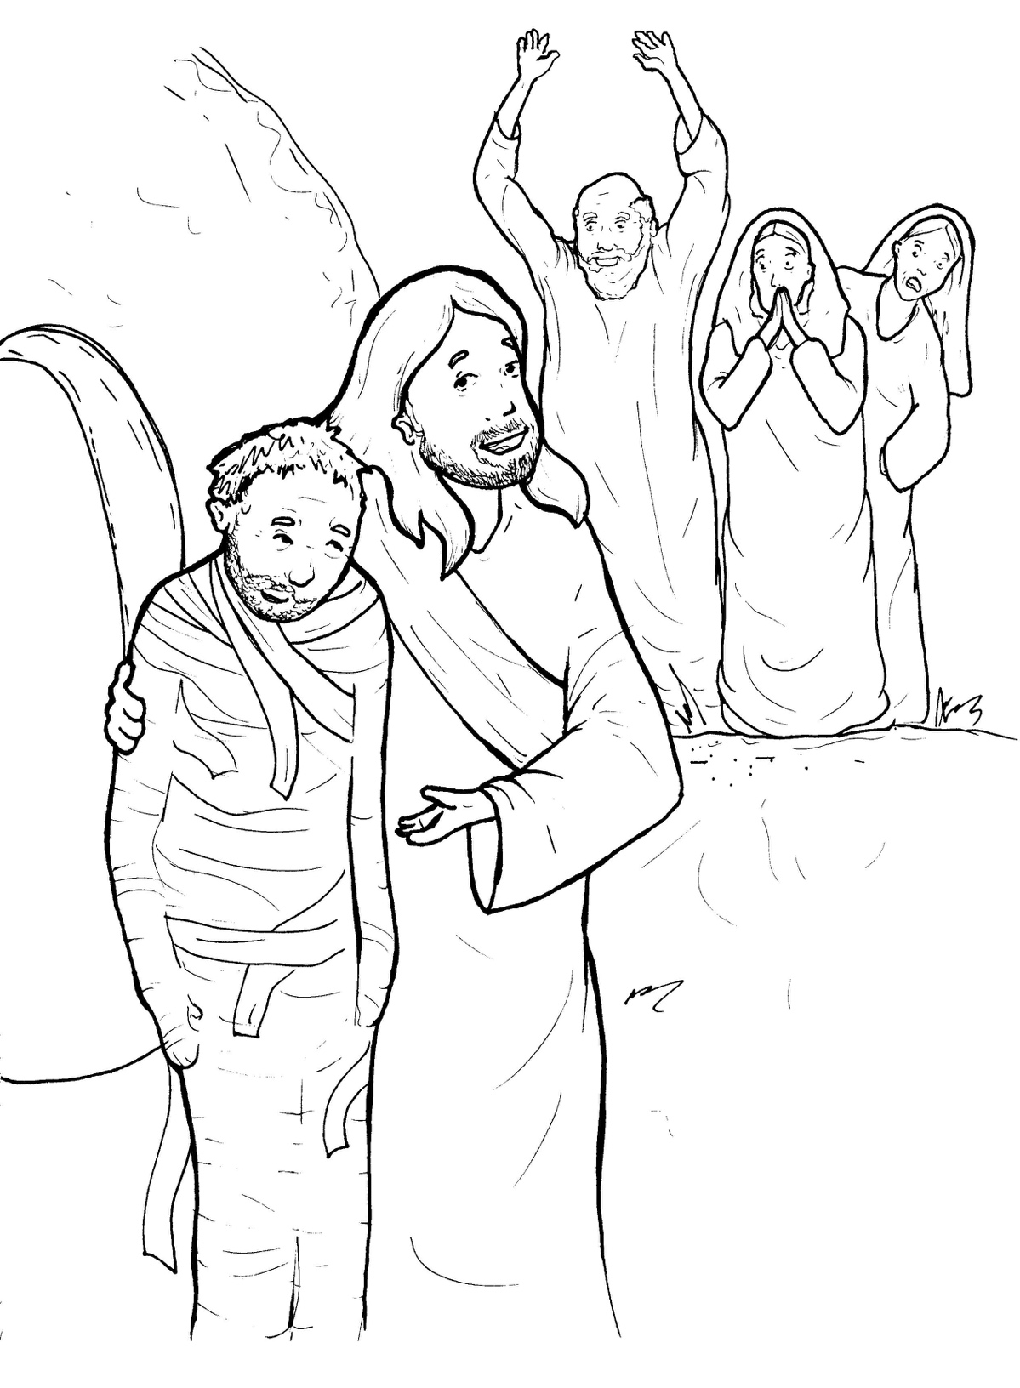
Part 3
33. Lazarus Lives Again
Syllable Divisions

Slide 2

Dividing Words
Into Syllables

Slide 3
Rabbit Words
When you see two consonants
between two vowels,
divide between the consonants.
ra it
bb
rab bit

Slide 4
af ter
after

Slide 5
com mand
command

Slide 6
Mes siah
Messiah

Slide 7
resur rec tion
resurrection

Slide 8
Tiger Words
When you see one consonant
between two vowels,
divide after the first vowel.
Try this pattern first.
ti er
g
ti ger

Slide 9
Je sus
Jesus

Slide 10
be came
became

Slide 11
be lieve
believe

Slide 12
Camel Words
When you see one consonant
between two vowels,
divide after the first consonant.
Try this pattern second.
ca el
m
cam el

Slide 13
Laz a rus
Lazarus

Slide 14
glor y
glory

Slide 15
Mar y
Mary

Slide 16
res urrection
resurrection

Slide 17
Hamster Words
When you see three consonants between two vowels,
divide after the first consonant.
ha
mst
er
ham ster

Slide 18
Mar tha
Martha

Slide 19
Turtle Words
When you see consonant-l-e,
count back three and divide.
tur
t
l
e
tur tle

Slide 20
peo ple
people

Slide 21
mir a cle
miracle

Slide 22

Foxes Suffixes
Focus on your base word.
fox es
fox es

Slide 23
command ed
commanded

Slide 24
power ful
powerful

Slide 25
resurrec tion
resurrection

Slide 26
died
died

Slide 27
bur ied
buried

Slide 28
rolled
rolled

Slide 29
called
called

Slide 30
walked
walked

Slide 31
wrapped
wrapped

Slide 32
prayed
prayed

Slide 33
sick ness
sickness

Slide 34

Anteater Words
These compound words are made up of two smaller words.
ant
eater
1
2
ant eater

Slide 35
who ever
whoever

Slide 36
Lion Words
If a word has two vowels together
that make two different sounds,
divide between the two vowels.
lion
li on

Slide 37
Messi ah
Messiah

Slide 38
Other Syllable Divisions
Some words don’t fit so neatly
into standard syllable division patterns.

Slide 39
a gain
again

Slide 40
a way
away

