Slide 1

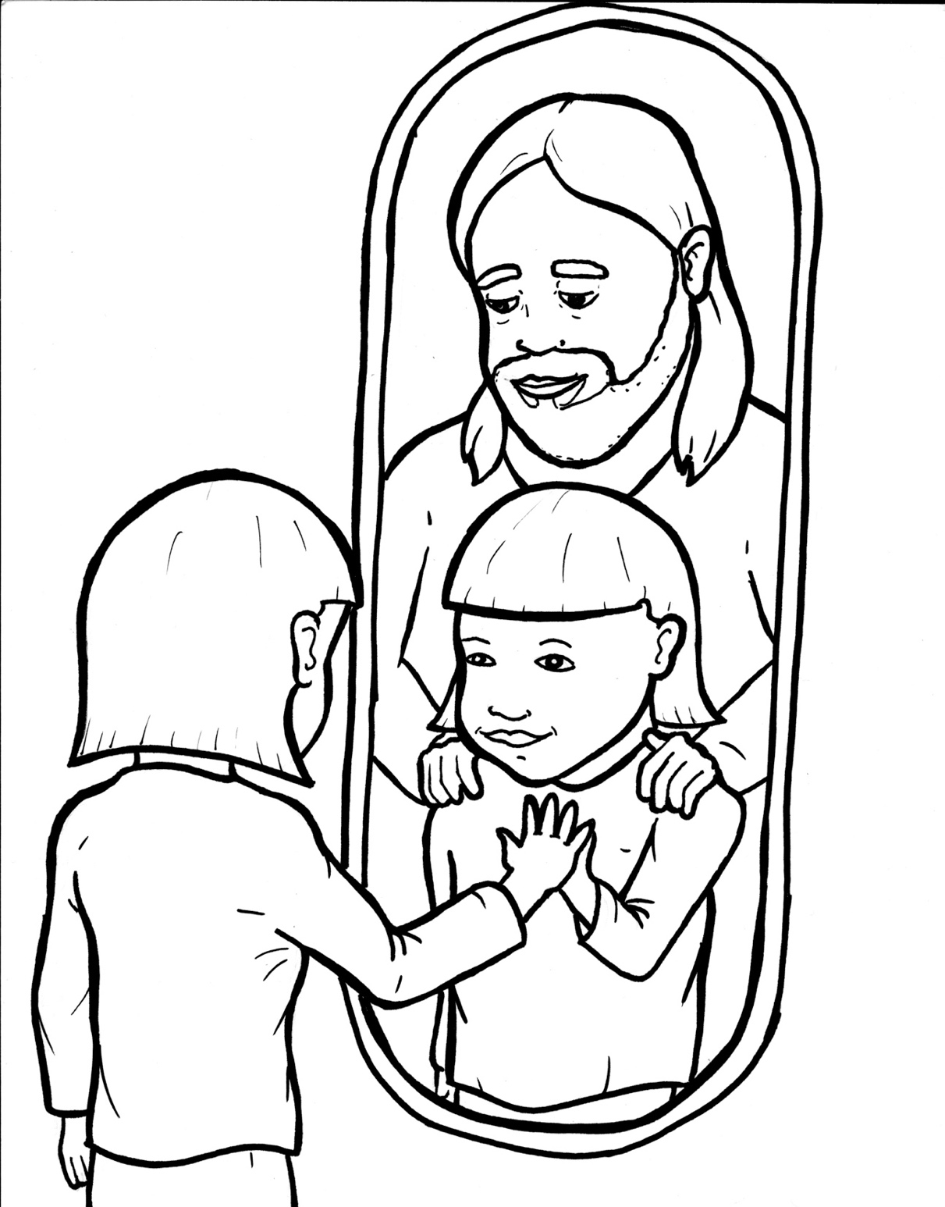
Part 3
48. Wow, I'm a Christian Now!
Syllable Divisions

Slide 2
Dividing Words
Into Syllables

Slide 3
Rabbit Words
When you see two consonants
between two vowels,
divide between the consonants.
ra it
bb
rab bit

Slide 4
dif fer ent
different

Slide 5
nor mal
normal

Slide 6
can not
cannot

Slide 7
writ ten
written

Slide 8
en joy
enjoy

Slide 9

Tiger Words
When you see one consonant
between two vowels,
divide after the first vowel.
Try this pattern first.
ti er
g
ti ger

Slide 10
ba by
baby

Slide 11
ma king
making

Slide 12
ho ly
holy

Slide 13
o ver
over

Slide 14
ex ci ting
exciting

Slide 15
Camel Words
When you see one consonant
between two vowels,
divide after the first consonant.
Try this pattern second.
ca el
m
cam el

Slide 16
glor y
glory

Slide 17
fam il y
family

Slide 18
ev er y
every

Slide 19
for ev er
forever

Slide 20
for giv en
forgiven

Slide 21
Turtle Words
When you see consonant-l-e,
count back three and divide.
tur
t
l
e
tur tle

Slide 22
lit tle
little

Slide 23
Other Syllable Divisions
Some words don’t fit so neatly
into standard syllable division patterns.

Slide 24
a way
away

Slide 25
a part
apart

Slide 26
a live
alive

Slide 27
a dopt
adopt

Slide 28
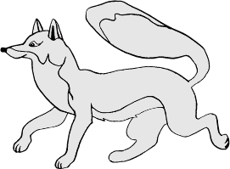
Foxes Suffixes
Focus on your base word.
fox es
fox es

Slide 29
joy ful
joyful

Slide 30
prais es
praises

Slide 31
happi ness
happiness

Slide 32
exci ting
exciting

Slide 33
shout ing
shouting

Slide 34
ma king
making

Slide 35
exci ted
excited

Slide 36
adopt ed
adopted

Slide 37
asked
asked

Slide 38
lined
lined

Slide 39
lived
lived

Slide 40
poured
poured

Slide 41
wrapped
wrapped

Slide 42
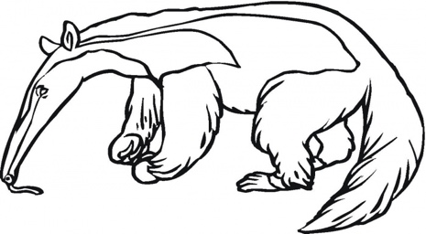
Anteater Words
These compound words are made up of two smaller words.
ant
eater
1
2
ant eater

Slide 43
in to
into

Slide 44
in side
inside

Slide 45
new born
newborn

Slide 46
world wide
worldwide

Slide 47
for ever
forever

Slide 48
for given
forgiven

Slide 49
any thing
anything

Slide 50
every thing
everything

Slide 51
can not
cannot

