Slide 1
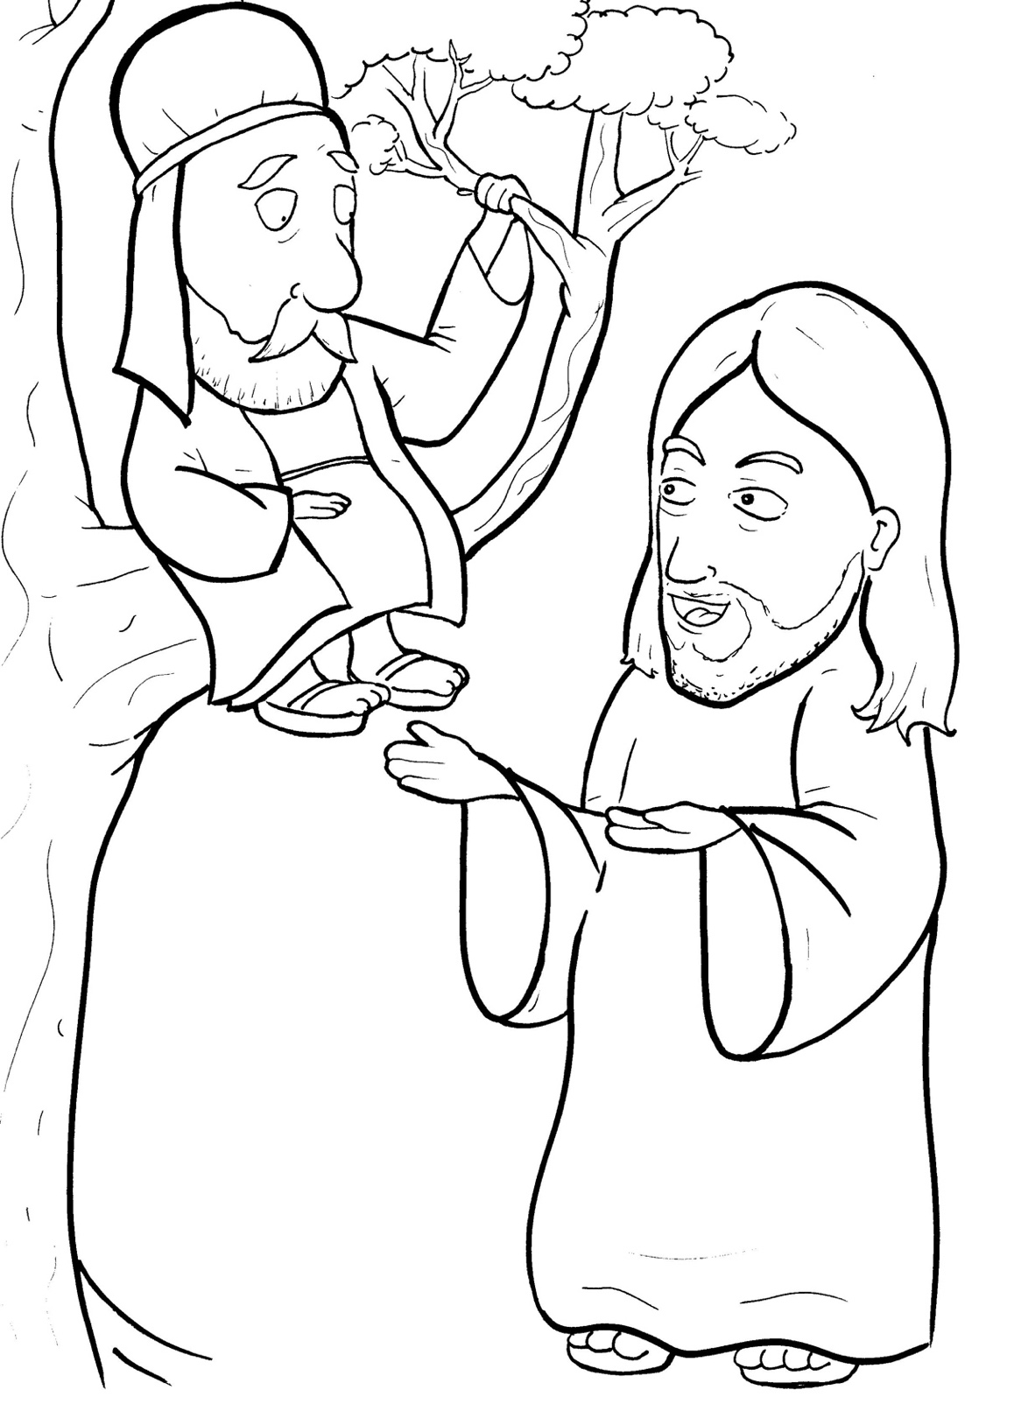
11. Jesus Loves a Short, Bad Man
Part 2
New Words
Rule Breakers

Slide 2
Other Sounds – Soft G
ge, gi, gy often make the soft sound
gentle
giant
gym

Slide 3
charge

Slide 4
Silent Letters
climb

Slide 5
Silent Letters
walk
half

Slide 6
New Words
Jericho
Zacchaeus
climb

Slide 7
Rule Breakers
These words do not follow phonetic patterns.
said
was

Slide 8
his
into
to
any
today
one

Slide 9
as
is
your
climb
poor
loves

Slide 10
could
should
money
very
walk
come

Slide 11
have
saw
give
thought

