Slide 1
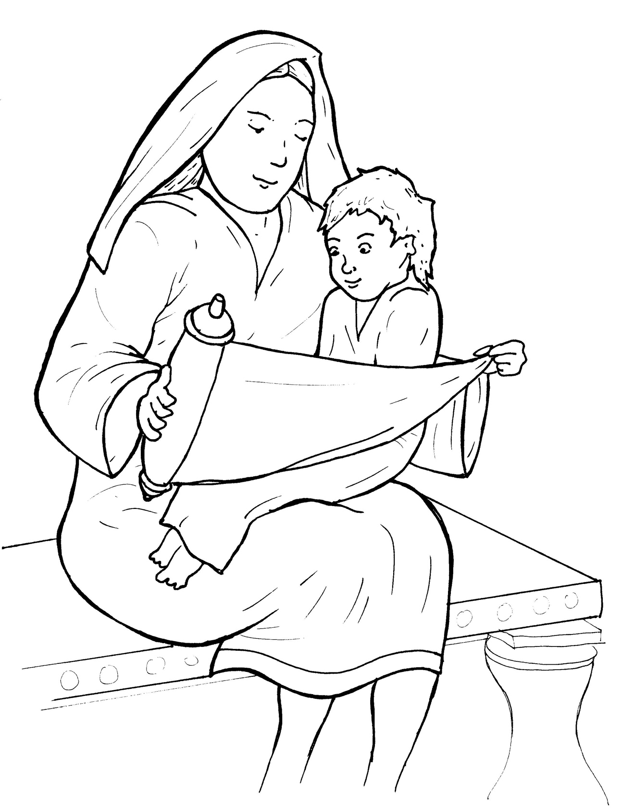
6. Jesus Grows Up
Part 2
New Words
Rule Breakers

Slide 2
Other Sounds – Soft G
ge, gi, gy often make the soft sound
gentle
giant
gym

Slide 3
angels

Slide 4
Silent Letters
knew
know

Slide 5
Possessives
God’s holy word

Slide 6
New Words
wisdom
Scriptures
Nazareth

Slide 7
Rule Breakers
These words do not follow phonetic patterns.
the
of

Slide 8
his
was
do
to
son
who

Slide 9
they
obeyed
always
mother
brothers
father

Slide 10
everyone
loved
people

