Slide 1
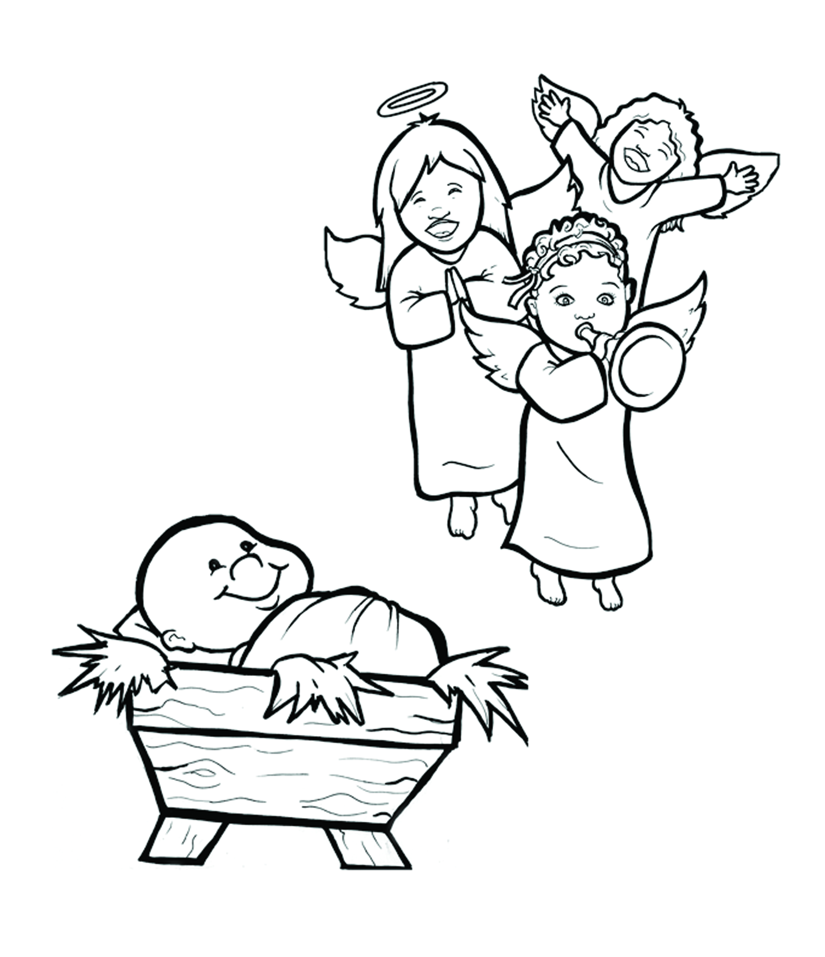
2. Happy Birthday, Jesus!
Part 4
Story in Easy Read English
Questions
Story in Phrases

Slide 2
Joseph and Mary could hardly wait for their son to be born.

Slide 3
Mary’s belly grew big as baby Jesus grew big inside her.

Slide 4
The rulers of Nazareth made a law.

Slide 5
Everyone must be counted.

Slide 6
People went back to the towns where they were born.

Slide 7
Joseph and Mary traveled to Bethlehem.

Slide 8
Mary rode on top of a wobbly donkey.

Slide 9
Joseph walked beside the donkey on that long, hard trip.

Slide 10
Bethlehem was crowded.

Slide 11
“Can we stay at your inn?” Joseph asked.

Slide 12
“No. There is no room here.”

Slide 13
So, Mary and Joseph slept in a cold, dark, smelly barn.

Slide 14
In the night, Mary felt pain.

Slide 15
It was time.

Slide 16
She gave birth to her first son.

Slide 17
Jesus, the king of the world, was born!

Slide 18
Life changed at that moment in time.

Slide 19
God came to us as a human.

Slide 20
Mary wrapped Jesus in strips of cloth.

Slide 21
She laid him where the donkeys ate.

Slide 22
A dazzling, bright star shone down on them.

Slide 23
First one, and then many angels burst out singing,

Slide 24
“We bring you good news of great joy.

Slide 25
A Savior has been born.

Slide 26
He is Christ the Lord.”

Slide 27
It was the first Christmas.

Slide 28
Question 1
Who is Jesus?

Slide 29
Question 2
What was the first
Christmas like?

Slide 30
Question 3
How does your family celebrate Jesus’ birthday?

Slide 31
Question 4
How can you celebrate the birth of Jesus, instead of only thinking about toys and Santa?

Slide 32
Prayer
Dear Jesus,
Happy Birthday! Thank you for leaving heaven to come to earth. Thank you for living among us as a human. You bring us joy. I want to bring you joy, too.
Merry Christmas!
Amen

Slide 33
Happy Birthday, Jesus!
Phrased for Fluency

Slide 34
Joseph and Mary
could hardly wait
for their son
to be born.

Slide 35
Mary’s belly
grew big
as baby Jesus
grew big
inside her.

Slide 36
The rulers of Nazareth
made a law.

Slide 37
Everyone
must be counted.

Slide 38
People
went back
to the towns
where they were born.

Slide 39
Joseph and Mary
traveled to Bethlehem.

Slide 40
Mary
rode on top
of a wobbly donkey.

Slide 41
Joseph walked
beside the donkey
on that long, hard trip.

Slide 42
Bethlehem
was crowded.

Slide 43
“Can we stay
at your inn?”
Joseph asked.

Slide 44
There is no
room here.”
“No.

Slide 45
So,
Mary and Joseph
slept in a cold, dark,
smelly barn.

Slide 46
In the night,
Mary
felt pain.

Slide 47
It was time.

Slide 48
She gave birth
to her first son.

Slide 49
Jesus,
the king of the world,
was born!

Slide 50
Life changed
at that moment
in time.

Slide 51
God
came to us
as a human.

Slide 52
Mary
wrapped Jesus
in strips of cloth.

Slide 53
She laid him
where the donkeys ate.

Slide 54
A dazzling, bright star
shone
down on them.

Slide 55
First one,
and then many angels
burst out
singing,

Slide 56
“We bring you
good news
of great joy.

Slide 57
A Savior
has been born.

Slide 58
He
is Christ the Lord.”

Slide 59
It
was the first Christmas.

