Slide 1
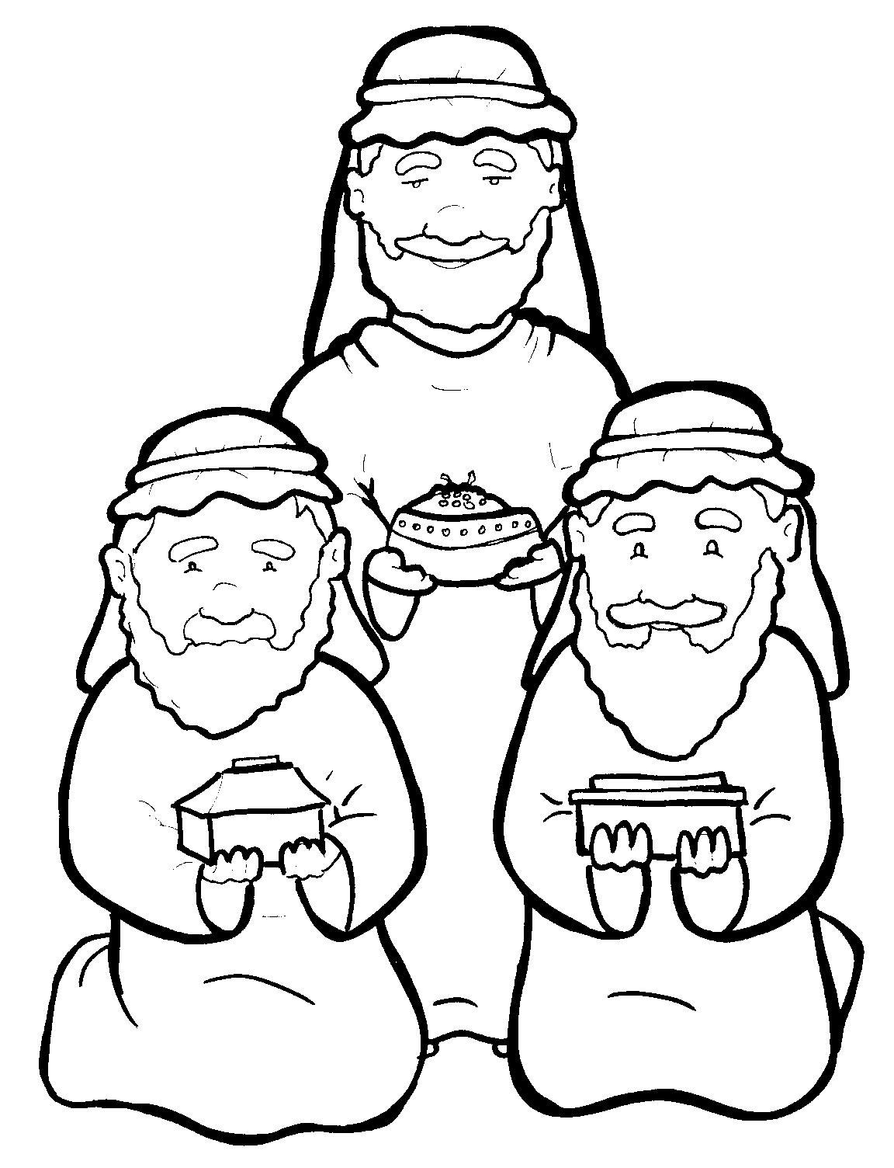
4. Wise Men Give Gifts to Jesus
Part 5
Vocabulary
Original Bible Story

Slide 2
Vocabulary

Slide 3
prophet
(PROPH -
et):
a person who speaks for God

Slide 4
behold
HOLD):
(be -
see!

Slide 5
frankincense
in -
cense):
(FRANK -
a strong and sweet perfume

Slide 6
diligently
(DIL -
i -
gent -
ly):
carefully

Slide 7
exceedingly
ing -
ly):
(ex -
CEED -
very

Slide 8
myrrh
(myrrh):
an oil used at death

Slide 9
Wise Men Give Gifts to Jesus
Matthew 2:1-12 (WEB)

Slide 10
Now when Jesus was born in Bethlehem of Judea in the days of King Herod, behold, wise men from the east came to Jerusalem, saying,
“Where is he who is born King of the Jews? For we saw his star in the east and have come to worship him.”

Slide 11
When King Herod heard it, he was troubled, and all Jerusalem with him.
Gathering together all the chief priests and scribes of the people, he asked them where the Christ would be born.

Slide 12
They said to him, “In Bethlehem of Judea, for this is written through the prophet,
‘You Bethlehem, land of Judah, are in no way least among the princes of Judah: for out of you shall come a governor, who shall shepherd my people, Israel.’”

Slide 13
Then Herod secretly called the wise men, and learned from them exactly what time the star appeared.
He sent them to Bethlehem, and said, “Go and search diligently for the young child.
When you have found him, bring me word, so that I also may come and worship him.”

Slide 14
They, having heard the king, went their way; and behold, the star, which they saw in the east, went before them, until it came and stood over where the young child was.
When they saw the star, they rejoiced with exceedingly great joy.

Slide 15
They came into the house and saw the young child with Mary, his mother, and they fell down and worshipped him.
Opening their treasures, they offered to him gifts: gold, frankincense, and myrrh.

Slide 16
Being warned in a dream not to return to Herod, they went back to their own country another way.

