Slide 1
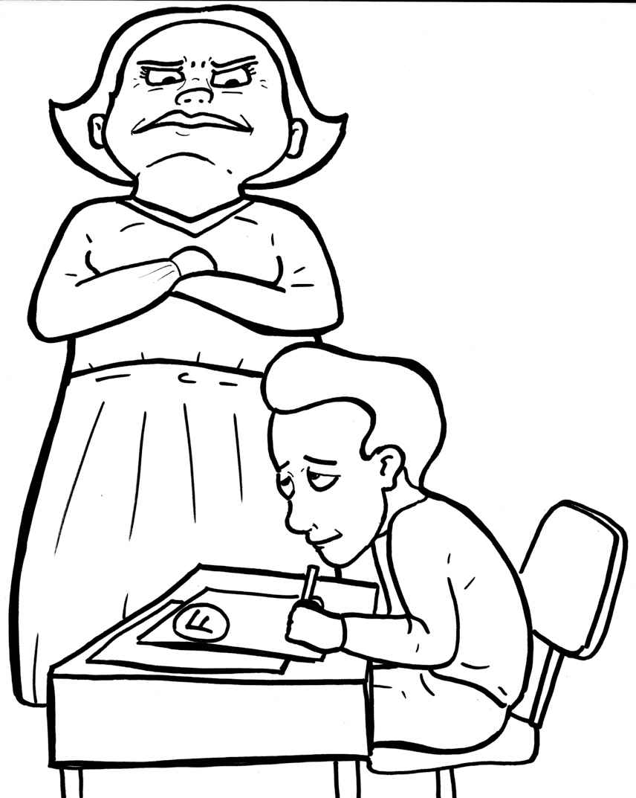
Part 4
46. First, the Bad News
– Sin Separates
Story in Easy Read English
Questions
Story in Phrases
You cheated!

Slide 2
Jesus told the people about his heavenly Father.

Slide 3
He said that God loves everyone.

Slide 4
He wants us to be together with him forever.

Slide 5
That means you!

Slide 6
But… there’s a problem.

Slide 7
Our hearts are not clean.

Slide 8
We don’t always obey God.

Slide 9
Sometimes, we don’t even want to obey!

Slide 10
Have you ever:

Slide 11
* lied to a friend?

Slide 12
* hurt a sister or brother?

Slide 13
* disobeyed your parents?

Slide 14
* yelled out mean words?

Slide 15
These wrongs are called sin.

Slide 16
In the book of Romans we read,

Slide 17
“There is no one who does good, not even one.”

Slide 18
And, “We all fall short of the glory of God.”

Slide 19
That means when we are selfish, we disappoint our perfect Father in heaven.

Slide 20
The bad news gets worse.

Slide 21
The whole world is in trouble because of sin.

Slide 22
Now, we have a huge, awful, ugly problem.

Slide 23
God is holy. He can’t even look on sin.

Slide 24
Our sin separates us from God.

Slide 25
It’s like a warm, sweet friendship has been broken.

Slide 26
We’ve hurt God.
We need to start fresh.

Slide 27
We need a whole, new heart.

Slide 28
What can we do to be made clean?

Slide 29
Will God forgive us?

Slide 30
Will God punish us?

Slide 31
Will we go to hell?

Slide 32
Jesus, help us!

Slide 33
Question 1
What is the bad news?
How bad is it?

Slide 34
Question 2
How does our sin affect God? Ourselves?

Slide 35
Question 3
What are some common sins that kids do?

Slide 36
Question 4
Ask yourself, “What sins do I struggle with? What can I do to stop myself?"

Slide 37
Prayer
Dear Lord,
I know I have a sin problem. It seems that every time I try to stop sinning, I do it again. Can you help me?
Thank you.
Amen

Slide 38
First, the Bad News - Sin Separates
Phrased for Fluency

Slide 39
Jesus
told the people
about his heavenly Father.

Slide 40
He said that
God loves
everyone.

Slide 41
He wants us
to be together
with him
forever.

Slide 42
That means you!

Slide 43
But…
there's a problem.

Slide 44
Our hearts
are not clean.

Slide 45
We don’t always
obey God.

Slide 46
Sometimes,
we don't
obey!
even want to

Slide 47
Have you ever:

Slide 48
* lied
to a
friend?

Slide 49
* hurt
a sister
or brother?

Slide 50
* disobeyed
your parents?

Slide 51
* yelled out
mean words?

Slide 52
These wrongs
are called
sin.

Slide 53
In the book
of Romans,
we read,

Slide 54
who does good,
"There is no one
not even one.”

Slide 55
"We all fall short
And,
of the glory
of God.”

Slide 56
when we are selfish,
That means
we disappoint
our perfect Father
in heaven.

Slide 57
The bad news
gets worse.

Slide 58
The whole world
is in trouble
because of sin.

Slide 59
Now,
we have a huge,
awful,
ugly problem.

Slide 60
God
is holy.

Slide 61
He can't
even look
on sin.

Slide 62
Our sin
separates us
from God.

Slide 63
It’s like a
warm,
sweet friendship
has been broken.

Slide 64
We’ve hurt God.

Slide 65
We need
to start
fresh.

Slide 66
We need
a whole,
new heart.

Slide 67
What can we do
to be
made clean?

Slide 68
Will God
forgive us?

Slide 69
Will God
punish us?

Slide 70
Will we
go to hell?

Slide 71
Jesus,
help us!

