Slide 1
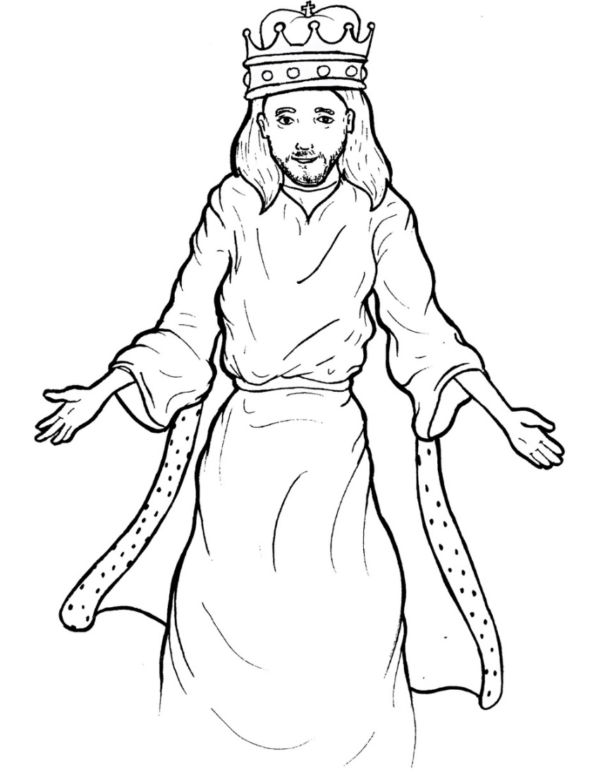
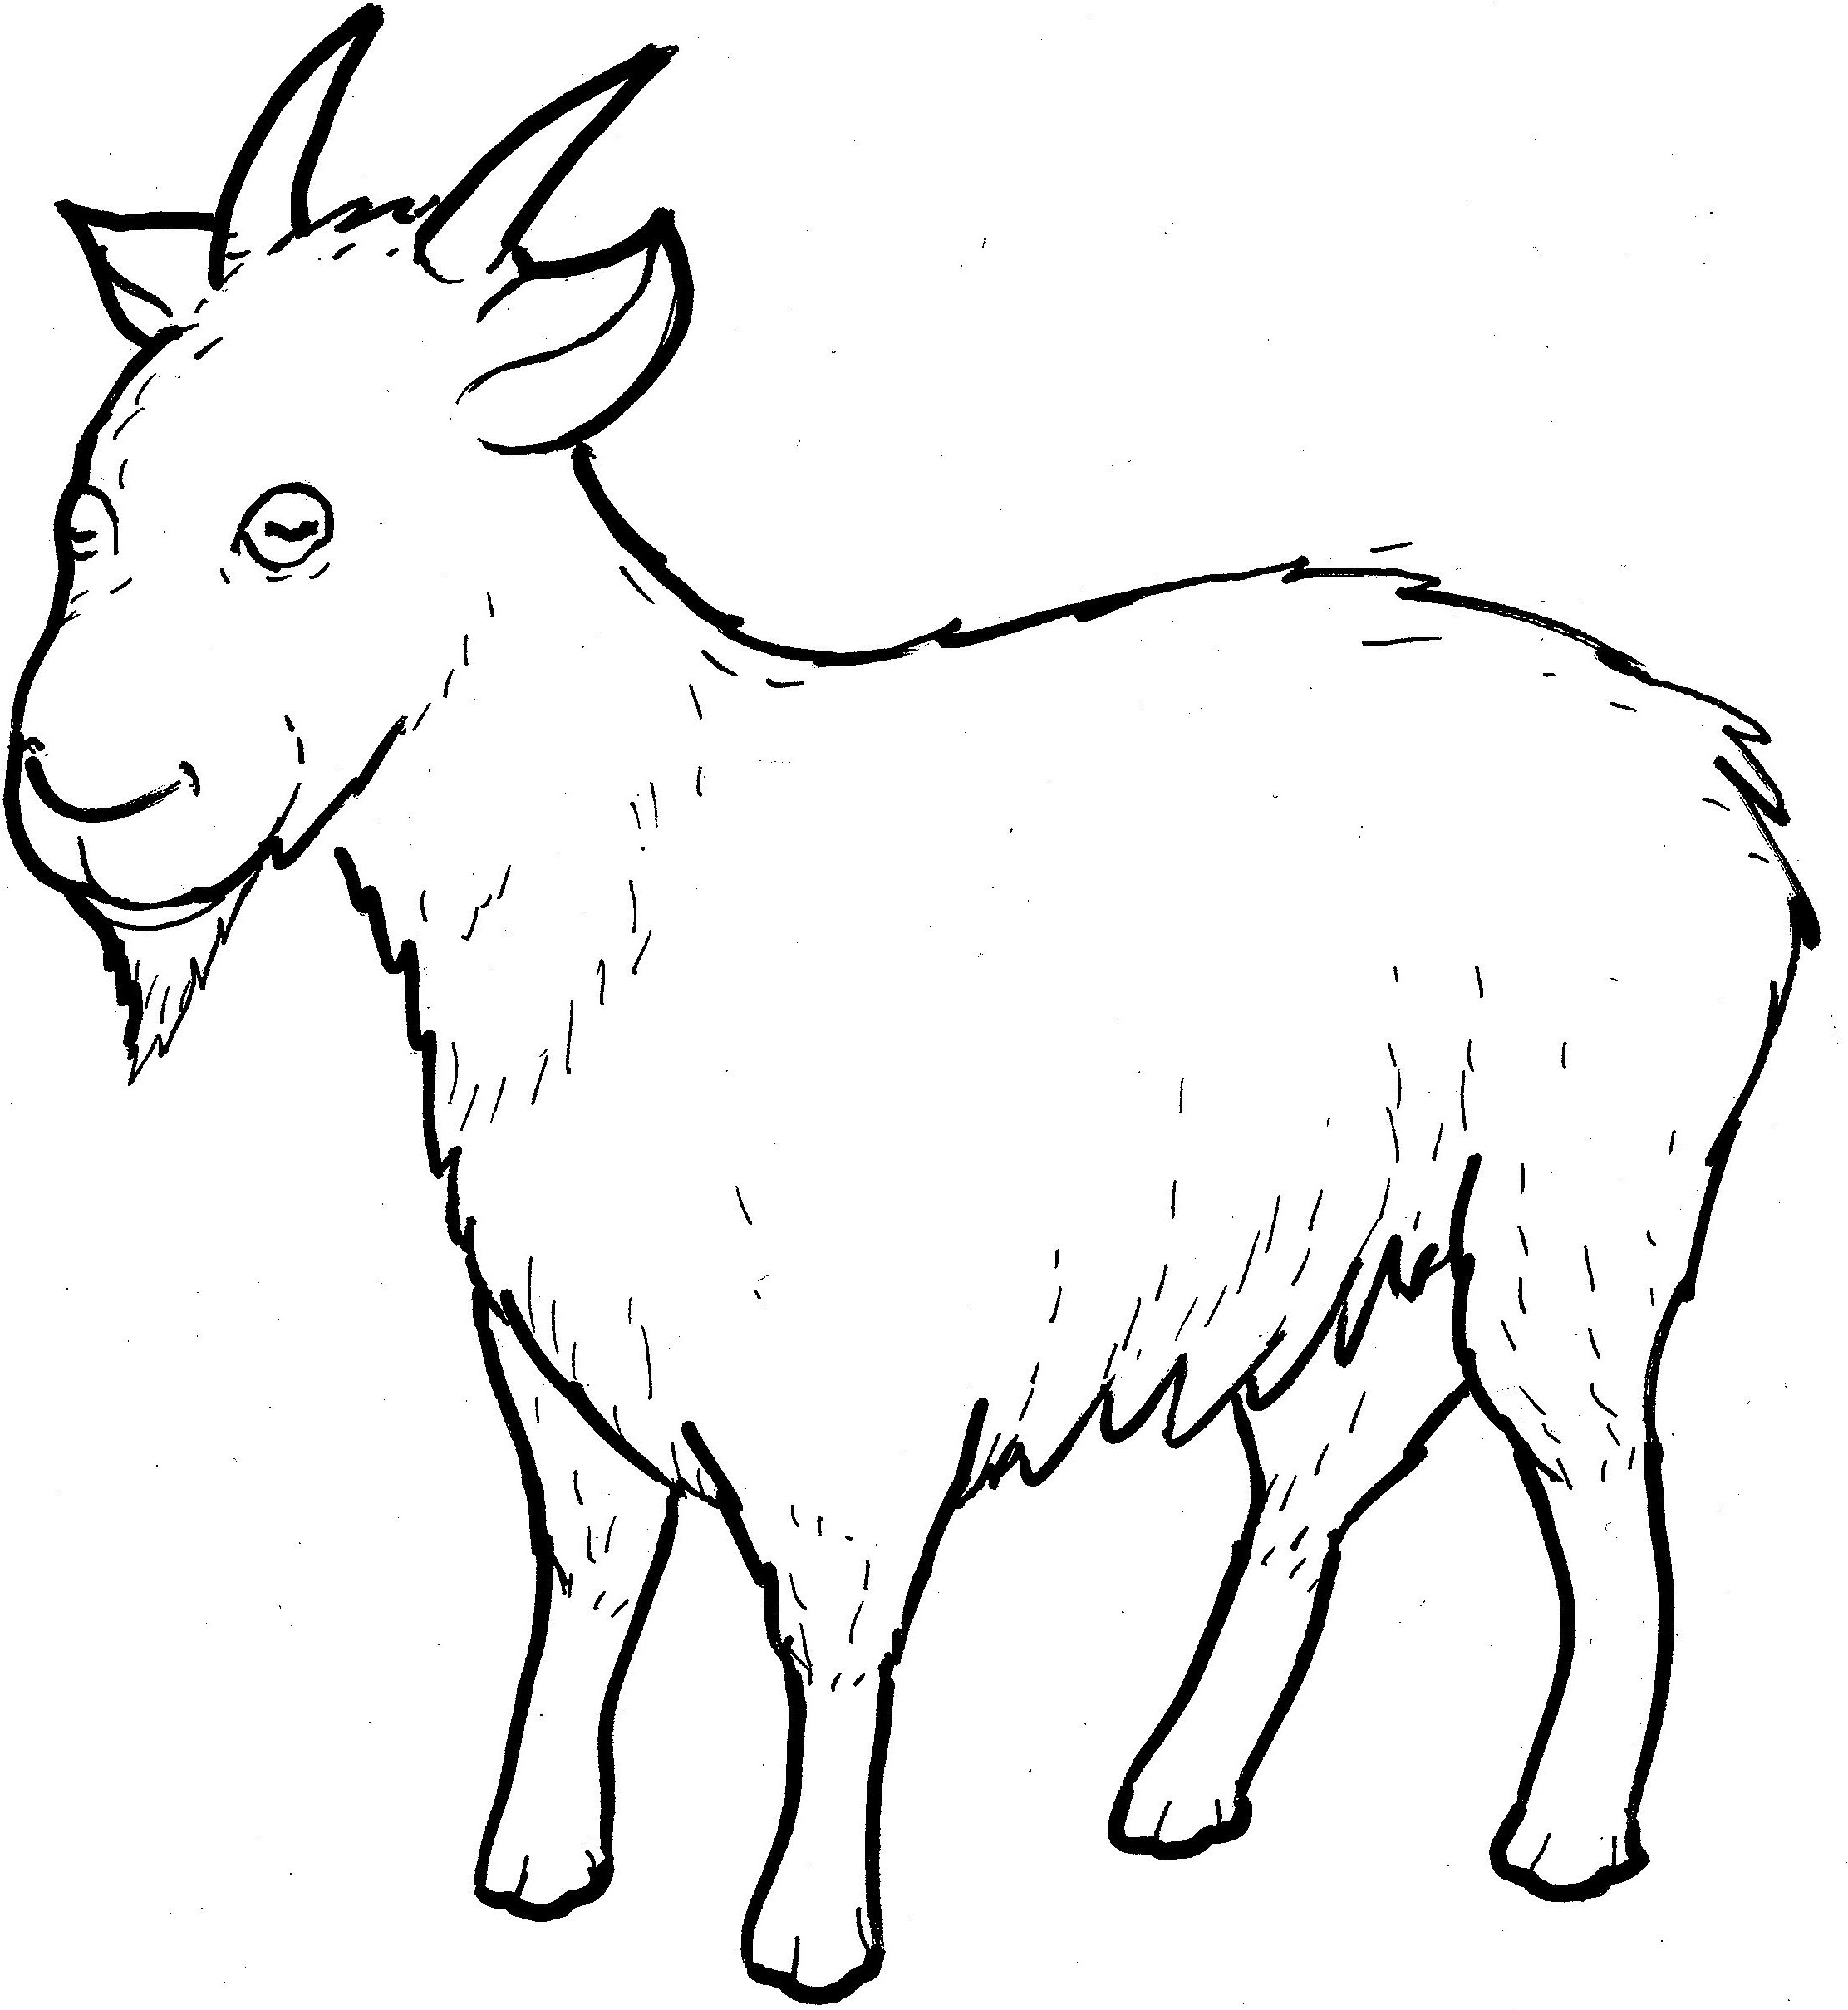
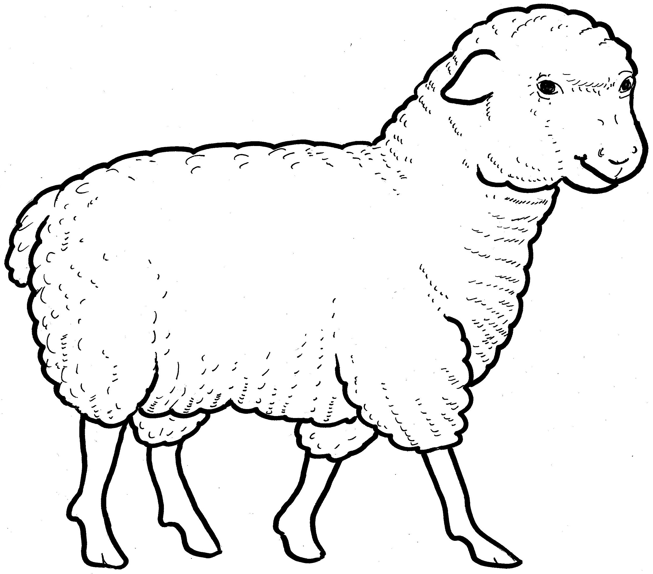
Part 1
27. The Sheep and Goats
Syllable Charts

Slide 2
Words in Syllable Types

Slide 3
Closed – Short Vowel
A closed syllable has one vowel
followed by one or more consonants,
and the vowel is short.
st
o
p
˘

Slide 4
Timing
Box
and

Slide 5
Timing
Box
ev-
-ment
left
when

Slide 6
Timing
Box
help
-gels
shep-
bless

Slide 7
Timing
Box
did
will
vis-
-it

Slide 8
Timing
Box
sick
-ish
pris-
with

Slide 9
Timing
Box
on
not

Slide 10
Timing
Box
pun-
-sus

Slide 11
Open – Long Vowel
An open syllable has one vowel
with no consonant after it,
and the vowel is long.
−
go

Slide 12
Timing
Box
he
we
me
re turns

Slide 13
Timing
Box
I

Slide 14
Timing
Box
go

Slide 15
Timing
Box
real ly
thir sty

Slide 16
Silent e – Long Vowel
A silent e syllable has one vowel,
followed by one consonant
and a silent e at the end.
The vowel is long.
−
ca
e
v

Slide 17
Timing
Box
came
gave

Slide 18
Timing
Box
these

Slide 19
Timing
Box
like
side

Slide 20
Timing
Box
those
throne

Slide 21
Vowel Teams – Long Vowel
Many vowel teams follow this rule:
When two vowels get together,
the first one names its letter.
So the first vowel will make its long sound,
and the second vowel is silent.
−
e
a
t

Slide 22
Timing
Box
say
a way

Slide 23
Timing
Box
see
sheep

Slide 24
Timing
Box
eat
least
real ly

Slide 25
Timing
Box
right

Slide 26
Timing
Box
goats

Slide 27
Vowel Teams – Other Sounds
Sometimes vowel teams make other sounds.
oil

Slide 28
Timing
Box
took

Slide 29
Timing
Box
with out

Slide 30
R - Controlled
R-controlled syllables have one or more vowels
followed by an “r.”
The “r” changes the sound of the vowel.
o
r
ange

Slide 31
Timing
Box
for
Lord

Slide 32
Timing
Box
shep herd
stran ger
for ev er
broth ers

Slide 33
Timing
Box
thir sty

Slide 34
Timing
Box
re turns

Slide 35
Other Sounds – -nk/-ng
The “-nk” and “-ng”
change the sound of the vowel.
bank
thing

Slide 36
Timing
Box
king
some thing

Slide 37
Timing
Box
strang er
ang els

Slide 38
Timing
Box
hung ry

Slide 39
Timing
Box
drink

Slide 40
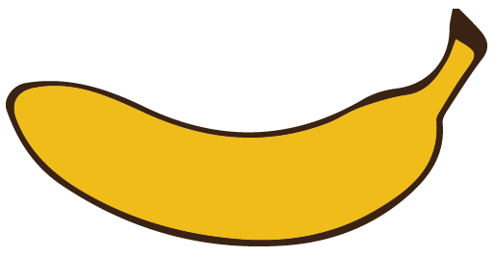
Other Sounds – schwa
The schwa syllable has an “a” that sounds
like the /u/ in banana.
The banana is even shaped like a short u.
ba nan a

Slide 41
Timing
Box
a way

Slide 42
Timing
Box
pris on
king dom

