Slide 1
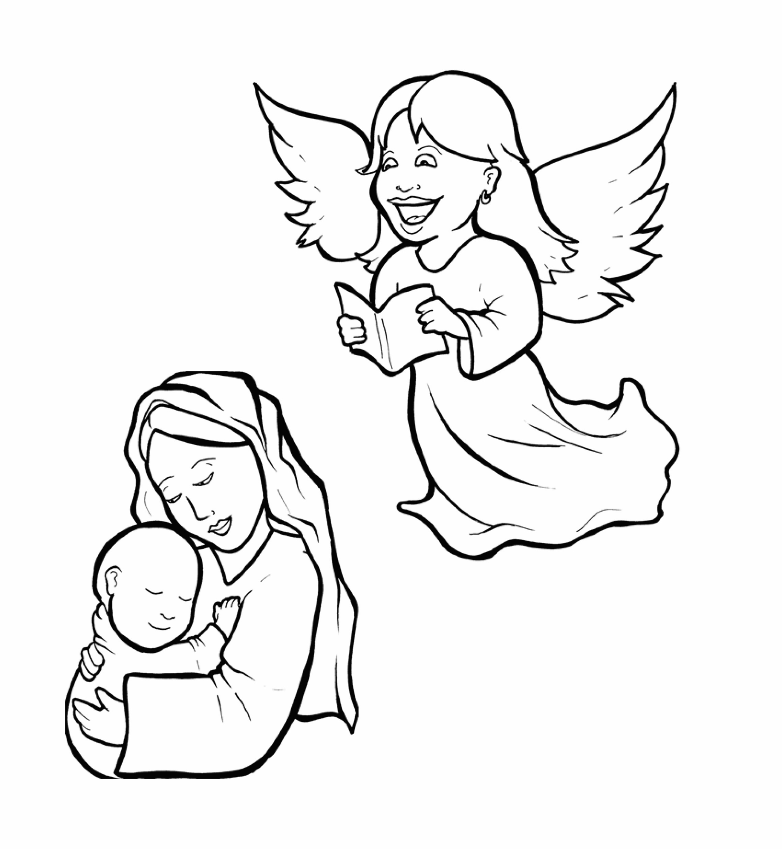
1.Will Mary Say Yes to God?
Part 5
Vocabulary
Original Bible Story

Slide 2
Vocabulary

Slide 3
virgin
(VIR -
gin):
an unmarried
woman

Slide 4
favor
vor):
(FA -
on the side of
(from favorite)

Slide 5
behold
HOLD):
(be -
see!

Slide 6
womb
(womb):
where an unborn
baby grows inside
the mother

Slide 7
relative
tive):
(REL -
a -
a family member

Slide 8
depart
went away
(de -
PART):

Slide 9
Will Mary Say Yes
to God?
Luke 1:26-38
World English Bible (WEB)

Slide 10
Now in the sixth month, the angel Gabriel was sent from God to a city of Galilee, named Nazareth, to a virgin pledged to be married to a man whose name was Joseph, of David’s house.
The virgin’s name was Mary.

Slide 11
Having come in, the angel said to her, “Rejoice, you highly favored one!
The Lord is with you.
Blessed are you among women!”

Slide 12
But when she saw him, she was greatly troubled at the saying, and considered what kind of salutation this might be.
The angel said to her, “Don’t be afraid, Mary, for you have found favor with God.

Slide 13
Behold, you will conceive in your womb, and give birth to a son, and will call his name ‘Jesus.’
He will be great, and will be called the Son of the Most High.

Slide 14
The Lord will give him the throne of his father, David, and he will reign over the house of Jacob forever.
There will be no end to his Kingdom.
Mary said to the angel, “How can this be, seeing I am a virgin?”

Slide 15
The angel answered her, “The Holy Spirit will come on you, and the power of the Most High will overshadow you.
Therefore, also the holy one who is born from you will be called the Son of God.

Slide 16
Behold, Elizabeth, your relative, also has conceived a son in her old age; and this is the sixth month with her who was called barren.
For nothing spoken by God is impossible.”

Slide 17
Mary said, “Behold, the servant of the Lord; let it be done to me according to your word.”
The angel departed from her.

