Slide 1
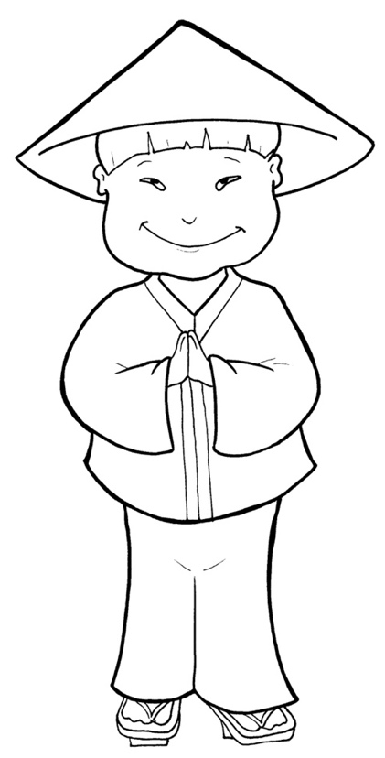
Timing
Box
Part 4
53. I Am Alive:
Tell the World
Story in Easy Read English
Questions
Story in Phrases

Slide 2
Timing
Box
Before Jesus went back to
heaven, he told his disciples:

Slide 3
Timing
Box
“All power in heaven and on
earth has been given to me.

Slide 4
Timing
Box
Therefore, go and make
disciples of all nations.

Slide 5
Timing
Box
Baptize them in the name of
the Father and of the Son and
of the Holy Spirit.

Slide 6
Timing
Box
Teach them to obey.
I will be with you always.”

Slide 7
Timing
Box
His disciples went by ship, by
foot, by horse.

Slide 8
Timing
Box
They traveled near and far.

Slide 9
Timing
Box
They told people about Jesus.

Slide 10
Timing
Box
They healed the sick.

Slide 11
Timing
Box
The men told demons to leave,
and they did!

Slide 12
Timing
Box
Night and day, the disciples
prayed.

Slide 13
Timing
Box
They baptized.
Churches sprang up.

Slide 14
Timing
Box
You can read about this
amazing time in the book
of Acts.

Slide 15
Timing
Box
Peter told a crowd, “Jesus
came from heaven.

Slide 16
Timing
Box
You put him to death on a cross.

Slide 17
Timing
Box
But God raised him from
the dead.

Slide 18
Timing
Box
We saw him ourselves.”

Slide 19
Timing
Box
Their hearts were filled with
sadness.

Slide 20
Timing
Box
“What shall we do?” they asked.

Slide 21
Timing
Box
Peter said, “Be sorry for your sins.

Slide 22
Timing
Box
Be baptized in the name of
Jesus.

Slide 23
Timing
Box
You will be forgiven.”

Slide 24
Timing
Box
That day, thousands of people
became believers.

Slide 25
Timing
Box
Jesus left us with the same
wonderful work.

Slide 26
Timing
Box
We get to share with the world
about Jesus.

Slide 27
Timing
Box
God will give us power through
the Holy Spirit, who lives inside us.

Slide 28
Timing
Box
We will tell the Good News
about Jesus.

Slide 29
Question 1
Timing
Box
What did Jesus tell Christians to do?

Slide 30
Question 2
Timing
Box
How did they obey?

Slide 31
Question 3
Timing
Box
How can you obey this command to go and tell?

Slide 32
Question 4
Timing
Box
Think of one person in your life who does not know Jesus as Lord. Will you tell that person?

Slide 33
Prayer
Timing
Box
Dear Lord Jesus,
I will obey your command to share the Good
News. Show me how. Use the power of the Holy
Spirit inside me. Help me be brave and tell the
truth. Send me where you want and to whom
you want.
Amen

Slide 34
Timing
Box
I am Alive:
Tell the World
Phrased for Fluency

Slide 35
Timing
Box
Before Jesus
went back
to heaven,
he told his disciples:

Slide 36
Timing
Box
“All power
in heaven
and on earth
has been given to me.

Slide 37
Timing
Box
Therefore,
go
and make disciples
of all nations.

Slide 38
Timing
Box
Baptize them
in the name
of the Father
and of the Son
and of the Holy Spirit.

Slide 39
Timing
Box
Teach them
to obey.

Slide 40
Timing
Box
I will
be with you
always.”

Slide 41
Timing
Box
His disciples went
by ship,
by foot,
by horse.

Slide 42
Timing
Box
They traveled
near and far.

Slide 43
Timing
Box
They
told people
about Jesus.

Slide 44
Timing
Box
They
healed the sick.

Slide 45
Timing
Box
The men
told demons
to leave,
and they did!

Slide 46
Timing
Box
Night and day,
the disciples
prayed.

Slide 47
Timing
Box
They baptized.
Churches sprang up.

Slide 48
Timing
Box
You can read
about this amazing time
in the book
of Acts.

Slide 49
Timing
Box
Peter told
a crowd,
“Jesus came
from heaven.

Slide 50
Timing
Box
You
put him
to death
on a cross.

Slide 51
Timing
Box
But God
raised him
from the dead.

Slide 52
Timing
Box
We saw him
ourselves.”

Slide 53
Timing
Box
Their hearts
were filled
with sadness.

Slide 54
Timing
Box
“What shall we do?”
they asked.

Slide 55
Timing
Box
Peter said,
“Be sorry
for your sins.

Slide 56
Timing
Box
Be baptized
in the name
of Jesus.

Slide 57
Timing
Box
You
will be
forgiven.”

Slide 58
Timing
Box
That day,
thousands
of people
became believers.

Slide 59
Timing
Box
Jesus left us
with the same
wonderful work.

Slide 60
Timing
Box
We get to share
with the world
about Jesus.

Slide 61
Timing
Box
God
will give us
power
through the Holy Spirit,
who lives
inside us.

Slide 62
Timing
Box
We will tell
the good news
about Jesus.

