Slide 1
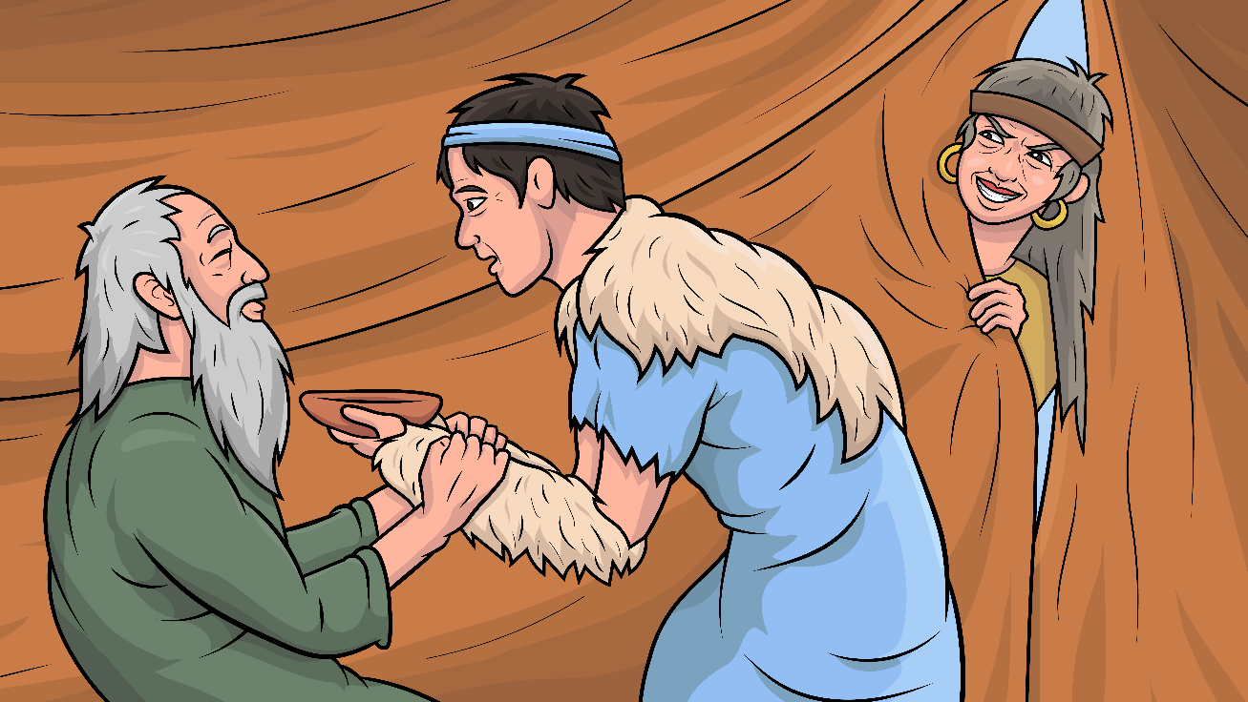
Story 1.13 The Big Switch
Story of Jacob, Rebekah, Esau, and Isaac- Genesis 27
( -tch )
www.EasyReadEnglish.com

Slide 2
New Words to Read
catch hatch snatch match patch
pitch snitch (tell on)

Slide 3
itch switch stitch
hitch ditch
stretch clutch
notch (a hole or slit in an object)

Slide 4
Rule Breakers (Read and Spell)
said do to
is his your
put of they
does

Slide 5
Sight Words
see out Jacob Isaac Esau
kid (baby goat)

Slide 6
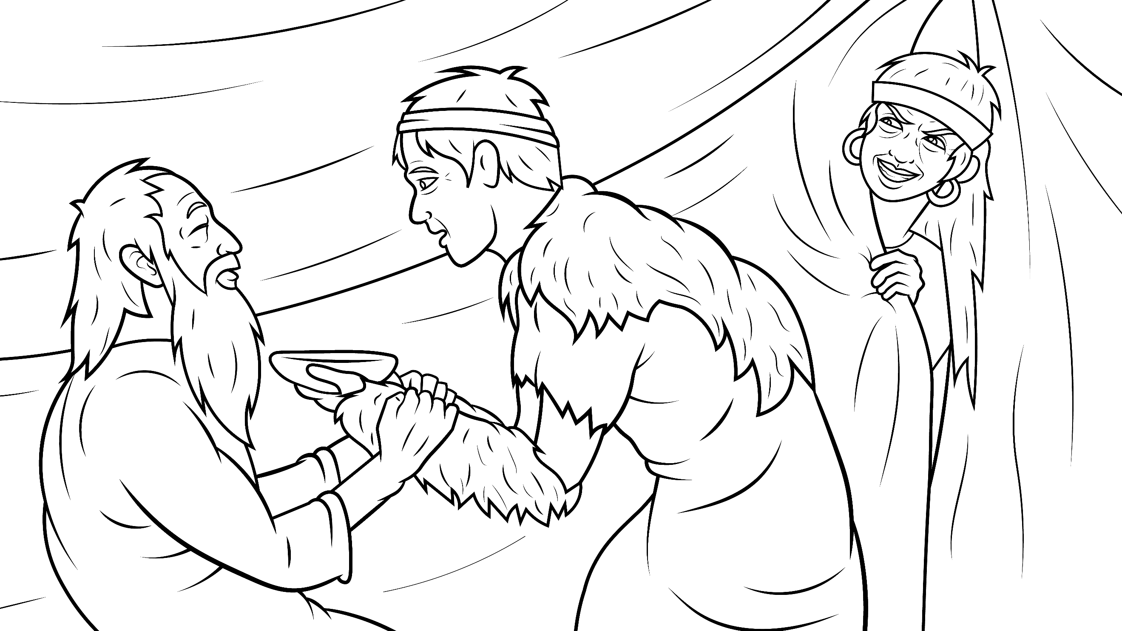
Story 1.13 The Big Switch
Story of Jacob, Rebekah, Esau, and Isaac- Genesis 27
( -tch )
I Read,
You Read
Bible Story
www.EasyReadEnglish.com

Slide 7
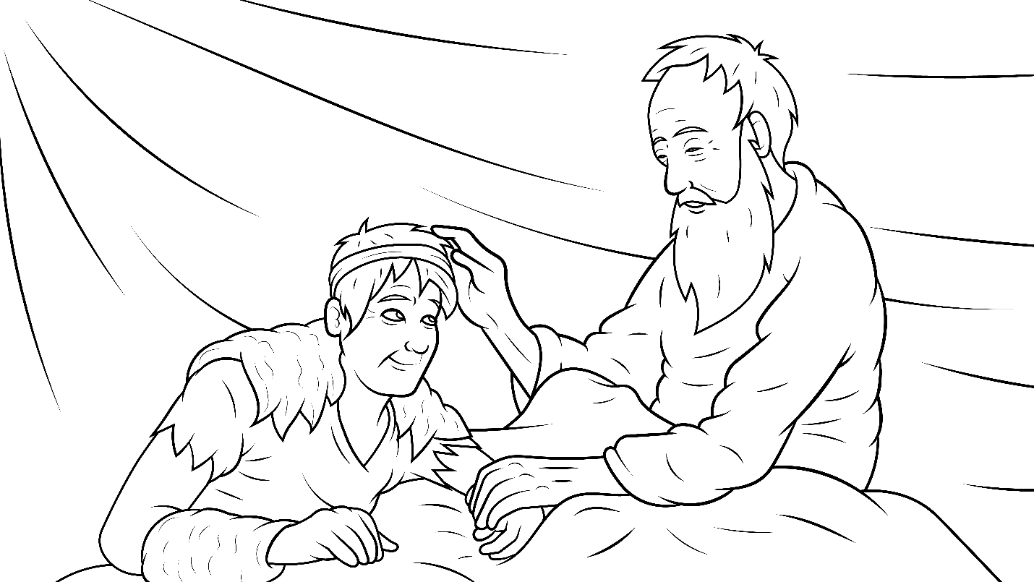
Isaac was very old. It was time to give Esau the blessing.

Slide 8
Isaac said, “I cannot see.
Esau, hunt and fetch lunch.”

Slide 9
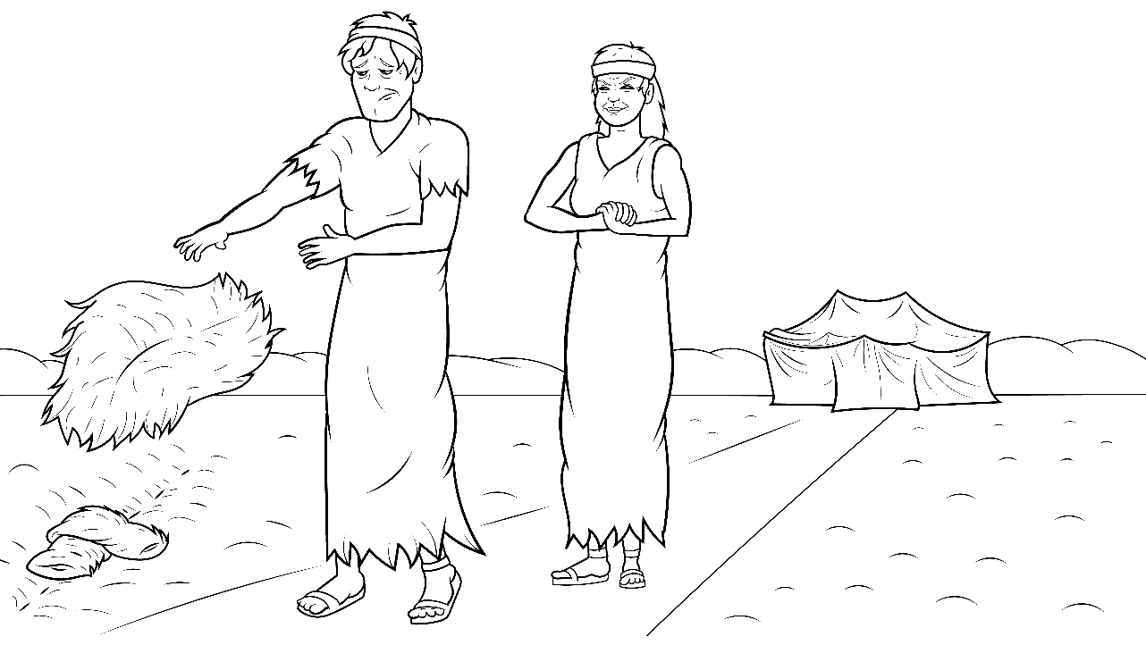
Esau went to catch lunch. Mom did hatch a plan.

Slide 10
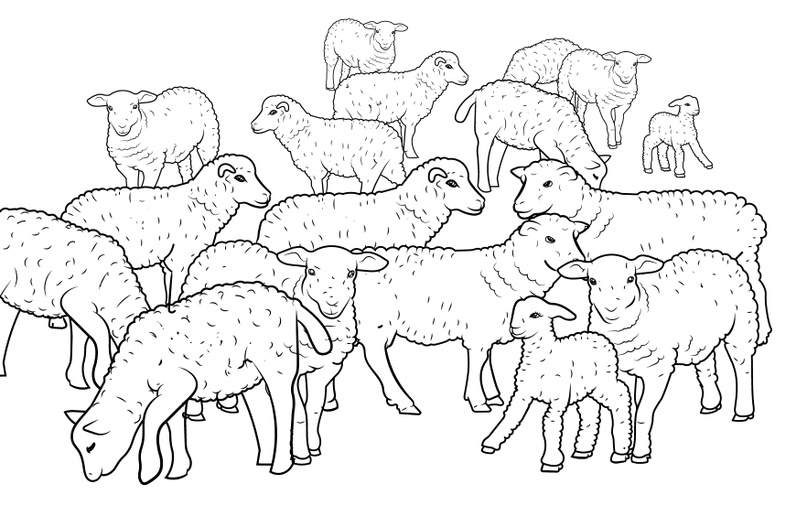
“We will do a big switch,” Mom said. “Quick, snatch
a kid.”

Slide 11
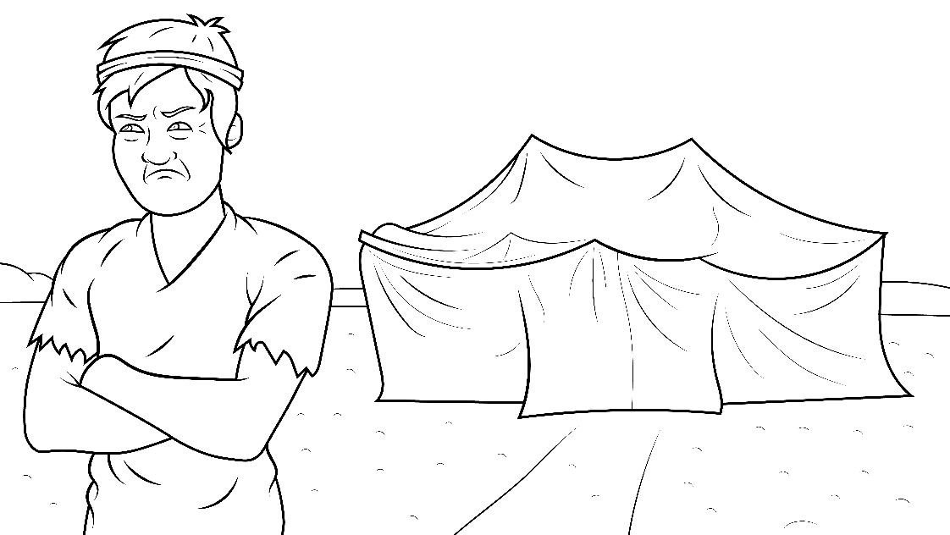
Jacob said, “Dad will catch me. By my smell, he will tell.”

Slide 12
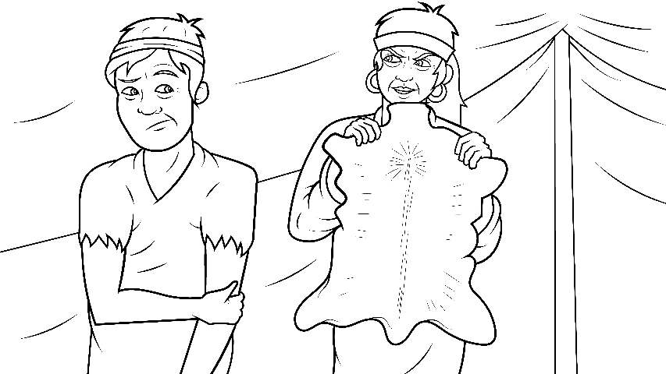
Mom said, “Dress up as your twin.
I will stitch
skin to
match.”

Slide 13
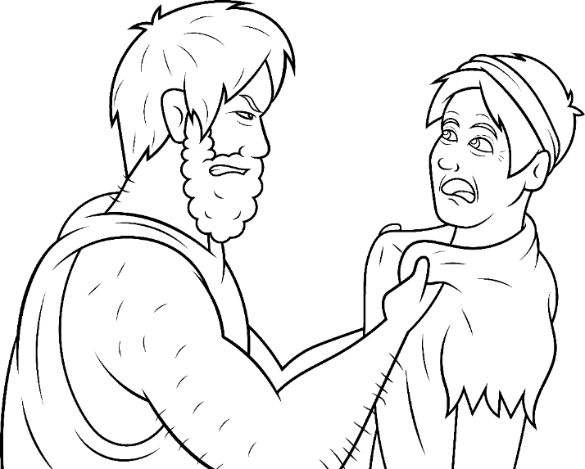
“Esau is a big man. Let me put a notch in this belt.”

Slide 14
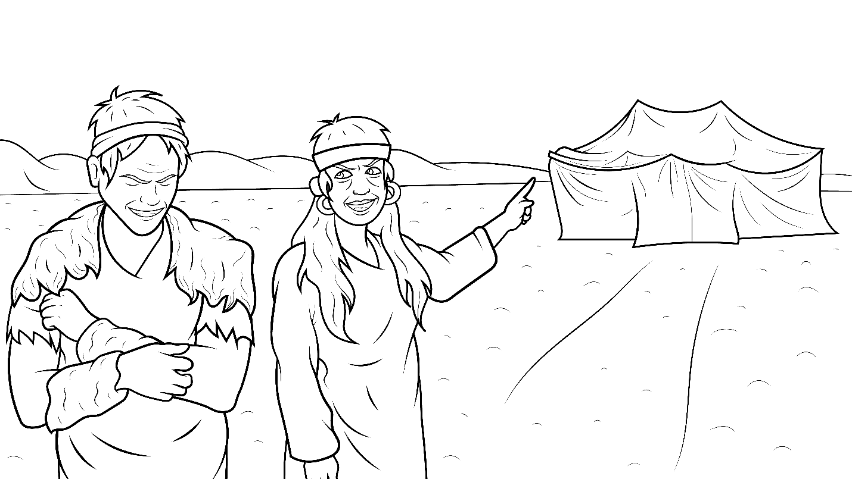
The patch of skin did itch.
Jacob went into the tent.

Slide 15
Jacob said to his dad, “I am Esau. I have your lunch.”

Slide 16
? ? ? ? ?
Was it all a big lie?
The old man felt the sound of his voice
did not match.
Did they switch?

Slide 17
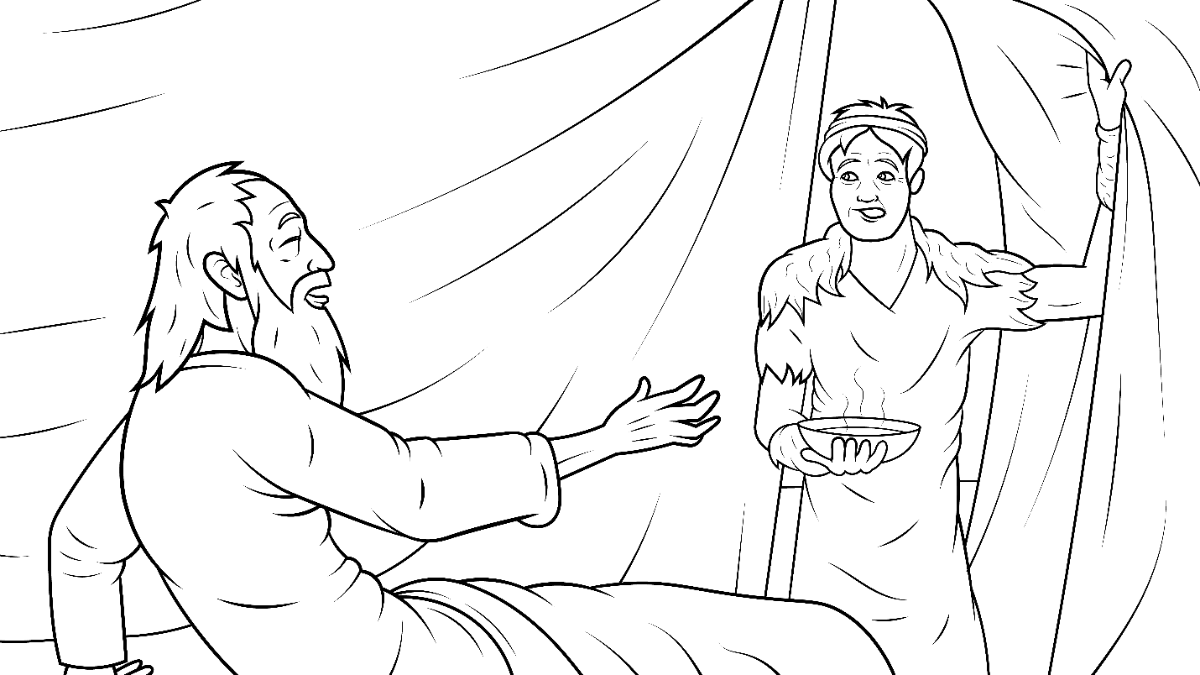
“The smell does match. Stretch out your hand,”
said Dad.
Jacob
did
stretch.

Slide 18
Isaac felt the patch. The switch went off without
a hitch.

Slide 19
Isaac gave Jacob the
blessing that was
meant for Esau.

Slide 20
Jacob did pitch the skins into a ditch.
Then he hid.

Slide 21
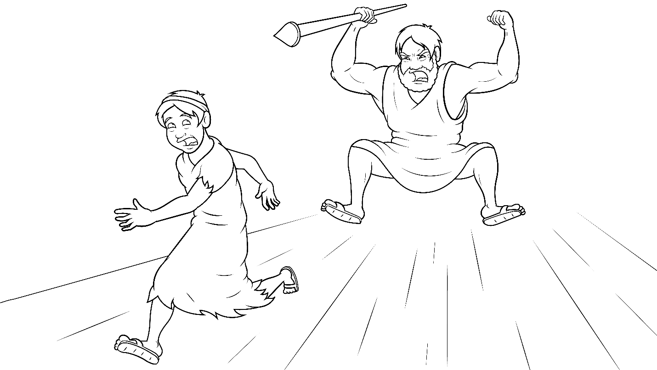
When Esau was back, he did pitch a
big fit
at the
switch.

Slide 22
He did clutch his dad and beg him, “Bless me!”

Slide 23
A man did snitch,
“Esau will kill Jacob!”

Slide 24
So, Jacob ran off.

Slide 25
The End

Slide 26
1.13 Story Without Illustrations
The Big
Switch
Genesis 27

Slide 27
Isaac was very old.
It was time to give Esau the blessing.
Isaac said, “I cannot see.
Esau, hunt and fetch lunch.”
Esau went to catch lunch.

Slide 28
Mom did hatch a plan.
“We will do a big switch,” Mom said. “Quick, snatch a kid.”
Jacob said, “Dad will catch me.
By my smell, he will tell.”

Slide 29
Mom said, “Dress up as your twin.
I will stitch skin to match.”
Esau is a big man.
Let me put a notch in this belt.”
The patch of skin did itch.

Slide 30
Jacob went into the tent. Jacob said to his dad, “I am Esau. I have your lunch.”
Was it all a big lie? The old man felt the sound of his voice did not match.
Did they switch?

Slide 31
“The smell does match.
Stretch out your hand,” said Dad. Jacob did stretch. Isaac felt the patch. The switch went off without a hitch.

Slide 32
Isaac gave Jacob the blessing that was meant for Esau.
Jacob did pitch the skins into a ditch. Then he hid.

Slide 33
When Esau was back, he did pitch a big fit at the switch.
He did clutch his dad and beg him, “Bless me!”

Slide 34
A man did snitch, “Esau will kill Jacob!” So, Jacob ran off.

Slide 35
The End

Slide 36
Story: Carol Hale
Illustrations: Ivan Mader
Power Point arrangements: Steve March
www.EasyReadEnglish.com
www.EZReadEnglish.org/lower-levels

Slide 37
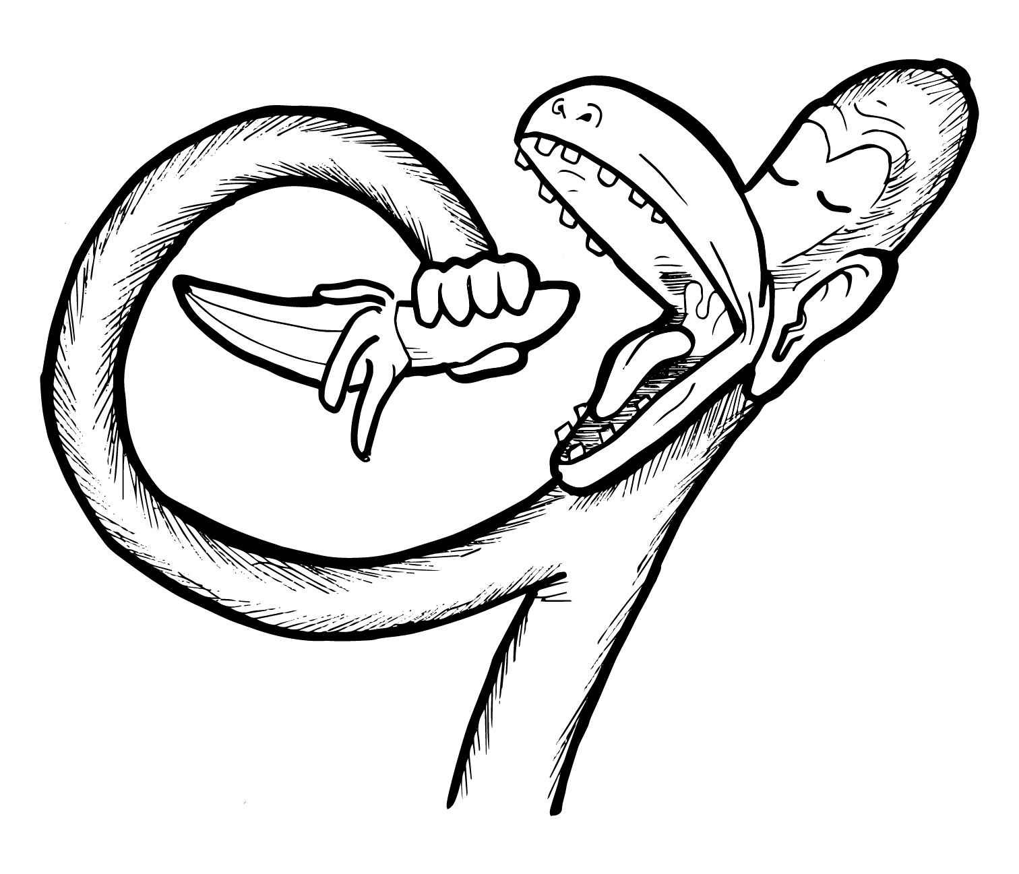
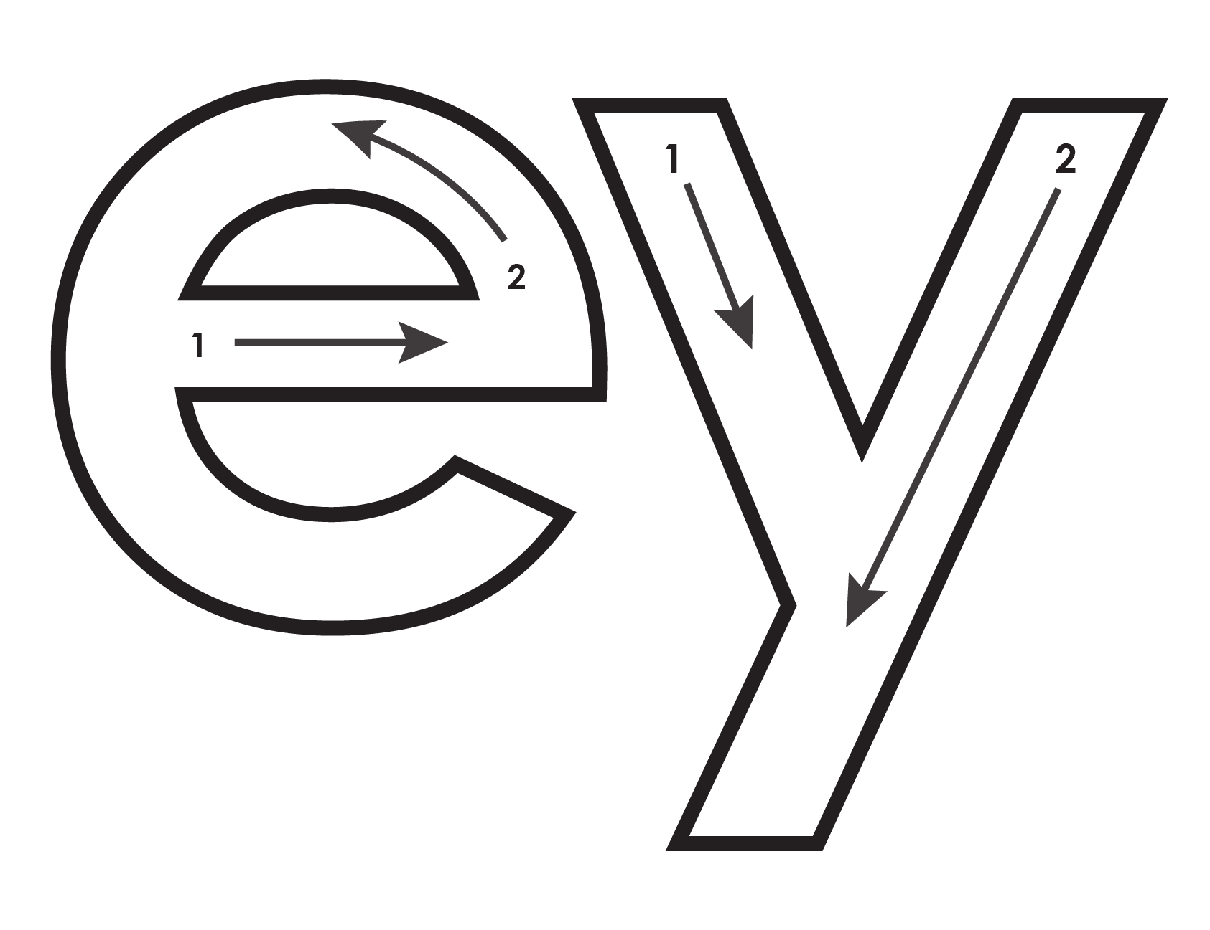
Another important teaching tool…
Easy Breezy Reading (https://www.easybreezyreading.com)
Designed to help new, struggling, and especially dyslexic learners, Easy Breezy Reading is broken up into Laughing Letters and Funny Phonograms. Both tools use illustrated patterns that mimic the shapes of the letters to give your students one more sense to link the phonetic sound of the letters.
ey
monk
Our scope and sequence matches Easy Read English Lower Levels. Progressing through the Easy Breezy Reading curriculum is sure to accelerate your students’ comprehension of the written English language.
You can procure Laughing Letters or Funny Phonograms through our website.
https://www.easybreezyreading.com/curriculum

