Slide 1

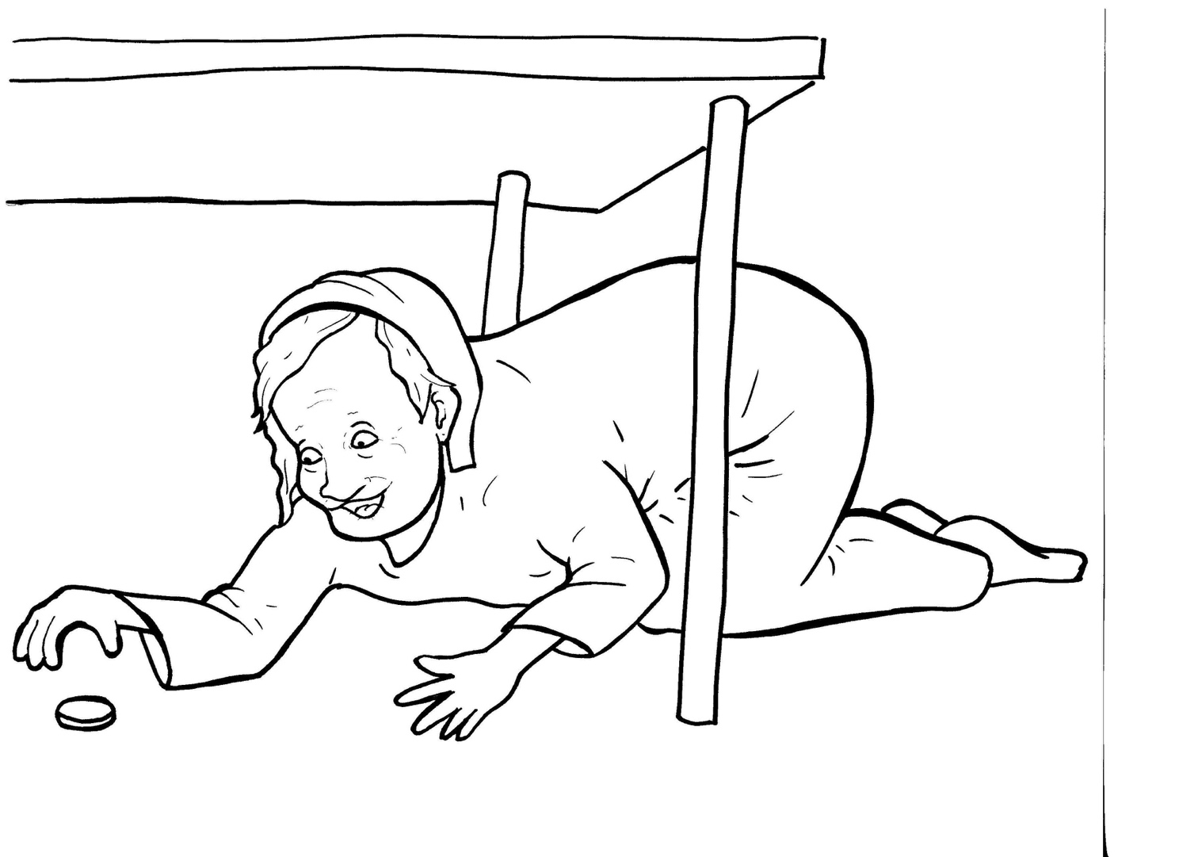
Part 5
23. The Lost Coin
Vocabulary
Original Bible Story

Slide 2

Vocabulary

Slide 3
Pharisee
(PHAR - i - see)
a Jewish leader in the days of Jesus

Slide 4
scribe
(scribe)
a person who copied the Scriptures

Slide 5
parable
(PAR - a - ble)
a story on earth about
things in heaven

Slide 6
murmur
(MUR - mur)
to whisper a
complaint

Slide 7
drachma
(DRACH – ma)
the kind of money used in the days of Jesus

Slide 8
diligently
(DIL – i – gent - ly)
not giving up

Slide 9
The Lost Coin
Luke 15:1-3; 8-10
World English Bible (WEB)

Slide 10
Now all the tax collectors
and sinners were coming close
to him to hear him.

Slide 11
The Pharisees and the scribes
murmured, saying,…

Slide 12
“This man welcomes sinners,
and eats with them.”

Slide 13
He told them this parable:
What woman, if she had ten
drachma coins,…

Slide 14
if she lost one drachma coin,
wouldn’t light a lamp,
sweep the house,…

Slide 15
and seek diligently until she
found it?

Slide 16
When she has found it,
she calls together her friends
and neighbors, saying,…

Slide 17
‘Rejoice with me,
for I have found
the drachma which I had lost.’

Slide 18
Even so, I tell you,
there is joy
in the presence
of the angels of God
over one sinner repenting.”

