Slide 1

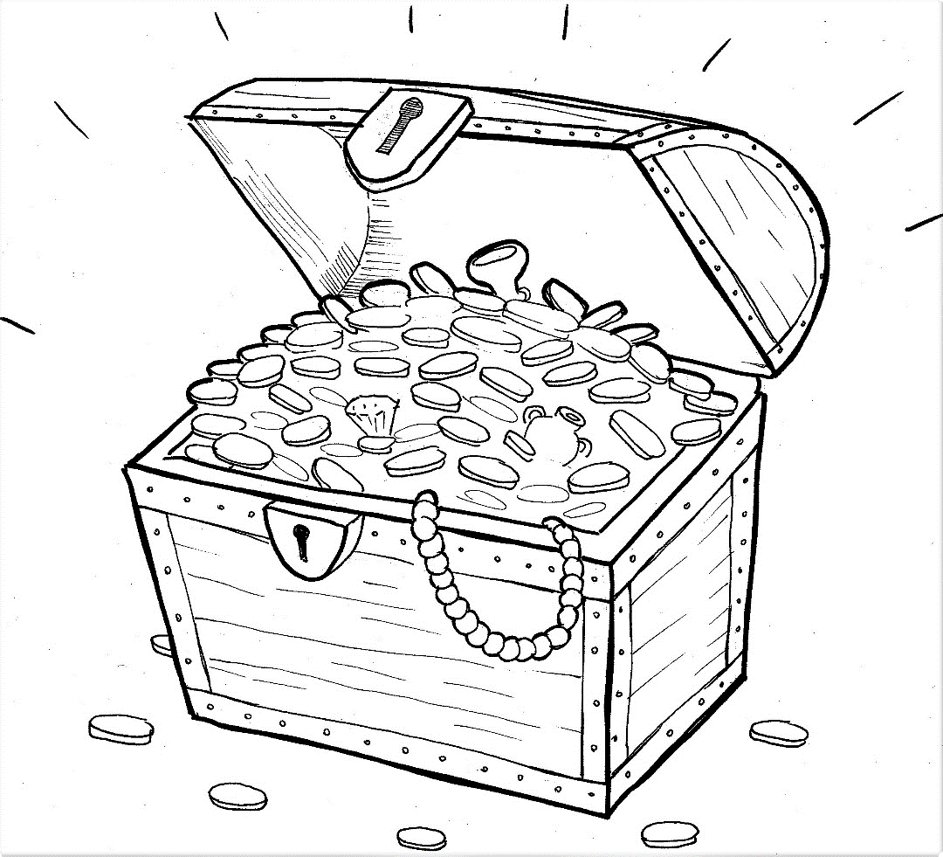
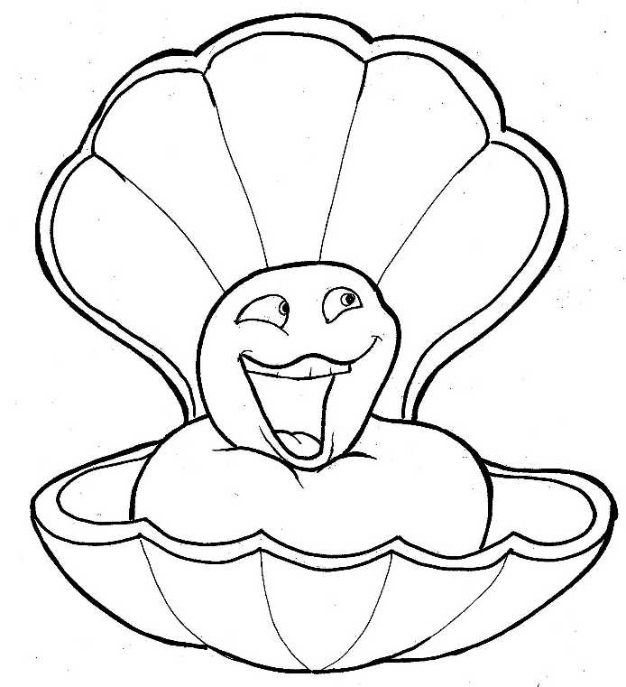
Part 5
21. Hidden Treasure and Priceless Pearl
Vocabulary
Original Bible Story

Slide 2
Vocabulary

Slide 3
parable
(PAR - a - ble):
a story on earth about
things in heaven

Slide 4
fulfill
(ful - FILL):
to come true

Slide 5
prophet
(PROPH - et):
a person who speaks for God

Slide 6
utter
(UT – ter):
to speak

Slide 7
foundation
(FOUN - da - tion):
the start

Slide 8
merchant
(MER- chant):
a person who buys and sells things

Slide 9
Hidden Treasure and Priceless Pearl
Matthew 13:34-35; 44-45; 51
World English Bible (WEB)

Slide 10
Jesus spoke all these things in parables to the
multitudes;
and without a parable, he didn’t speak to them,

Slide 11
that it might be fulfilled which was spoken
through the prophet, saying,

Slide 12
“I will open my mouth in parables;
things hidden from the foundation of the world.”
I will utter

Slide 13
Again, the kingdom of heaven is like treasure
hidden in the field, which a man found and hid.

Slide 14
In his joy, he goes and sells all that he has
and buys that field.

Slide 15
Again, the kingdom of heaven is like a man
who is a merchant seeking fine pearls,

Slide 16
who having found one pearl of great price,
he went and sold all that he had
and bought it.

Slide 17
Jesus said to them,
all these things?”
They answered him,
“Have you understood
“Yes, Lord.”

