Slide 1

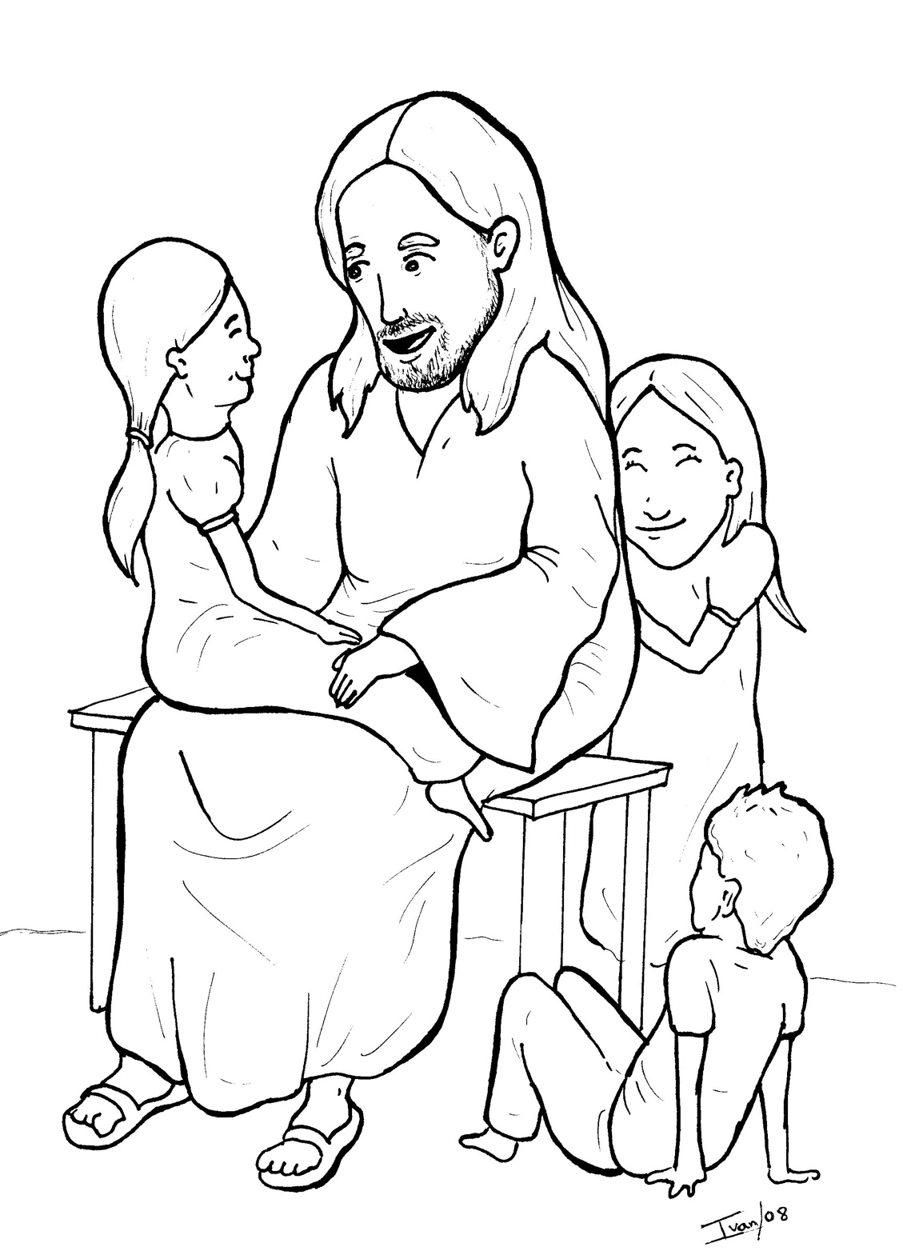
12. Jesus Loves the Little Children
Part 3
Syllable Divisions

Slide 2
Dividing Words
Into Syllables

Slide 3
Rabbit Words
When you see two consonants
between two vowels,
divide between the consonants.
ra it
bb
rab bit

Slide 4
dis ci ples
disciples

Slide 5
ac cept
accept

Slide 6
en ter
enter

Slide 7
hap py
happy

Slide 8

Tiger Words
When you see one consonant
between two vowels,
divide after the first vowel.
Try this pattern first.
ti er
g
ti ger

Slide 9
Je sus
Jesus

Slide 10
be longs
belongs

Slide 11
ba bies
babies

Slide 12
Camel Words
When you see one consonant
between two vowels,
divide after the first consonant.
Try this pattern second.
ca el
m
cam el

Slide 13
nev er
never

Slide 14
Turtle Words
When you see consonant-l-e,
count back three and divide.
tur
t
l
e
tur tle

Slide 15
peo ple
people

Slide 16
disci ple
disciple

Slide 17
lit tle
little

Slide 18
Hamster Words
When you see three consonants between two vowels,
divide after the first consonant.
ha
mst
er
ham ster

Slide 19
chil dren
children

Slide 20

Anteater Words
These compound words are made up of two smaller words.
ant
eater
1
2
ant eater

Slide 21
in to
into

Slide 22
up set
upset

Slide 23
every one
everyone

Slide 24
Other Syllable Divisions
Some words don’t fit so neatly
into standard syllable division patterns.
a way
away

Slide 25

Foxes Suffixes
Focus on your base word.
fox es
fox es

Slide 26
babies
babies

Slide 27
blessed
blessed

Slide 28
pushed
pushed

Slide 29
scold ed
scolded

Slide 30
smiled
smiled

Slide 31
king dom
kingdom

