Slide 1
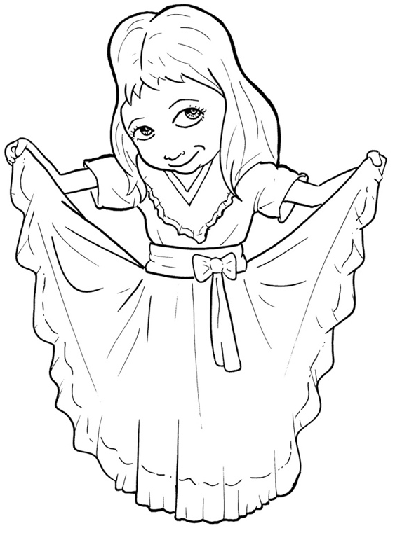
47. Now, the Good
News: Jesus Saves
Part 4
Story in Easy Read English
Questions
Story in Phrases

Slide 2
Jesus came to die.

Slide 3
What? Who would go somewhere only to die?

Slide 4
Jesus did.

Slide 5
God's love is so deep that he gave the world his only Son.

Slide 6
Jesus, who never sinned, took our punishment.

Slide 7
He gave his life on the cross because his blood saves.

Slide 8
Now, we can be made clean in God's eyes!

Slide 9
Whoever trusts Jesus will not die without God.

Slide 10
We will enjoy life with God forever.

Slide 11
That's the super, great, wonderful "Good News!"

Slide 12
The broken friendship can be fixed.

Slide 13
The Bible tells us, "If you say with your mouth that Jesus is Lord…

Slide 14
…if you believe in your heart that God raised him from the dead, you will be saved."

Slide 15
Do you believe that?

Slide 16
If you do, say this prayer or use your own words.

Slide 17
Dear Lord Jesus,
I'm sorry for the wrong I do.

Slide 18
Thank you for coming and dying to pay the price for my sin.

Slide 19
Thank you for forgiving me and saving me.

Slide 20
I believe that you rose from the dead.

Slide 21
Help me to love, obey, and follow you forever.
Amen

Slide 22
If you said that prayer, and meant every word, God has heard your prayer.

Slide 23
Tell someone you trust.

Slide 24
The angels in heaven are throwing a party.

Slide 25
God is smiling.

Slide 26
You are now God's child.

Slide 27
This really is good news!

Slide 28
Question 1
How does someone become God's child?

Slide 29
Question 2
What happens when you believe in Jesus?

Slide 30
Question 3
Have you asked Jesus to forgive you and to be your Lord? When?

Slide 31
Question 4
If you have not made that choice yet, what would help you to believe?

Slide 32
Ready? If you believe in Jesus, pray this prayer:
Dear Lord Jesus,
Thank you for finding me. Thank you for forgiving me. Thank you for saving me. Help me understand what this new life means.
Amen

Slide 33
Not ready yet? Pray this prayer:
Dear Jesus,
I want to follow you, but I am not quite ready. Please show me the way. Help me believe in you. Please help me understand and accept God's gift of love.
Amen

Slide 34
Now, the Good News
- Jesus Saves
Phrased for Fluency

Slide 35
Jesus came
to die.

Slide 36
What?
Who would go
somewhere
only to die?

Slide 37
Jesus did.

Slide 38
God's love
is so deep
that he gave
the world
his only Son.

Slide 39
Jesus,
who never sinned,
took our punishment.

Slide 40
He gave his life
on the cross
because
his blood saves.

Slide 41
Now,
we can be
made clean
in God's eyes!

Slide 42
Whoever
trusts Jesus
will not die
without God.

Slide 43
We will enjoy life
with God
forever.

Slide 44
That's
the super,
great,
wonderful,
"Good News!"

Slide 45
The broken friendship
can be fixed.

Slide 46
The Bible
tells us,
"If you say
with your mouth
that Jesus
is Lord…

Slide 47
if you believe
in your heart
that God
raised Him
from the dead,
you
will be saved."

Slide 48
Do you
believe that?
If you do,
say this prayer
or use
your own words.

Slide 49
Dear Lord Jesus,
I'm sorry
for the wrong
I do.

Slide 50
Thank you for coming
and dying
to pay the price
for my sin.

Slide 51
Thank you
for forgiving me
and saving me.

Slide 52
I believe
that you rose
from the dead.

Slide 53
Help me
to love,
obey,
and follow you
forever.
Amen

Slide 54
If you said
that prayer,
and meant
every word,
God has heard
your prayer.

Slide 55
Tell someone
you trust.

Slide 56
The angels
in heaven
are throwing
a party.

Slide 57
God is smiling.

Slide 58
You are now
God's child.

Slide 59
This really is
good news!

