Slide 1

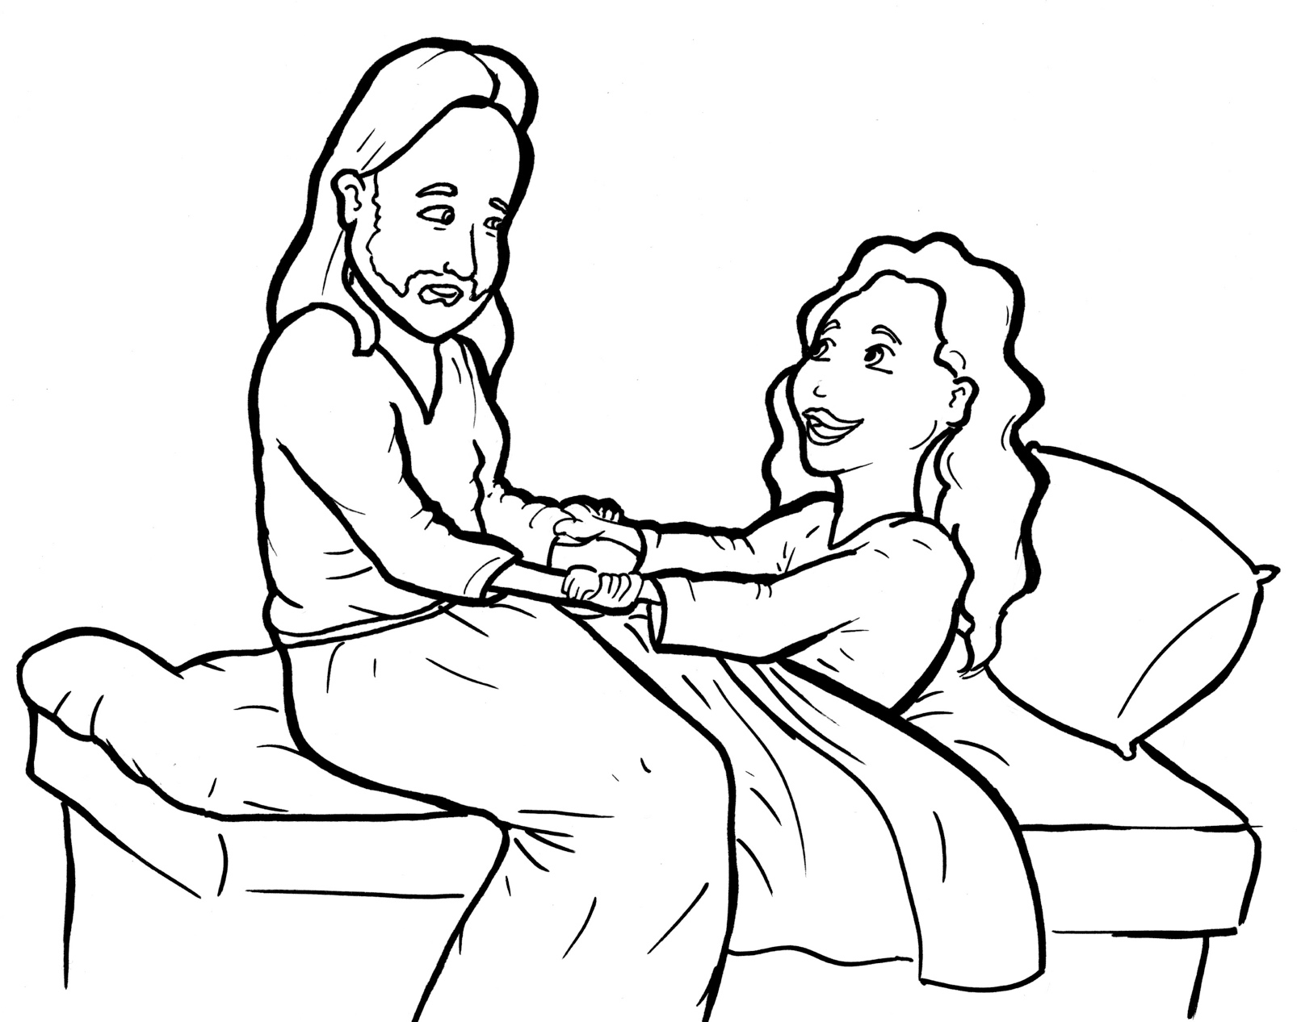
Part 5
30. Jesus Raises a Dead Girl to Life
Vocabulary
Original Bible Story

Slide 2

Vocabulary

Slide 3
synagogue
(SYN - a - gogue)
a Jewish
house of worship

Slide 4
uproar
(UP - roar)
a lot of noise over a big event

Slide 5
wail
(WAIL)
to cry loudly

Slide 6
ridicule
(RID – i - cule)
to make fun
of someone

Slide 7
interpreted
(in - TER - pret - ed)
explained words
in their own language

Slide 8
strictly
(STRICT - ly)
in a serious way

Slide 9
Jesus Raises
a Dead Girl
to Life
Mark 5:35-43
World English Bible (WEB)

Slide 10
While he was still speaking,

Slide 11
people came from the
synagogue ruler’s house
saying,

Slide 12
“Your daughter is dead.
Why bother the Teacher
anymore?”

Slide 13
But Jesus,
when he heard
the message spoken,

Slide 14
immediately said
to the ruler of the synagogue,

Slide 15
“Don’t be afraid,
only believe.”

Slide 16
He allowed no one
to follow him,

Slide 17
except Peter, James,
and John the brother of James.

Slide 18
He came to the synagogue
ruler’s house,

Slide 19
and saw an uproar,
weeping, and great wailing.

Slide 20
When he had entered in,
he said to them,
“Why do you make
an uproar and weep?

Slide 21
The child is not dead,
but is asleep.”

Slide 22
They ridiculed him.
But he, having put them all out,

Slide 23
took the father of the child,
her mother,
and those who were with him,

Slide 24
and went in where
the child was lying.

Slide 25
Taking the child by the hand,
he said to her,
“Talitha koum!”

Slide 26
which means, being interpreted,
“Girl, I tell you, get up!”

Slide 27
Immediately the girl
rose up and walked,
for she was twelve years old.

Slide 28
They were amazed
with great amazement.

Slide 29
He strictly ordered them
that no one should know this,

Slide 30
and commanded that something
should be given to her to eat.

