Slide 1
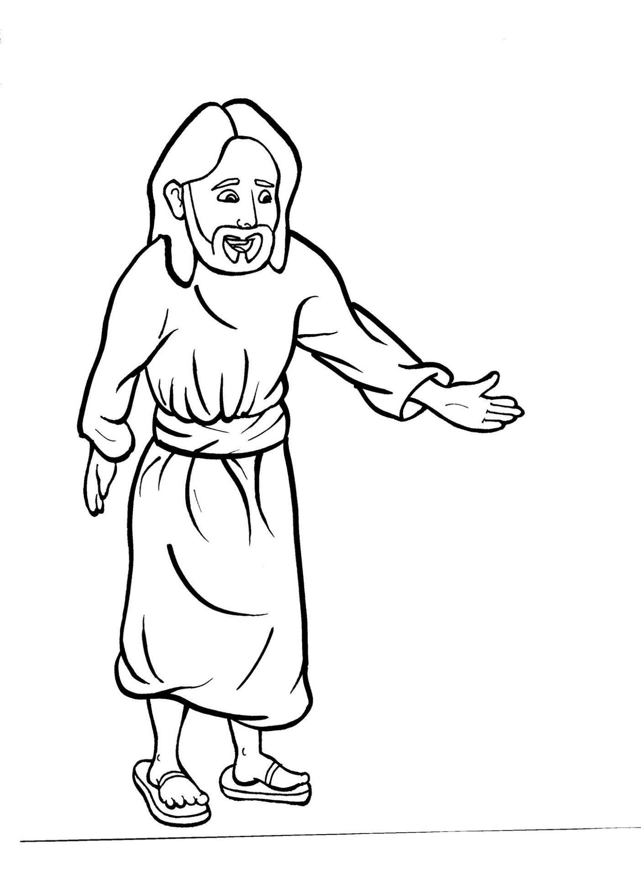
Part 2
42. Jesus Appears to His Disciples
New Words
Rule Breakers

Slide 2
Other Sounds – Soft C
ce, ci, cy make the soft sound
cent
city
fancy

Slide 3
peace

Slide 4
disciples

Slide 5
Other Sounds – Soft G
ge, gi, gy often make the soft sound
gentle
giant
gym

Slide 6
village
angel

Slide 7
Silent Letters
know
ghost
walk
talk

Slide 8
Contractions
The first word stays the same,
and the apostrophe takes the place
of the missing letters in the second word.
do
n’t
=
do
not

Slide 9
Contractions
didn’t = did not
it’s = it is

Slide 10
New Words
touched
women
ghost
disappeared

Slide 11
Rule Breakers
Words like these do not follow phonetic patterns.
to
you
said
could
two
f
from

Slide 12
is
two
of
the
to
his

Slide 13
has
you
was
were
who
their

Slide 14
said
come
eyes
doors
have
others

Slide 15
touch
together
women
hearts

Slide 16
full
they
among

