Slide 1
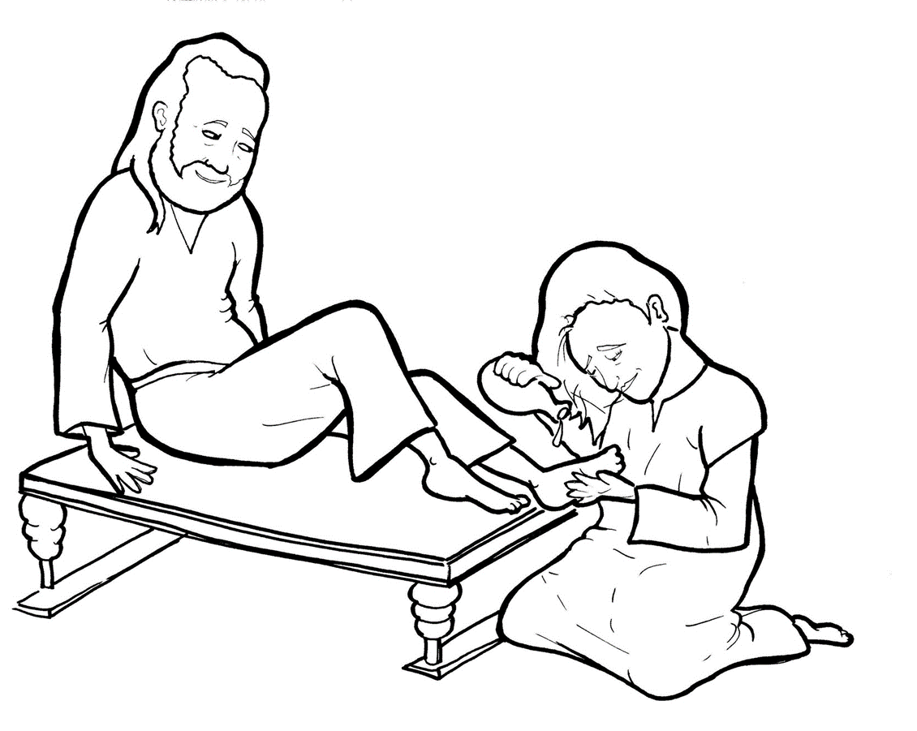
14. A Woman Washes Jesus’ Feet
Part 5
Vocabulary
Original Bible Story

Slide 2
Vocabulary

Slide 3
leper
(LEP -
er):
a person with leprosy,
which is a terrible skin disease

Slide 4
anoint
NOINT):
(a -
to pour oil over someone
for a godly job they will do

Slide 5
ointment
(OINT -ment):
healing oil

Slide 6
memorial
(mem – OR – i - al):
a way to remember a
special person or event

Slide 7
indignant
(in- DIG - nant):
angry about something unfair

Slide 8
Good News
(Good News):
story of Jesus’ life and
death to save us

Slide 9
A Woman Washes Jesus’ Feet
Mark 14:3-9
World English Bible (WEB)

Slide 10
While he was at Bethany, in the house of Simon the leper, as he sat at the table, a woman came having an alabaster jar of ointment of pure nard—very costly.

Slide 11
She broke the jar, and poured it over his head.

Slide 12
But there were some who were indignant among themselves, saying, “Why has this ointment been wasted?

Slide 13
For this might have been sold for more than three hundred denarii, and given to the poor.”

Slide 14
So they grumbled against her.
But Jesus said, “Leave her alone. Why do you trouble her? She has done a good work for me.

Slide 15
For you always have the poor with you, and whenever you want to, you can do them good; but you will not have always have me.

Slide 16
She has done what she could. She has anointed my body beforehand for the burying.

Slide 17
Most certainly I tell you, wherever this Good News may be preached throughout the whole world,

Slide 18
that which this woman has done will also be spoken of for a memorial of her.”

