Slide 1

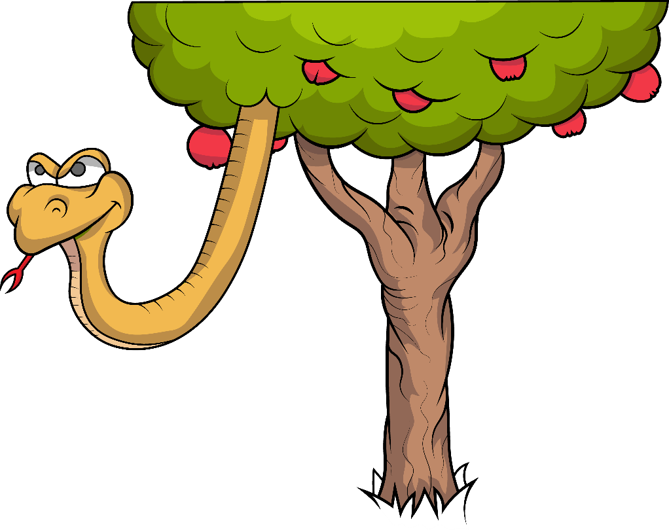
1.3 Song:
The Big Fib

Slide 2
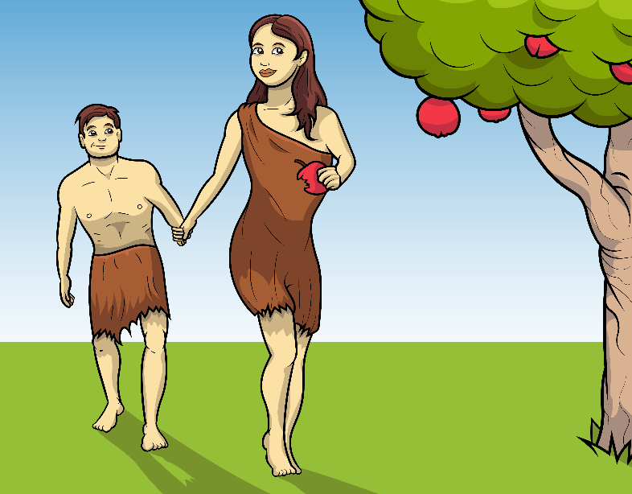
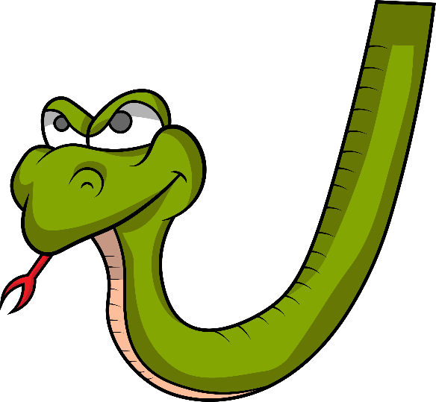
The sneaky snake said a big, bad, fib.

Slide 3
“Hiss, hiss, hiss,” he said a fib.

Slide 4

“You will not die,”
came the lie.”

Slide 5
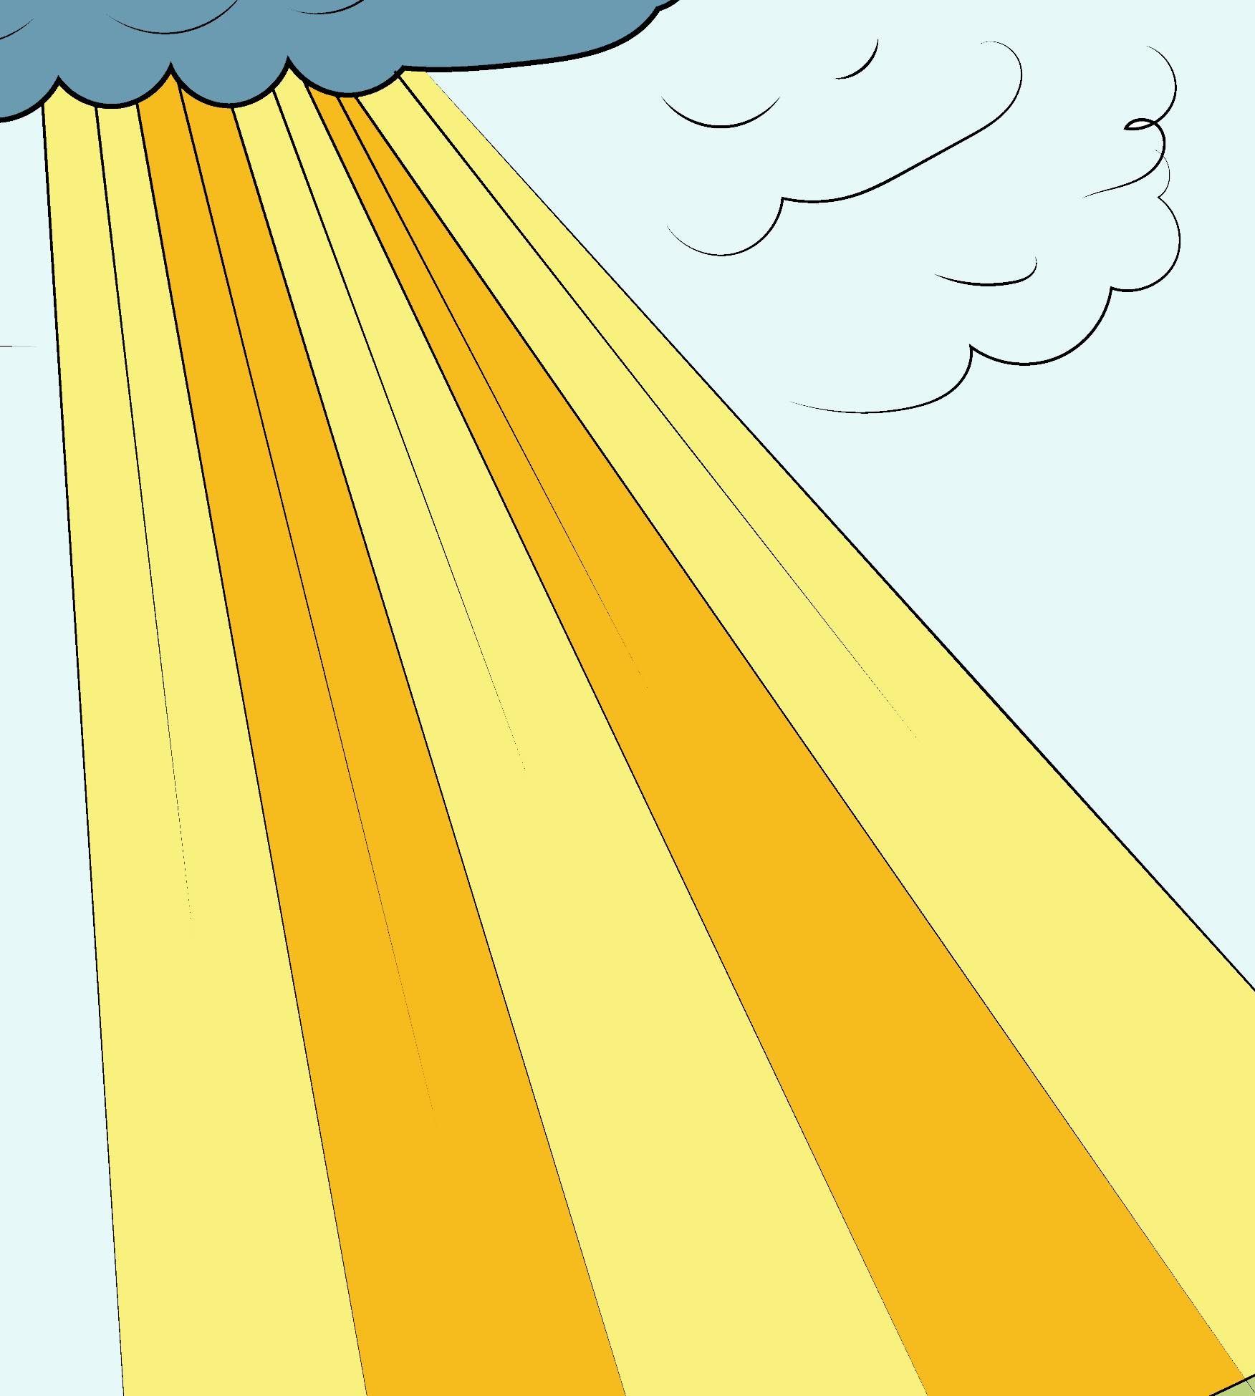
“If you bit it, you will be like God.”

Slide 6
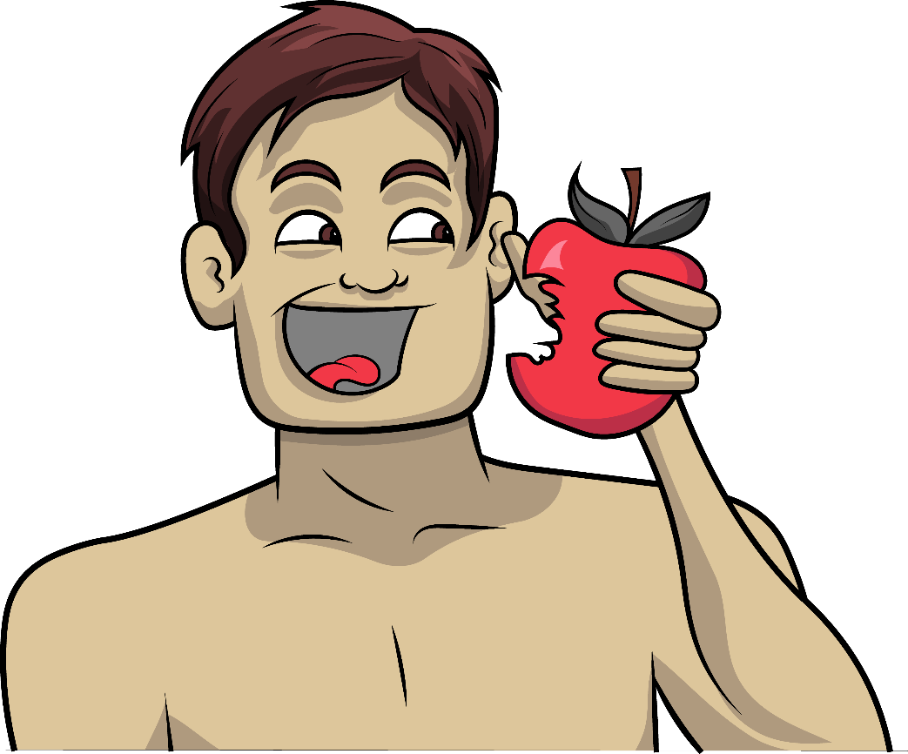
And so…
Adam did bad.

Slide 7

And so… Eve did bad.

Slide 8
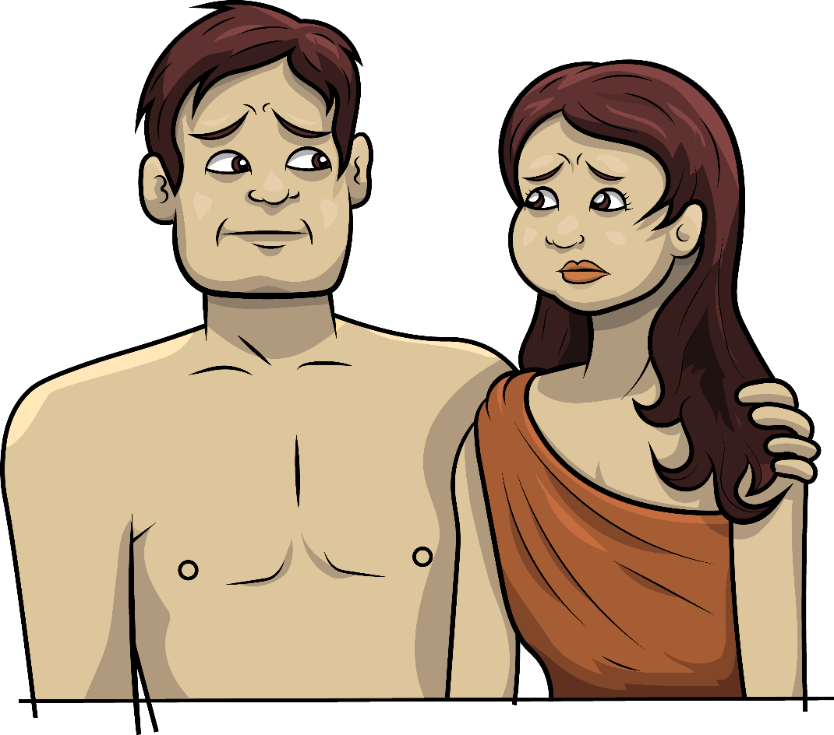
Adam and Eve bit and had an apple.

Slide 9
God said, “Did you eat it?”
?
?

Slide 10
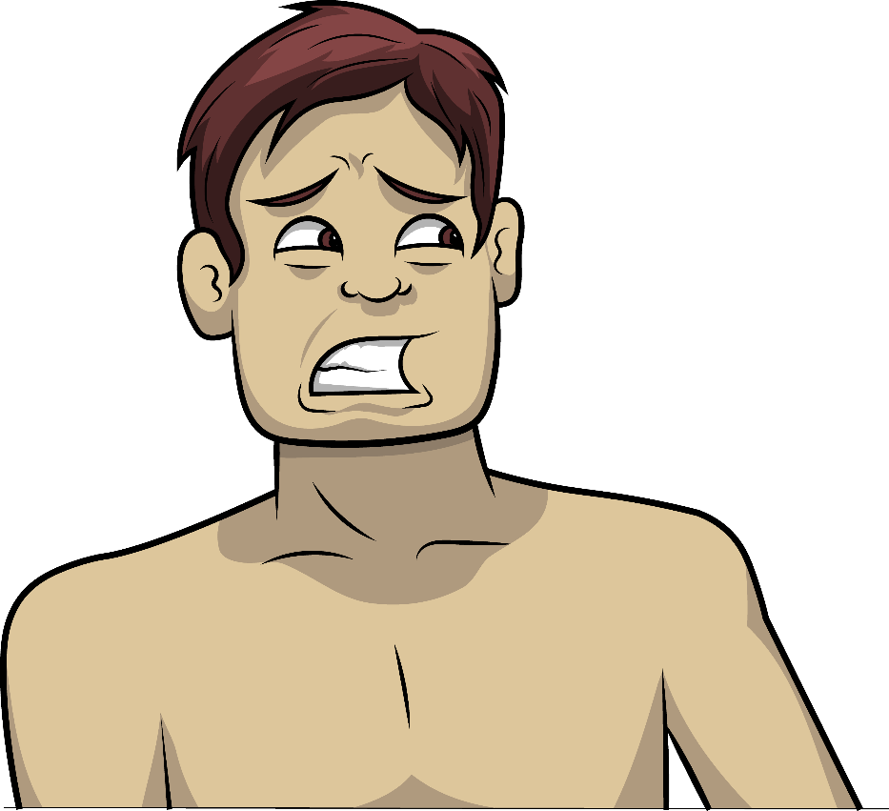
Adam said, “Yes, I did.
I did the sin.”

Slide 11
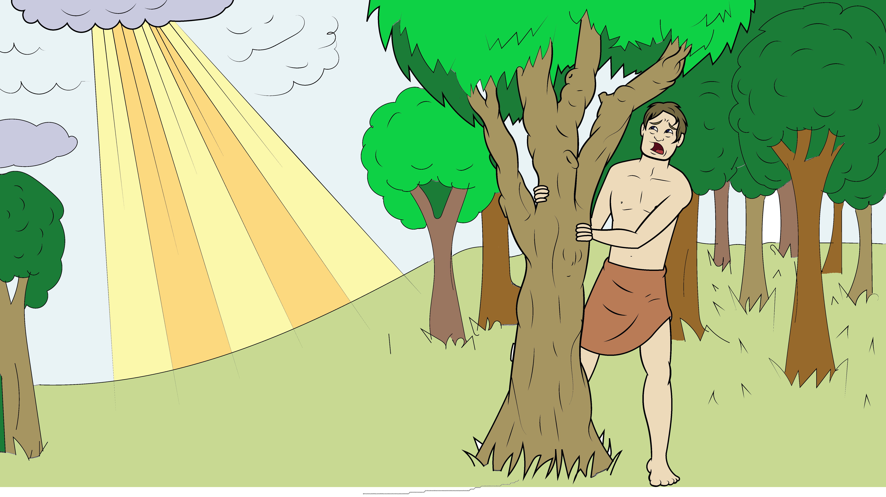
“I did the big sin and then I hid.”

Slide 12
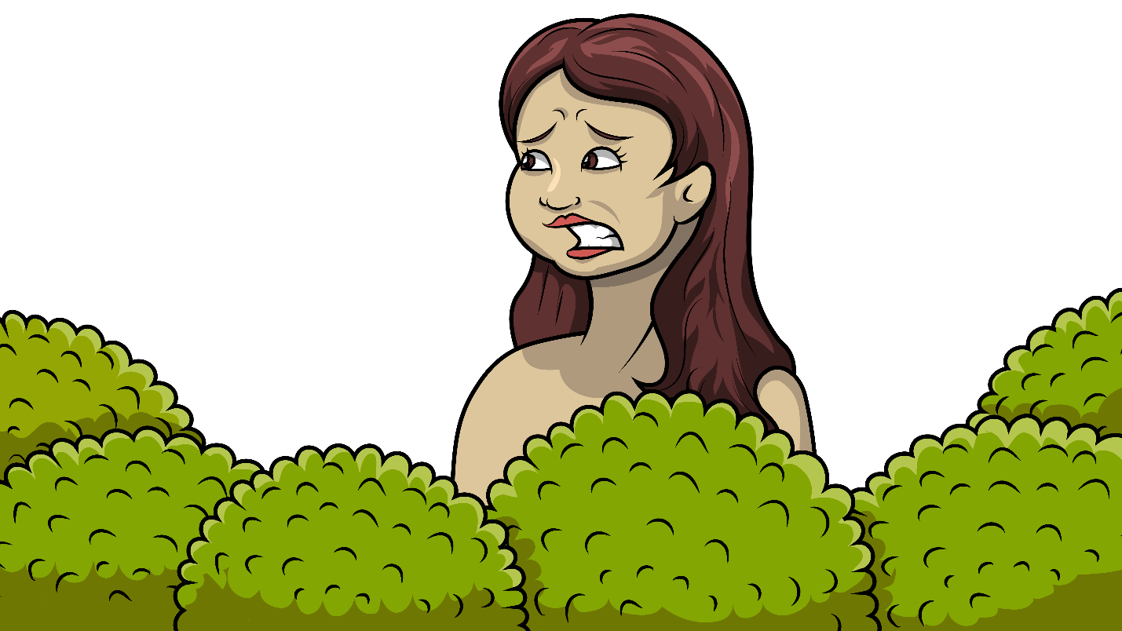
Eve said, “Yes, I did.
I did the sin.”

Slide 13
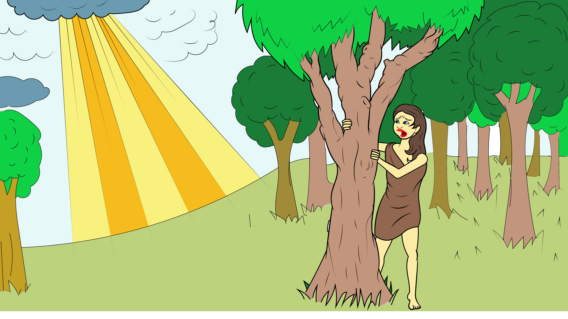
“I did the big sin and then I hid.”

Slide 14
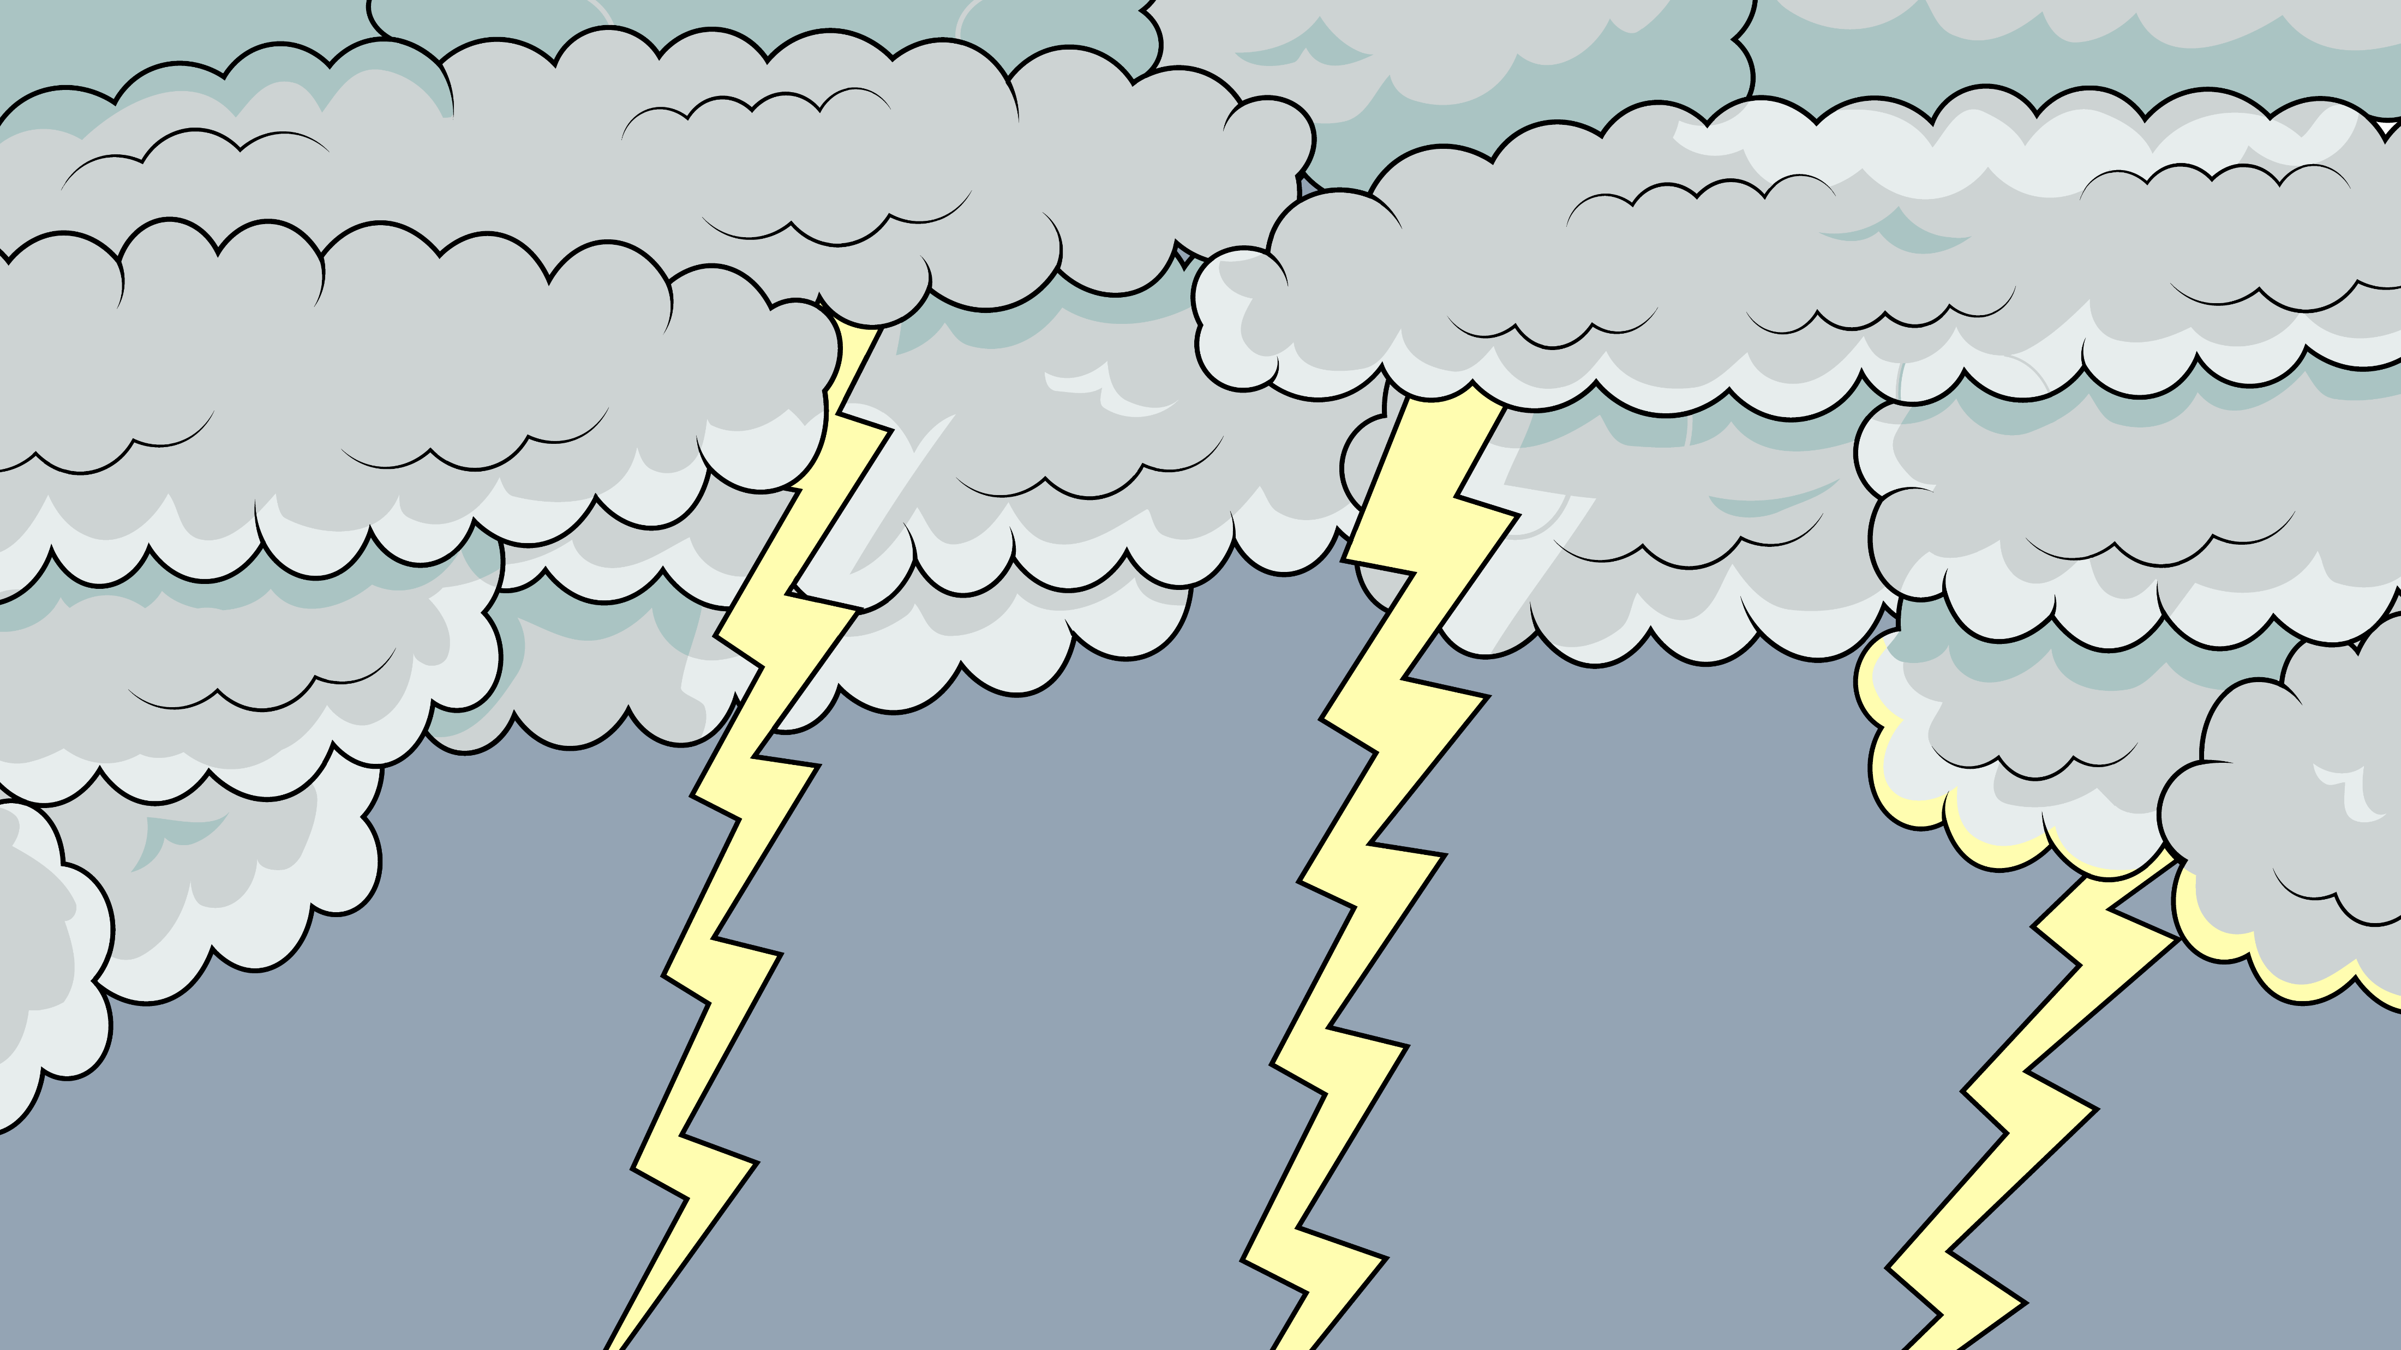
God was mad and sad.

Slide 15

Adam and Eve were bad and had to go.

Slide 16
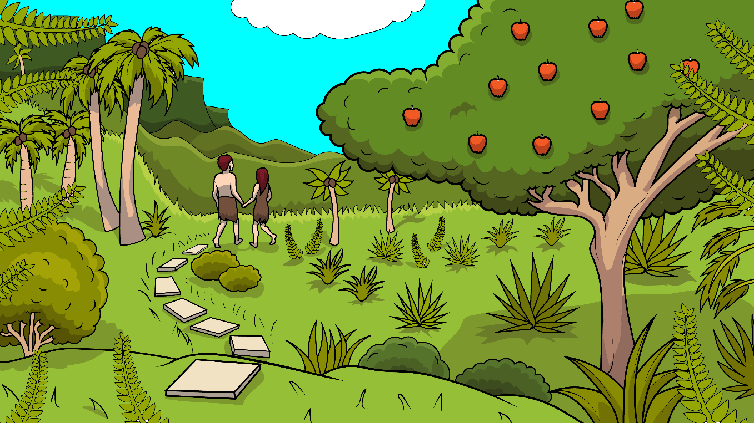
But first, God made a skin to get in.

Slide 17
And so, they left their garden home.

Slide 18
The sneaky snake said a big, bad, fib.

Slide 19
“Hiss, hiss, hiss,” he said a fib.

Slide 20
“You will not die,”
came the lie.

Slide 21
“If you bit it, you will be like God.”

Slide 22
And so… Adam did bad.

Slide 23
And so…
Eve did bad.

Slide 24
Adam and Eve bit and had an apple.

Slide 25
God said, “Did you eat it?”
?
?

Slide 26
Adam said, “Yes,
I did. I did the sin.”

Slide 27
“I did the big sin and then I hid.”

Slide 28
Eve said, “Yes, I did.
I did the sin.”

Slide 29
“I did the big sin and then I hid.”

Slide 30
God was mad and sad.

Slide 31
Adam and Eve were bad and had to go.

Slide 32
But first, God made a skin to get in.

Slide 33
And so, they left their garden home.

Slide 34
The End

Slide 35
Song lyrics and melody: Carol Hale
Song arrangements and singer: Steffi VornBerger
Illustrations: Ivan Mader
Power Point arrangements: Steve March
www.EasyReadEnglish.com
www.EZReadEnglish.org/lower-levels

