Slide 1

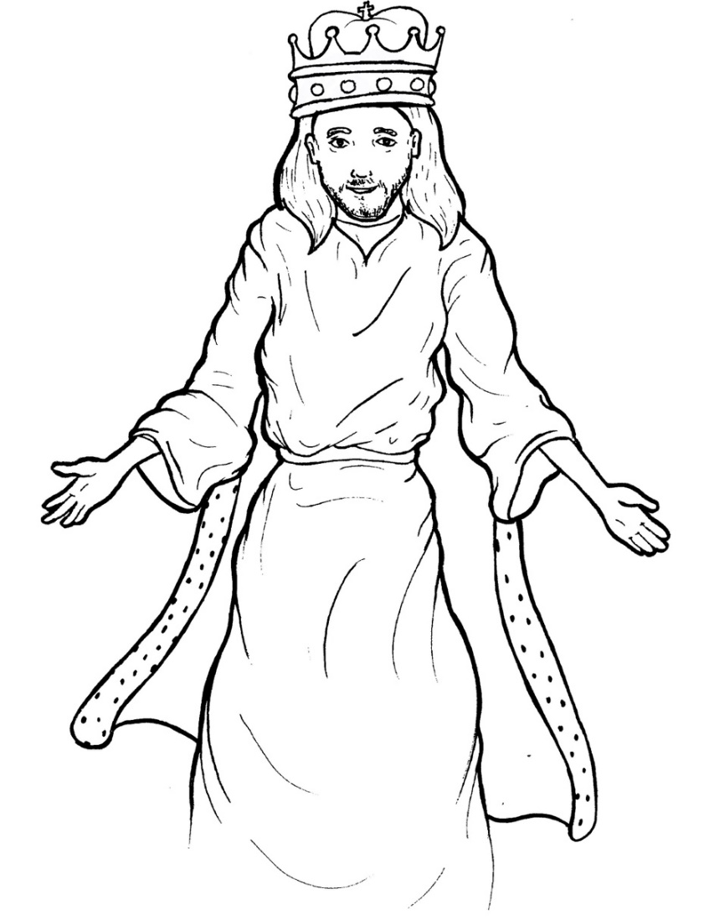
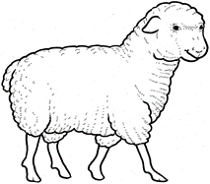
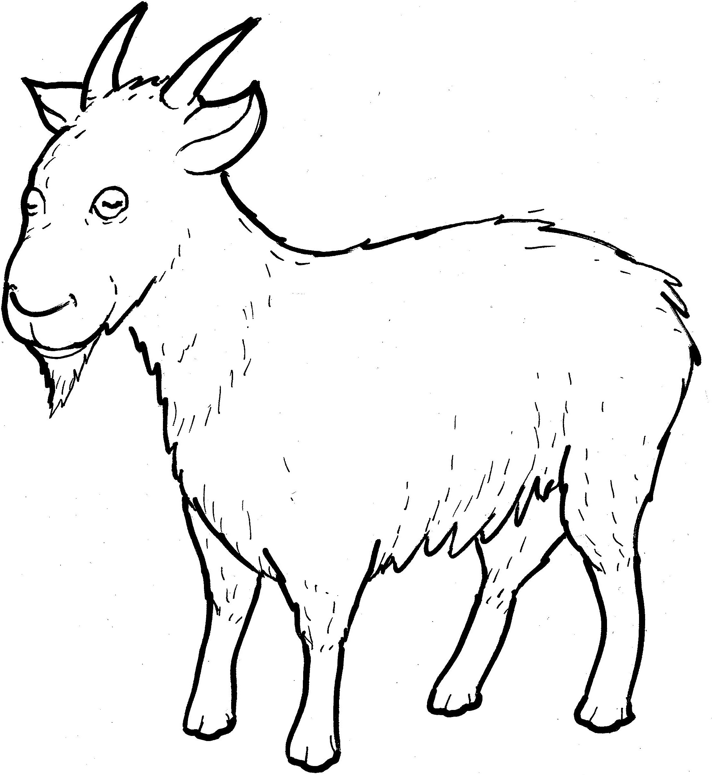
Part 3
27. The Sheep and Goats
Syllable Divisions

Slide 2

Dividing Words
Into Syllables

Slide 3
Rabbit Words
When you see two consonants
between two vowels,
divide between the consonants.
ra it
bb
rab bit

Slide 4
shep herd
shepherd

Slide 5
real ly
really

Slide 6
Tiger Words
When you see one consonant
between two vowels,
divide after the first vowel.
Try this pattern first.
ti er
g
ti ger

Slide 7
re turns
returns

Slide 8
Je sus
Jesus

Slide 9
Camel Words
When you see one consonant
between two vowels,
divide after the first consonant.
Try this pattern second.
ca el
m
cam el

Slide 10
vis it
visit

Slide 11
for ev er
forever

Slide 12
pun ishment
punishment

Slide 13
pris on
prison

Slide 14
Hamster Words
When you see three consonants between two vowels,
divide after the first consonant.
ha
mst
er
ham ster

Slide 15
thir sty
thirsty

Slide 16

Foxes Suffixes
Focus on your base word.
fox es
fox es

Slide 17
blessed
blessed

Slide 18
helped
helped

Slide 19
punish ment
punishment

Slide 20
king dom
kingdom

Slide 21
strang er
stranger

Slide 22
thirst y
thirsty

Slide 23

Anteater Words
These compound words are made up of two smaller words.
ant
eater
1
2
ant eater

Slide 24
in to
into

Slide 25
with out
without

Slide 26
some thing
something

Slide 27
Other Syllable Divisions
Some words don’t fit so neatly
into standard syllable division patterns.

Slide 28
a way
away

Slide 29
ang els
angels

Slide 30
hung ry
hungry

