Slide 1
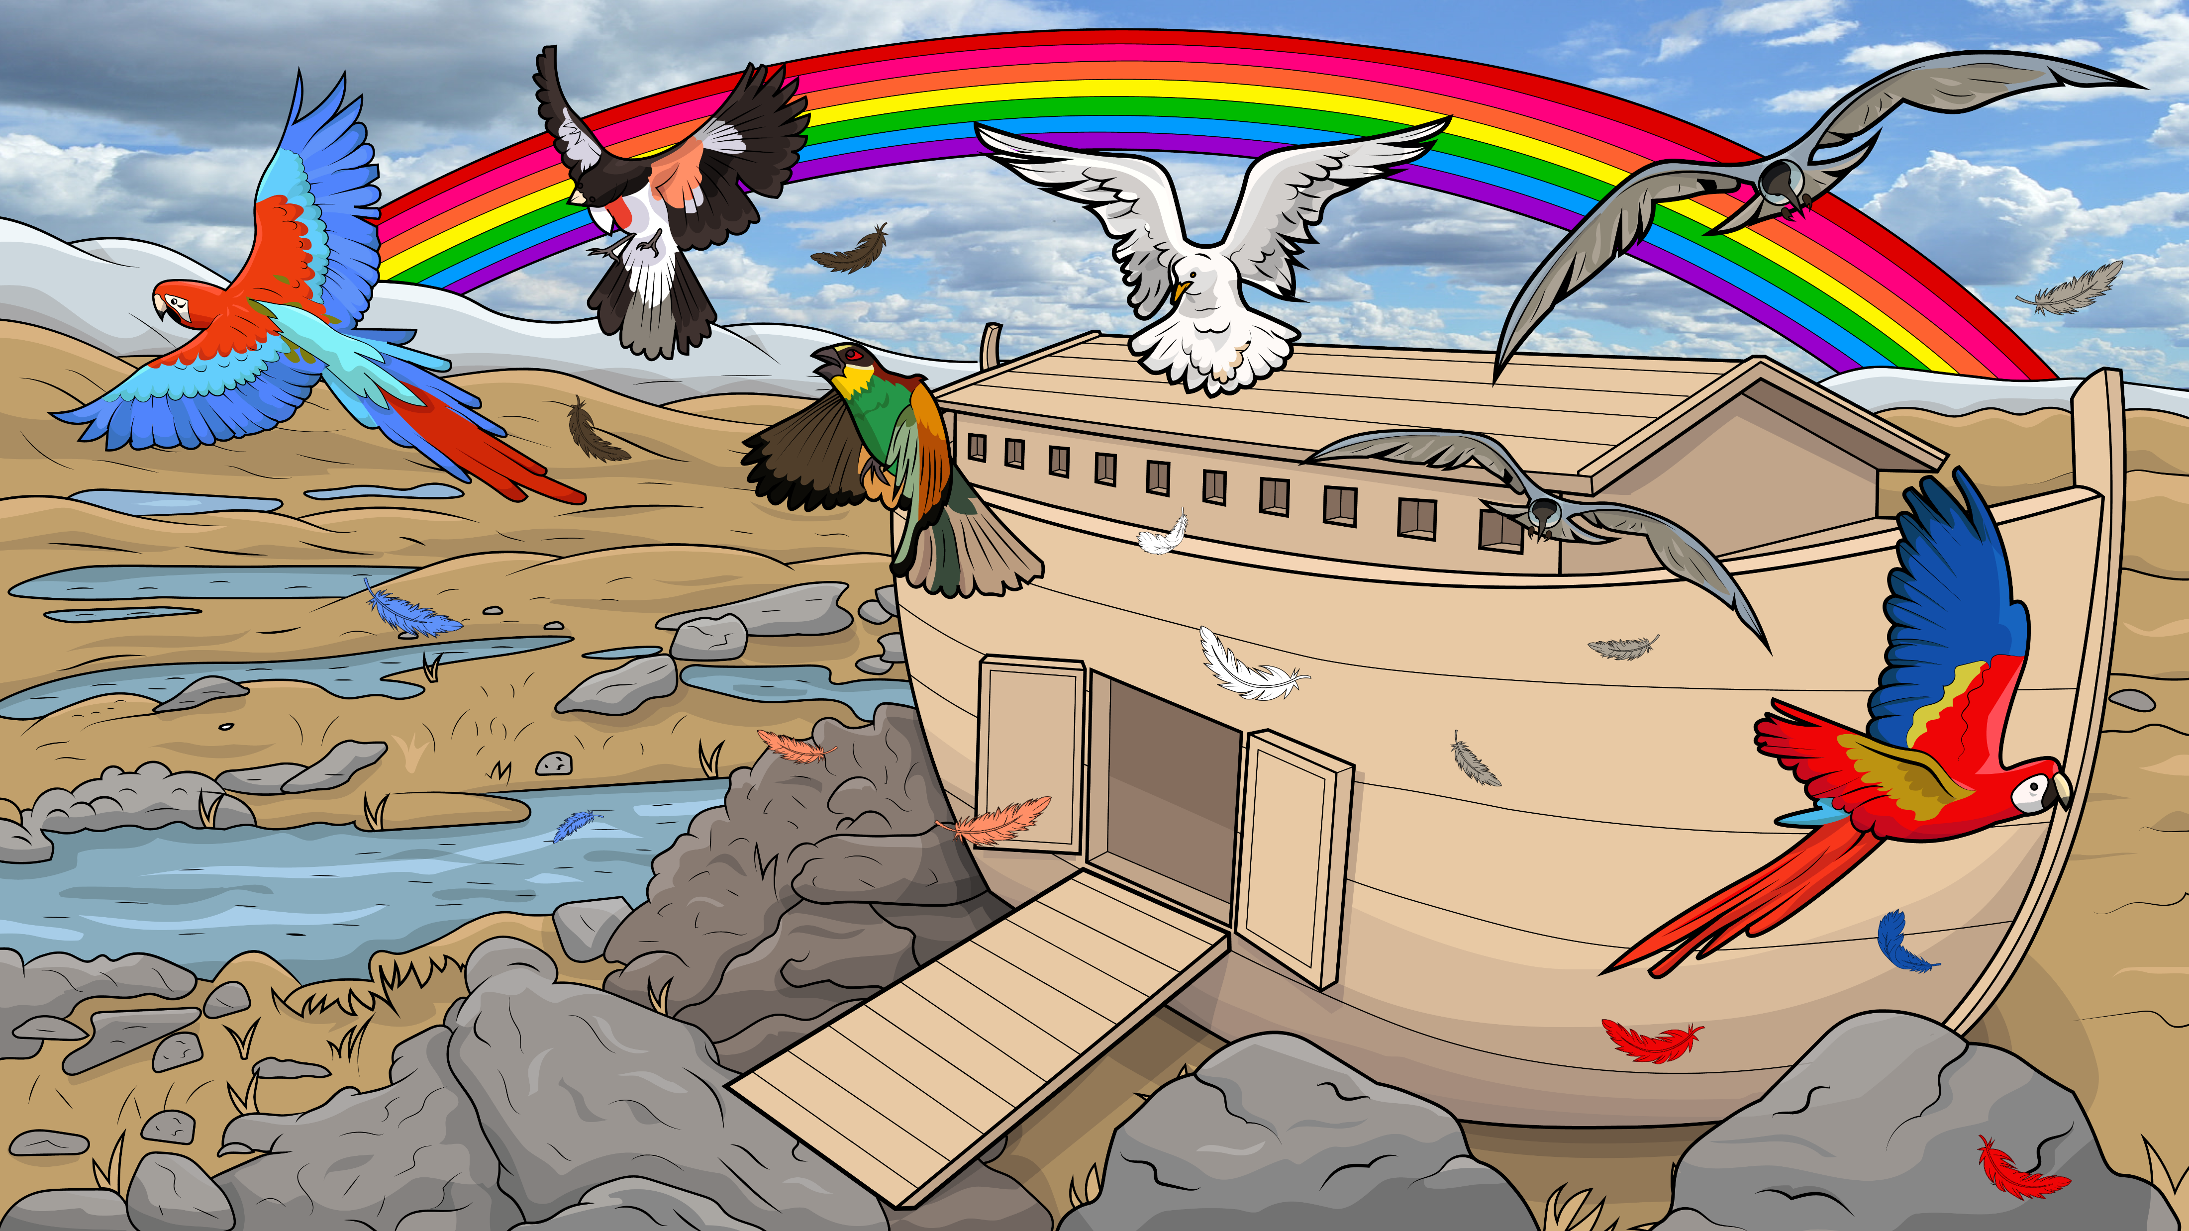
Song 1.11
Drip, Drop, Stomp, Clomp
Noah’s Ark, Part 3
Genesis 8
( Blends )
www.EasyReadEnglish.com

Slide 2
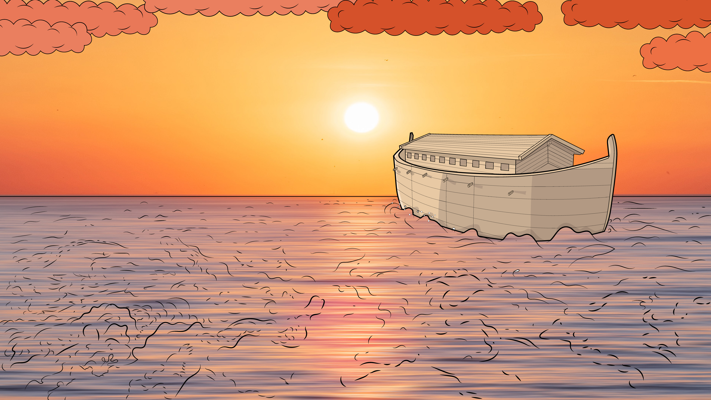
There was a ship
in the middle
of the sea

Slide 3
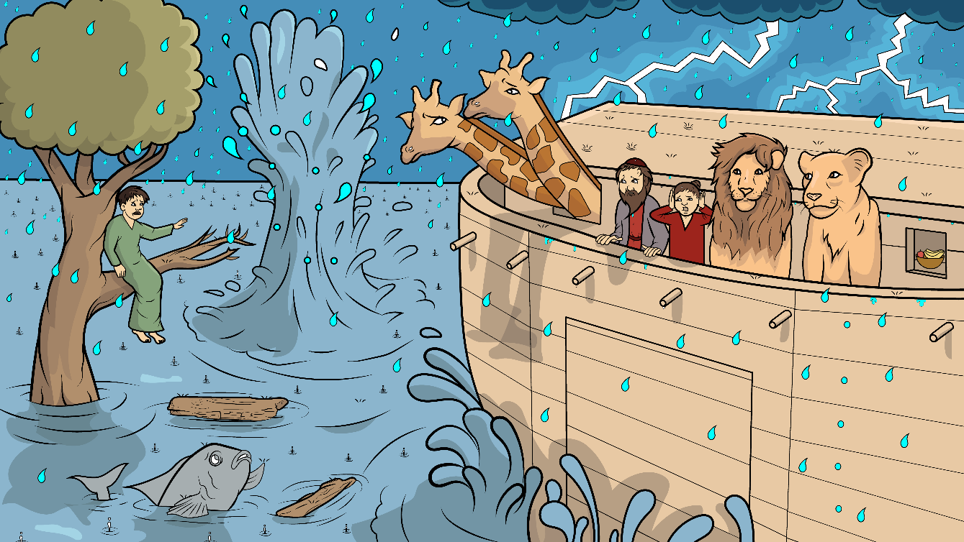
the funniest ship
that you ever did see.

Slide 4
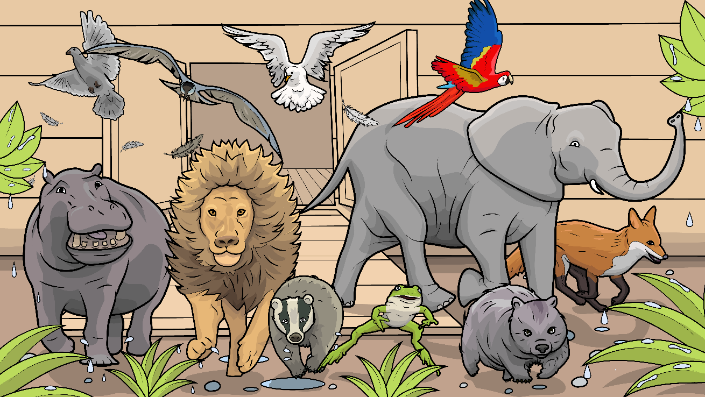
And the animals all went off that ship
and the animals all went off.

Slide 5
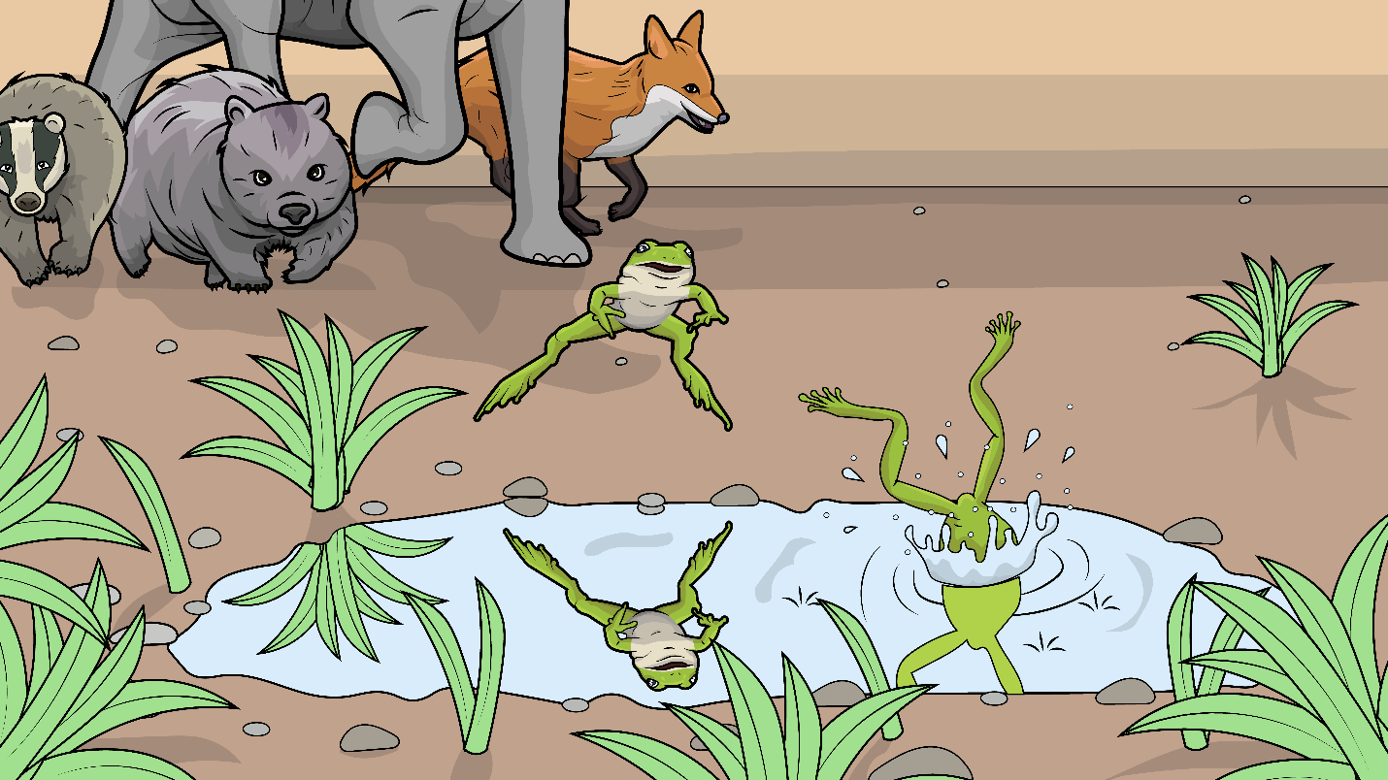
And off that ship, a frog did hop…

Slide 6
…with a flip and
a flop, that frog
did plop.

Slide 7
With a flip and a flop and plip and a plop,

Slide 8
…and the animals all went off that ship, and the animals all went off.

Slide 9
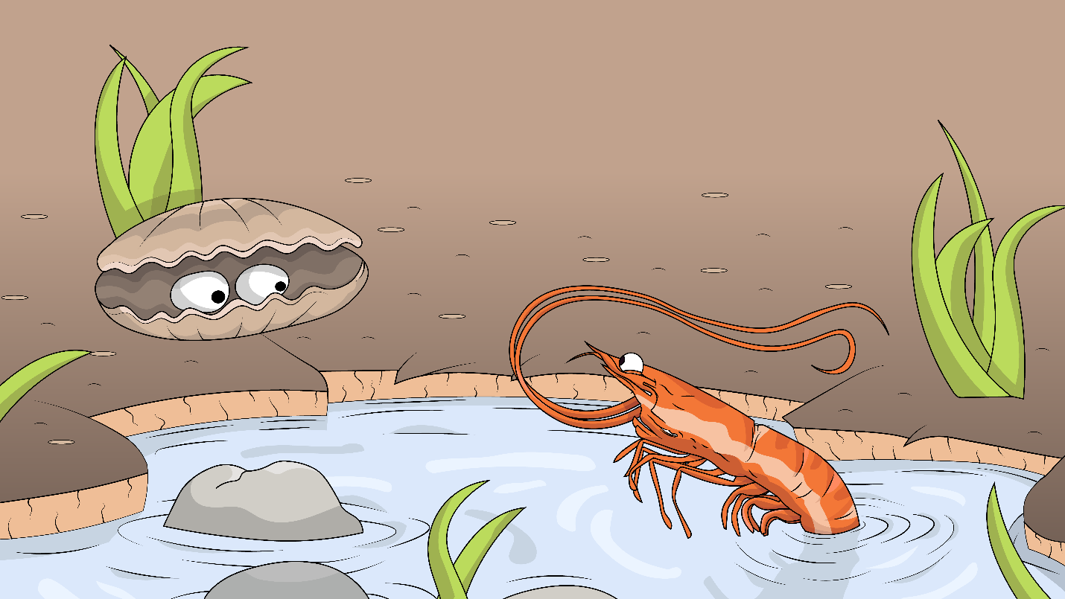
And off that ship,
went shrimps and clams.

Slide 10
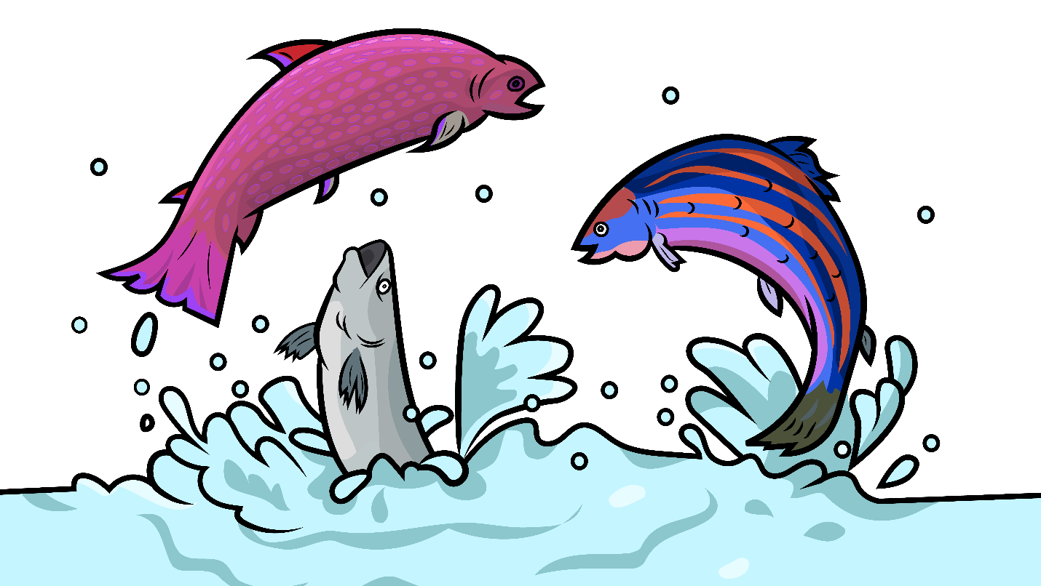
And fish did
swish,
then off they swam.

Slide 11
With a wish and swish and splash and a splish
and a flip and a flop and plip and a plop...

Slide 12
…and the animals all went off that ship, and the animals all went off.

Slide 13
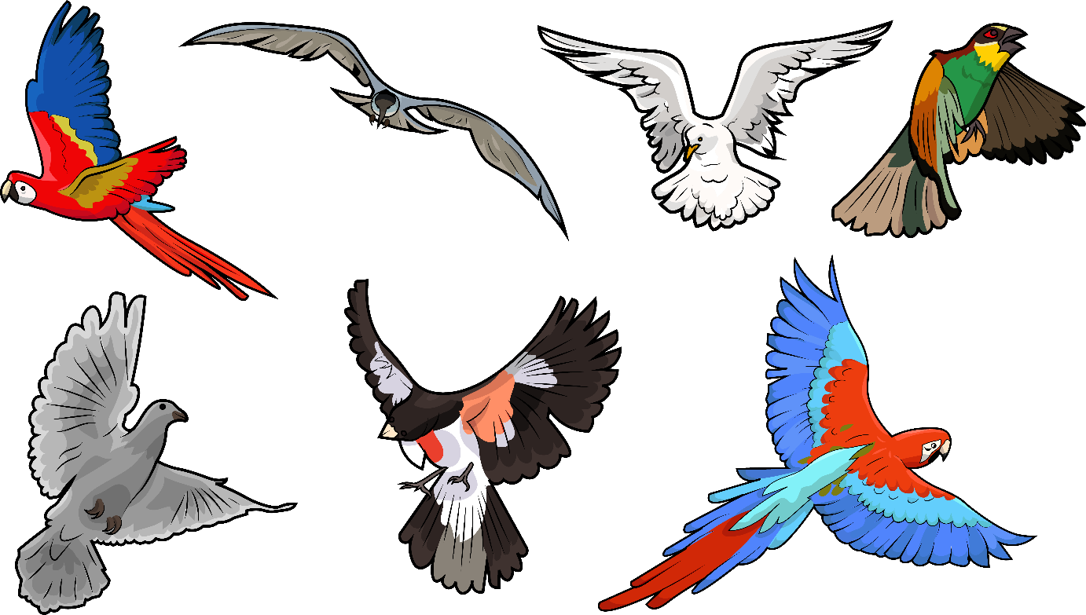
And off that ship, the birds did flap
with a
flip and a flap, their wings did clap.

Slide 14
With a flip and a flap and a clip and a clap
and a wish and swish and splash and a splish
and a flip and a flop and plip and a plop...

Slide 15
..and the animals all went off that ship, and the animals all went off.

Slide 16
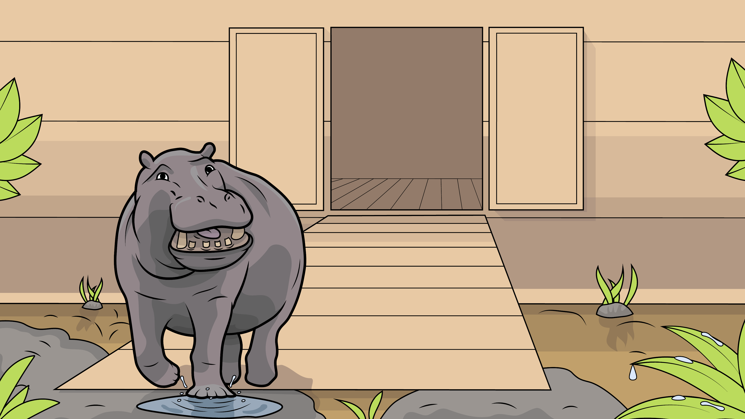
And off that ship, hippo did stomp…

Slide 17
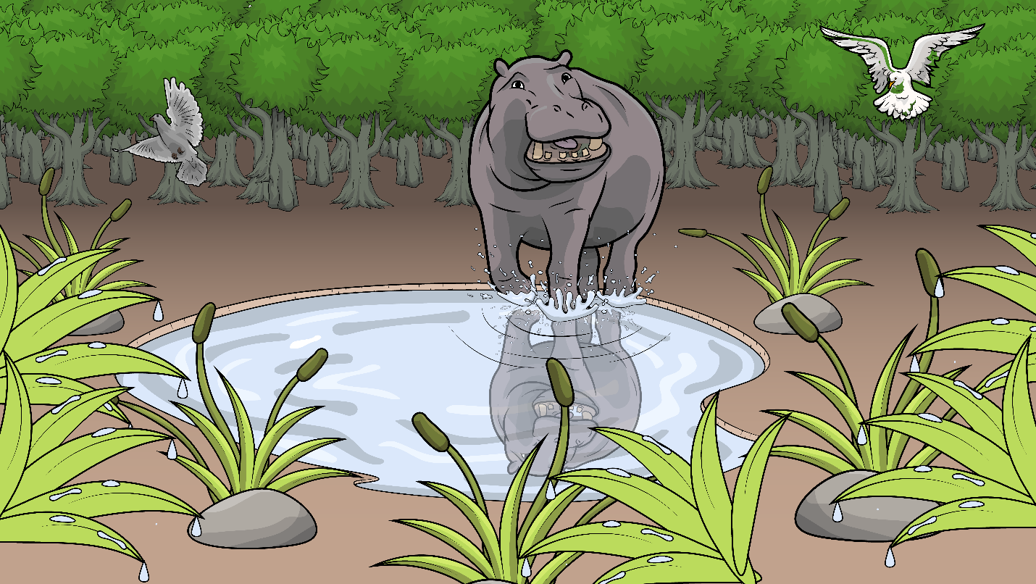
with a stomp and a clomp,
he did tromp off.

Slide 18
With a stomp and a clomp and
a trump and a tromp
and a flip and a flap and a clip and a clap
and a wish and swish and splash and a splish
and a flip and a flop and plip and a plop...

Slide 19
…and the animals all went off that ship, and the animals all went off.

Slide 20
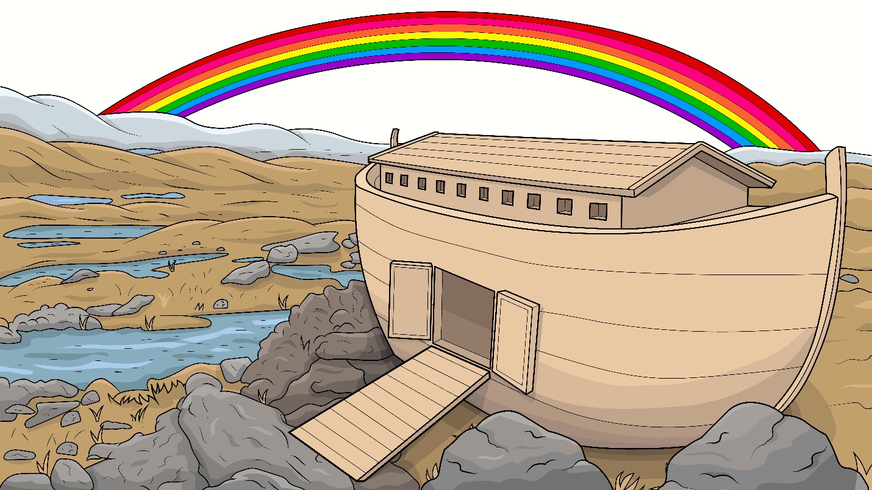
And in that sky, a rainbow grew
with green and pink of every hue.
With a red and a blue and a yellow too,

Slide 21
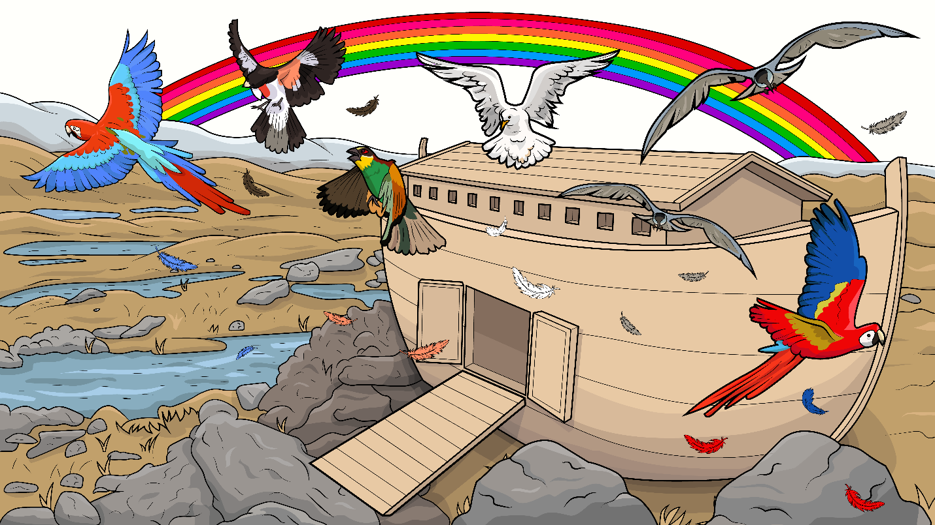
God put his rainbow in the sky.
And the animals all went home.
And the animals all went home.

Slide 22
The End

Slide 23
Song lyrics: Carol Hale
Song arrangements and singer: Steffi VornBerger
Illustrations: Ivan Mader
Power Point arrangements: Steve March
www.EasyReadEnglish.com
www.EZReadEnglish.org/Lower-Levels

Slide 24
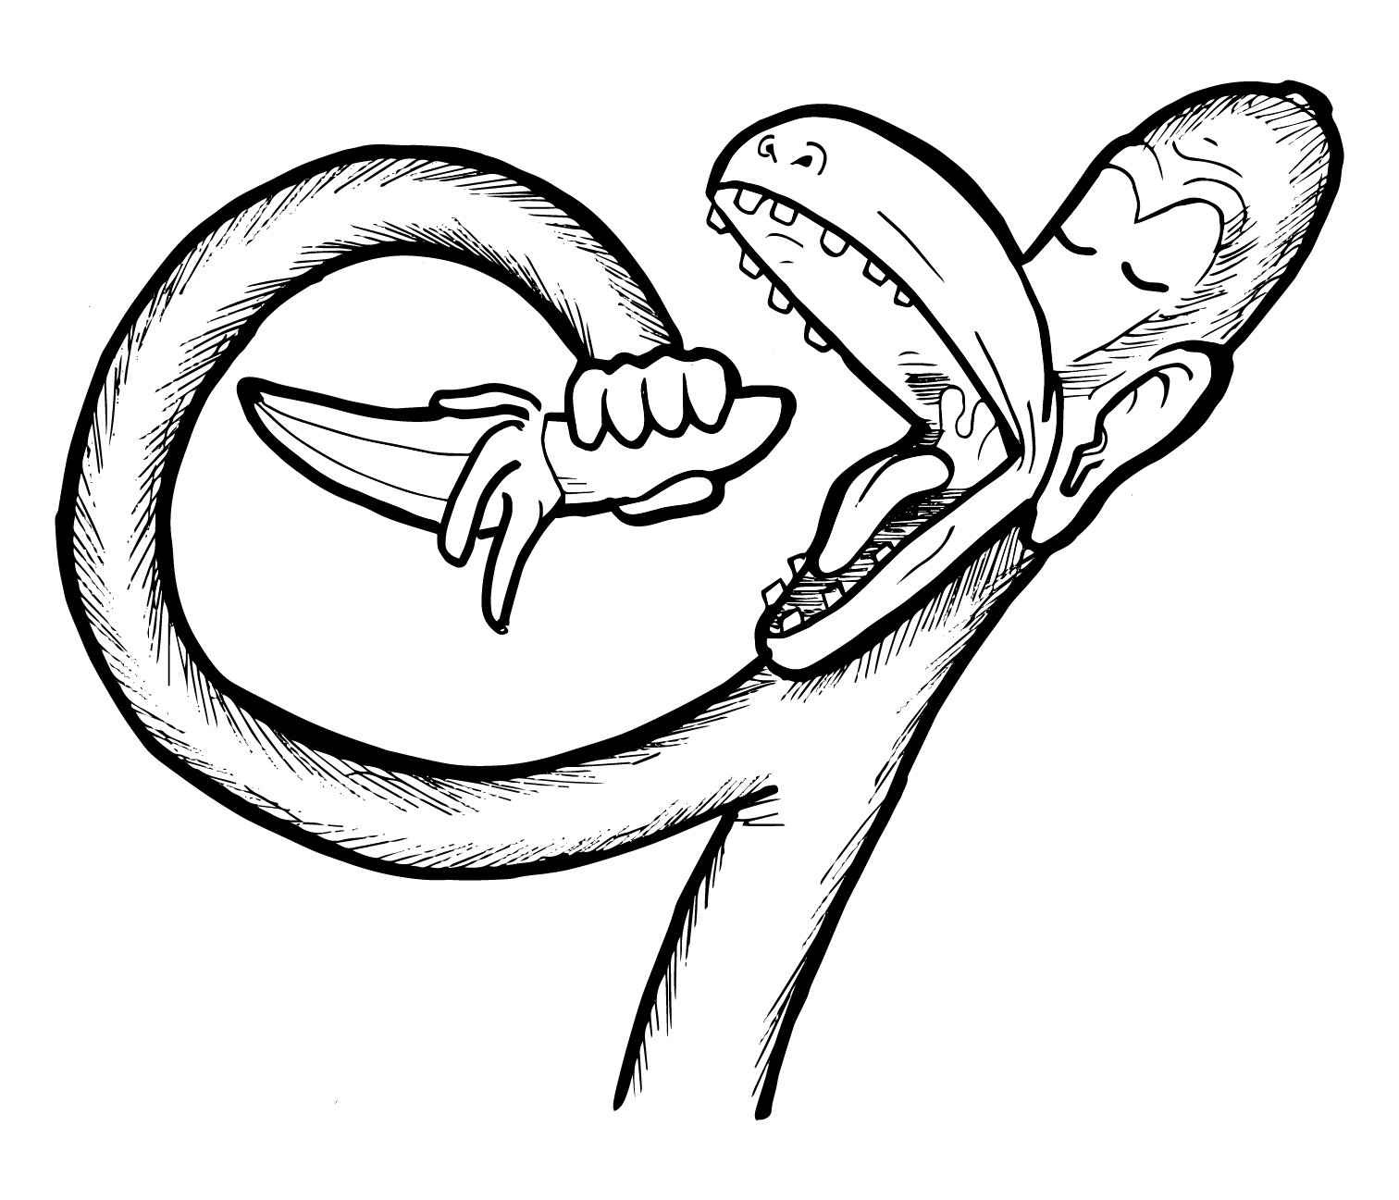
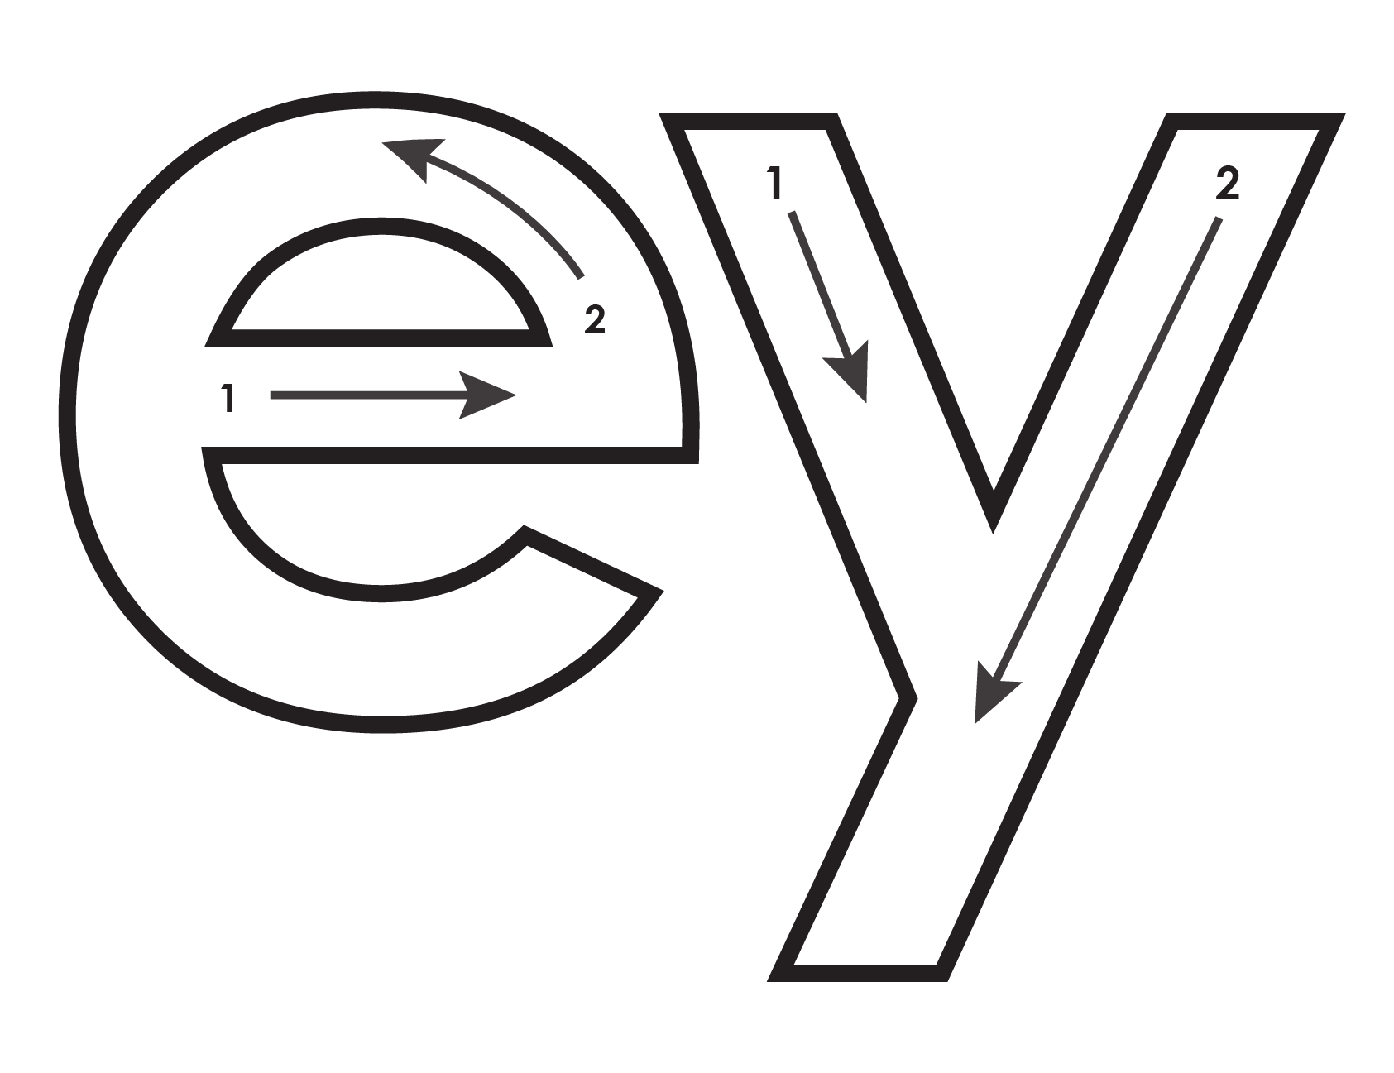
Another important teaching tool…
Easy Breezy Reading (https://www.easybreezyreading.com)
Designed to help new, struggling, and especially dyslexic learners, Easy Breezy Reading is broken up into Laughing Letters and Funny Phonograms. Both tools use illustrated patterns that mimic the shapes of the letters to give your students one more sense to link the phonetic sound of the letters.
ey
monk
Our scope and sequence matches Easy Read English Lower Levels. Progressing through the Easy Breezy Reading curriculum is sure to accelerate your students’ comprehension of the written English language.
You can procure Laughing Letters or Funny Phonograms through our website.
https://www.easybreezyreading.com/curriculum

