Slide 1

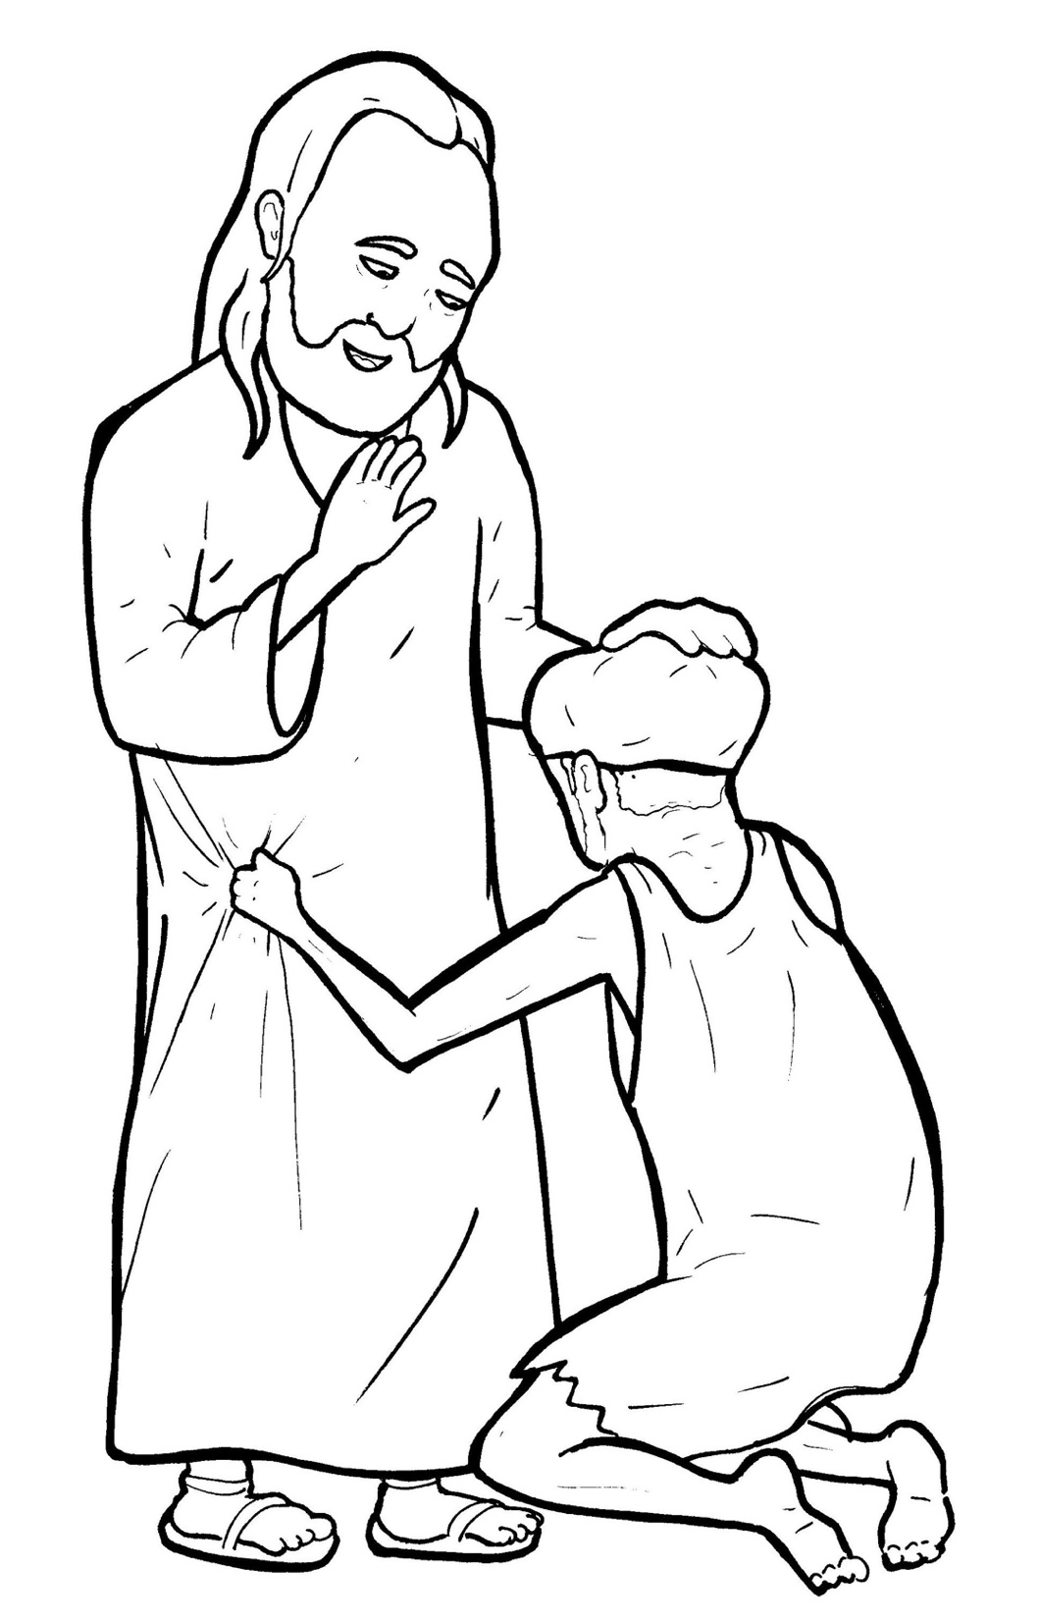
Part 4
31. A Blind Man Asks to See
Story in Easy Read English
Questions
Story in Phrases

Slide 2
Poor, blind Bartimaeus sat in
the dark by the road.

Slide 3
He could hear, but not see.

Slide 4
He heard many happy voices.

Slide 5
He felt hundreds of footsteps
running past him.

Slide 6
"What is happening?"
he cried out.

Slide 7
"Jesus is passing by,” people
told him.

Slide 8
Bartimaeus begged for help.
No one stopped.

Slide 9
So, he yelled out loud,
"Jesus, have mercy on me."

Slide 10
Some told him to be quiet.

Slide 11
But Bartimaeus shouted louder,
"Jesus, have mercy on me!"

Slide 12
A few people ran to
the blind man.

Slide 13
"Cheer up,” they said.

Slide 14
"Get on your feet.
Jesus is calling you!"

Slide 15
Bartimaeus jumped up.

Slide 16
He threw off his cloak.

Slide 17
He stumbled his way to Jesus.

Slide 18
"What do you want me to do
for you? "Jesus asked him.

Slide 19
"Lord,” the blind man said,
"I want to see."

Slide 20
"Go,” Jesus said,
“your faith has healed you."

Slide 21
Right away, Bartimaeus’ dark
world became bright!

Slide 22
He saw trees and birds.

Slide 23
He saw houses and men.

Slide 24
He saw women and children.

Slide 25
And he saw the kind face
of Jesus.

Slide 26
"Praise God!" he cried out.

Slide 27
All the people praised God
with him.

Slide 28
With his eyes wide open,
Bartimaeus followed Jesus
along the road.

Slide 29
Question 1
When Bartimaeus came to Jesus, what did Jesus say?

Slide 30
Question 2
What did the blind man say?

Slide 31
Question 3
How does asking for healing show faith in Jesus?

Slide 32
Question 4
Ask and believe. If Jesus were to ask you, "What do you want me to do for you?" what would you say?

Slide 33
Prayer
Dear Jesus,
You can do anything. You made a blind man see. Help me ask and believe like Bartimaeus. I will ask. I will believe.
Amen

Slide 34
A Blind Man
Asks to See
Phrased for Fluency

Slide 35
Poor, blind Bartimaeus
sat in the dark
by the road.

Slide 36
He could hear,
but not see.

Slide 37
He heard
many happy voices.

Slide 38
He felt hundreds
of footsteps
running past him.

Slide 39
"What is happening?"
he cried out.

Slide 40
"Jesus
is passing by,"
people told him.

Slide 41
Bartimaeus begged
for help.
No one stopped.

Slide 42
So,
he yelled
out loud,
"Jesus,
have mercy
on me."

Slide 43
Some told him
to be quiet.

Slide 44
But Bartimaeus
shouted louder,
"Jesus,
have mercy on me!"

Slide 45
A few people
ran
to the blind man.
"Cheer up,”
they said.

Slide 46
"Get on
your feet.
Jesus
is calling you!"

Slide 47
Bartimaeus
jumped up.

Slide 48
He threw
off his cloak.

Slide 49
He stumbled his way
to Jesus.

Slide 50
"What do you
want me to do
for you?"
Jesus
asked him.

Slide 51
"Lord,”
the blind man said,
to see."
"I want

Slide 52
"Go,”
Jesus said,
"your faith
has healed you."

Slide 53
Right away,
Bartimaeus’
dark world
became bright!

Slide 54
He saw
trees and birds.

Slide 55
He saw
houses and men.

Slide 56
He saw
women and children.

Slide 57
And he saw
the kind face
of Jesus.

Slide 58
"Praise God!"
he cried out.

Slide 59
All the people
praised God
with him.

Slide 60
With his eyes
wide open,
Bartimaeus
followed Jesus
along the road.

