Slide 1

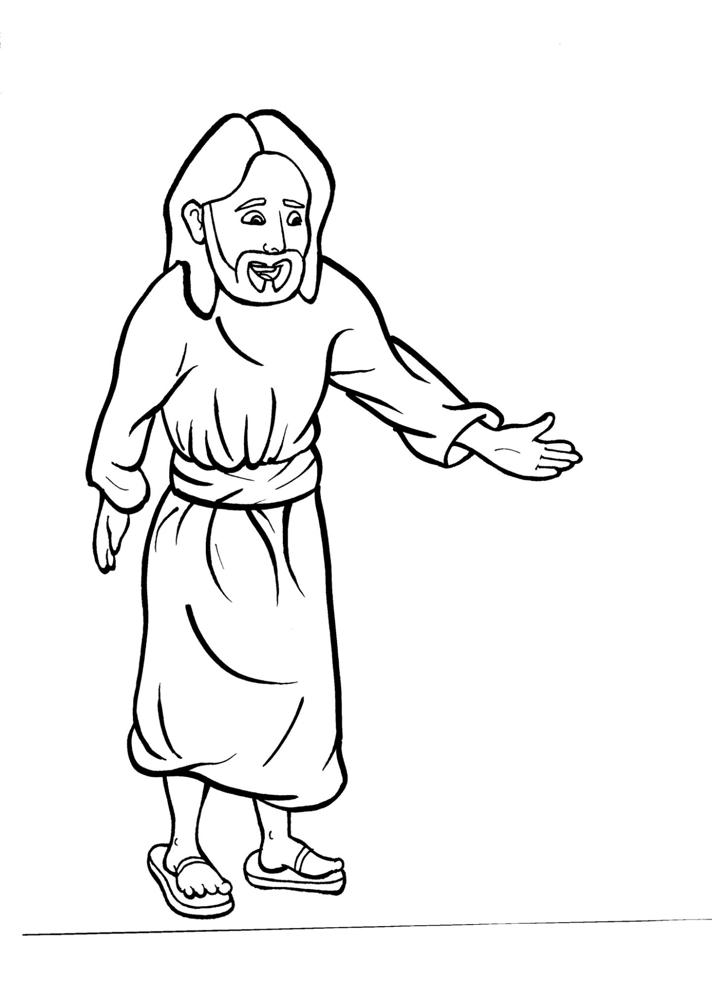
Part 3
42. Jesus Appears to His Disciples
Syllable Divisions

Slide 2

Dividing Words
Into Syllables

Slide 3
Rabbit Words
When you see two consonants
between two vowels,
divide between the consonants.
ra it
bb
rab bit

Slide 4
sil ly
silly

Slide 5
fol low
follow

Slide 6
vil lage
village

Slide 7
Tes ta ment
Testament

Slide 8
dis ap pear
disappear

Slide 9
dis ci ples
disciples

Slide 10
Mes si ah
Messiah

Slide 11
Tiger Words
When you see one consonant
between two vowels,
divide after the first vowel.
Try this pattern first.
ti er
g
ti ger

Slide 12
Je sus
Jesus

Slide 13
o pen
open

Slide 14
be lieve
believe

Slide 15
Camel Words
When you see one consonant
between two vowels,
divide after the first consonant.
Try this pattern second.
ca el
m
cam el

Slide 16
stor y
story

Slide 17
ris en
risen

Slide 18
heav y
heavy

Slide 19
dis ap pear
disappear

Slide 20
Turtle Words
When you see consonant-l-e,
count back three and divide.
tur
t
l
e
tur tle

Slide 21
dis ci ple
disciple

Slide 22

Anteater Words
These compound words are made up of two smaller words.
ant
eater
1
2
ant eater

Slide 23
with in
within

Slide 24

Foxes Suffixes
Focus on your base word.
fox es
fox es

Slide 25
go ing
going

Slide 26
cry ing
crying

Slide 27
talk ing
talking

Slide 28
burn ing
burning

Slide 29
pray ing
praying

Slide 30
follow ers
followers

Slide 31
sound ed
sounded

Slide 32
locked
locked

Slide 33
walked
walked

Slide 34
touched
touched

Slide 35
worshipped
worshipped

Slide 36
opened
opened

Slide 37
disappeared
disappeared

Slide 38
Hamster Words
When you see three consonants between two vowels,
divide after the first consonant.
ha
mst
er
ham ster

Slide 39
wor shipped
worshipped

Slide 40
Other Syllable Divisions
Some words don’t fit so neatly
into standard syllable division patterns.

Slide 41
a live
alive

Slide 42
ap pear
appear

Slide 43
a maze
amaze

Slide 44
a long
along

Slide 45
a mong
among

Slide 46
Tes ta ment
Testament

