Slide 1
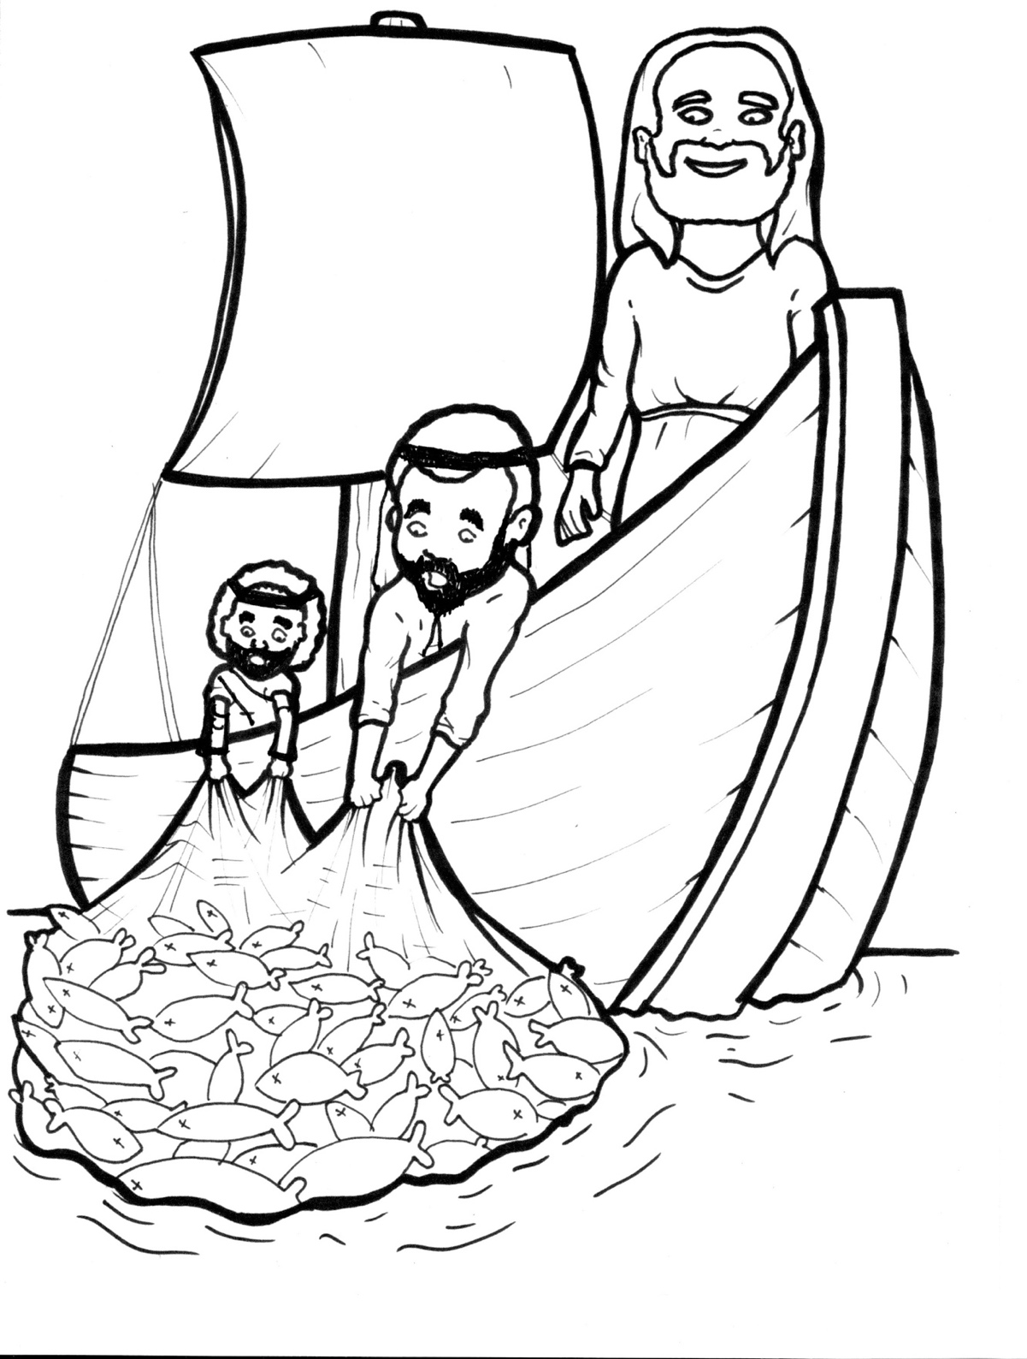
16. Jesus Commands Fish
Part 4
Story in Easy Read English
Questions
Story in Phrases

Slide 2
The moon sparkled on the dark lake.

Slide 3
Simon Peter threw a net into the water.

Slide 4
James and John pulled it into the boat.

Slide 5
Not one fish was in the net.

Slide 6
Sigh. Throw, splash, pull … sigh.

Slide 7
They finally gave up.

Slide 8
On the shore, James and John washed the empty nets.

Slide 9
Why a crowd so early in the morning?

Slide 10
Jesus was there!

Slide 11
He said to Simon, “Go back to the deep water.

Slide 12
Put down your nets for a catch.”

Slide 13
“Master, we did not catch a fish all night,” Simon said. “But, I will obey.”

Slide 14
They went back out.

Slide 15
Under the sea… fish swam from the south.

Slide 16
Sardines raced from the north.

Slide 17
Barbels wiggled from the west.

Slide 18
Silver fins flashed from the east.

Slide 19
The water bubbled with scales and tails.

Slide 20
Hundreds of fish jumped with joy into the nets.

Slide 21
“Our nets are breaking!” James said with a laugh.

Slide 22
Two boats were so full, they began to sink!

Slide 23
Simon fell down at the feet of Jesus.

Slide 24
“Go away from me, Lord,” he said. “I am a sinful man.”

Slide 25
“Don’t be afraid,” Jesus said. “From now on, you will fish for people.”

Slide 26
The men left all they had and followed Jesus.

Slide 27
Question 1
What miracle did Jesus perform?

Slide 28
Question 2
How did a full net of fish change the lives of the fishermen?

Slide 29
Question 3
All Christians are called to "fish for people." What does that mean?

Slide 30
Question 4
Who would you like to “catch” (bring into the kingdom of God)? How can you “fish” for this person?

Slide 31
Prayer
Dear King Jesus,
You are the Lord of the seas. You command fish and they obey you. I want to obey you and follow you. Will you help me “fish for people”? I want to bring these friends and family into the kingdom of God.
Amen

Slide 32
Jesus Commands Fish
(Phrased for Fluency)

Slide 33
The moon
sparkled
on the dark lake.

Slide 34
Simon Peter
threw a net
into the water.

Slide 35
James and John
pulled it
into the boat.

Slide 36
Not one fish
was in the net.

Slide 37
Sigh.
Throw, splash, pull ...
sigh.

Slide 38
They finally
gave up.

Slide 39
On the shore,
James and John
washed
the empty nets.

Slide 40
Why a crowd
so early
in the morning?

Slide 41
Jesus
was there!

Slide 42
He said to Simon,
“Go back
to the deep water.

Slide 43
Put down
your nets
for a catch."

Slide 44
"Master,
we did not catch
a fish all night,"
Simon said.
"But,
I will obey."

Slide 45
They went
back out.

Slide 46
Under the sea...
fish swam
from the south.

Slide 47
Sardines raced
from the north.

Slide 48
Barbels wiggled
from the west.

Slide 49
Silver fins flashed
from the east.

Slide 50
The water bubbled
with scales and tails.

Slide 51
Hundreds of fish
jumped with joy
into the nets.

Slide 52
"Our nets
are breaking!"
James said
with a laugh.

Slide 53
Two boats
were so full,
they began to sink!

Slide 54
Simon
fell down
at the feet
of Jesus.

Slide 55
"Go away from me,
Lord,"
he said.
"I am
a sinful man."

Slide 56
"Don't be afraid,"
Jesus said.
"From now on,
you will fish
for people."

Slide 57
The men left
all they had
and followed Jesus.

