Slide 1
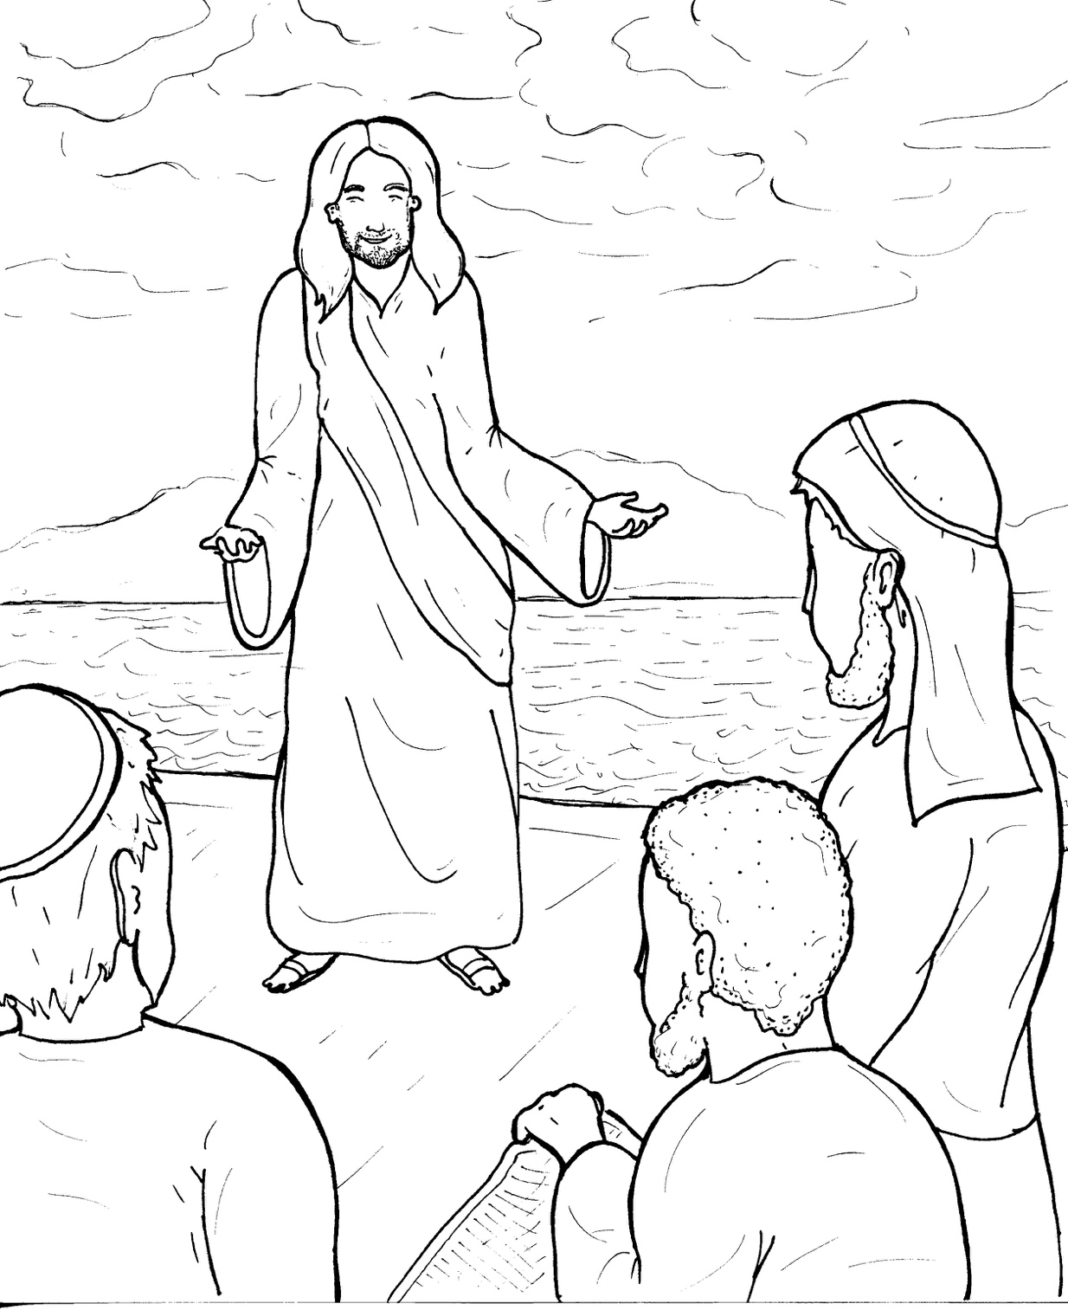
10. Jesus Calls Followers
Part 2
New Words
Rule Breakers

Slide 2
Other Sounds – Soft C
ce, ci, cy make the soft sound
cent
city
fancy

Slide 3
disciple

Slide 4
Other Sounds – Soft G
ge, gi, gy often make the soft sound
gentle
giant
gym

Slide 5
message

Slide 6
Silent Letters
Thomas
whole

Slide 7
New Words
disciples
Bartholomew
Thaddeus

Slide 8
Judas
Simon
evil spirits

Slide 9
Rule Breakers
These words do not follow phonetic patterns.
come
many

Slide 10
was
said
walking
yours
money
were

Slide 11
other
whole
brothers
full
once
into

Slide 12
they
their
from
two
love
also

