Slide 1
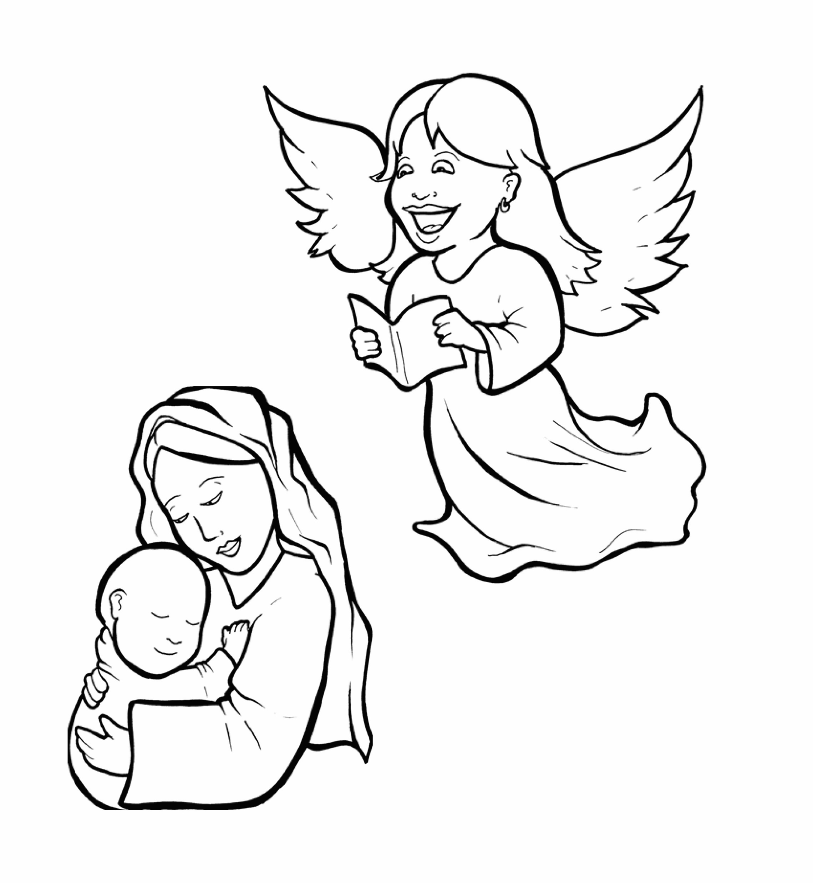
1.Will Mary Say Yes to God?
Part 2
New Words
Rule Breakers

Slide 2
Other Sounds – Soft C
ce, ci, cy make the soft sound
cent
city
fancy

Slide 3
rejoice

Slide 4
Other Sounds – Soft G
ge, gi, gy often make the soft sound
gentle
giant
gym

Slide 5
angel

Slide 6
Contractions
The first word stays the same,
and the apostrophe takes the place
of the missing letters in the second word.
do
n’t
=
do
not

Slide 7
New Words
Mary
Gabriel
obeyed
Spirit
married

Slide 8
Rule Breakers
These words do not follow
phonetic patterns.

Slide 9
his
of
are
were
to
you

Slide 10
your
son
says
said
the
they

Slide 11
obey
obeyed
have
love
loved
come

Slide 12
done
don't
both
nothing

