Slide 1
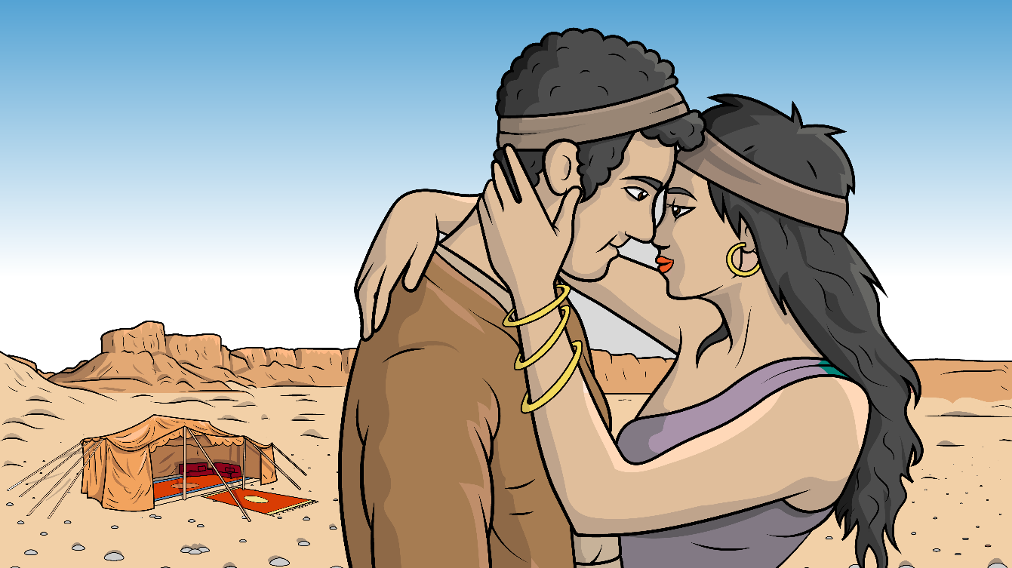
1.5 Song: You Must Just Trust
(Genesis 24)

Slide 2
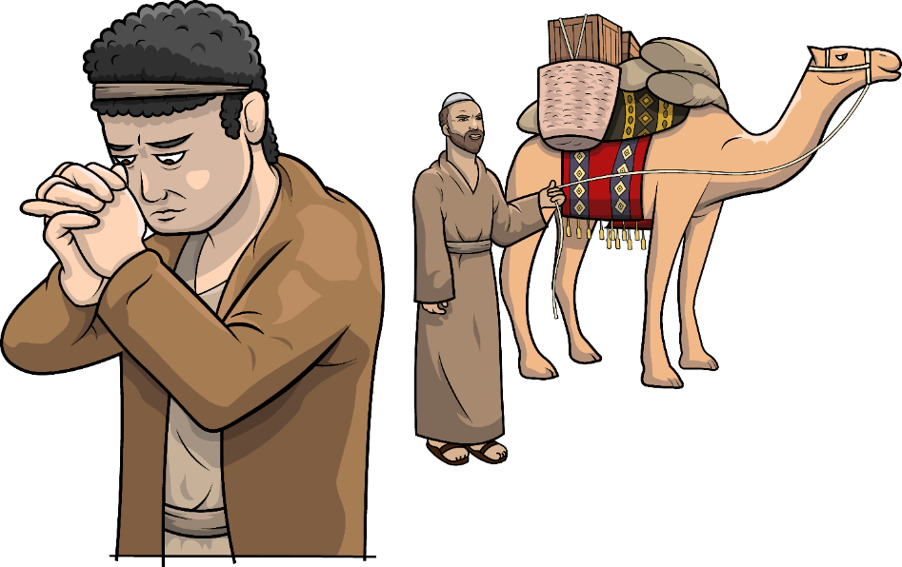
I must just trust God for my wife.

Slide 3
I must just trust God for my wife.

Slide 4
She will
be my wife for life.

Slide 5
She will be my wife for life.

Slide 6
I must just trust God for my wife.

Slide 7
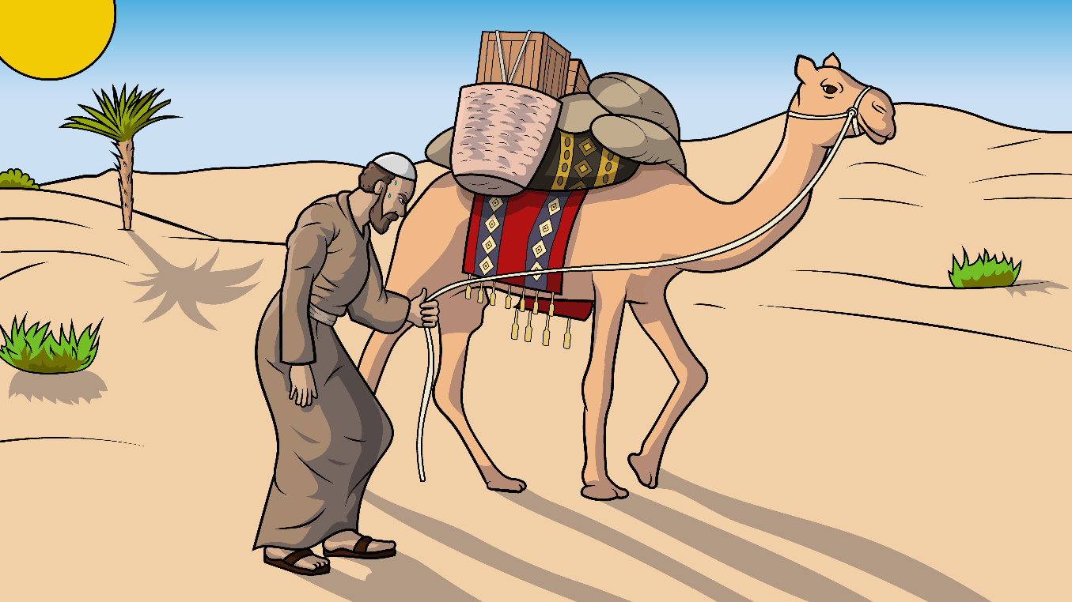
The sun
was up –
huff, huff, huff, puff.

Slide 8
The sun
was up –
huff, huff, huff, puff.

Slide 9
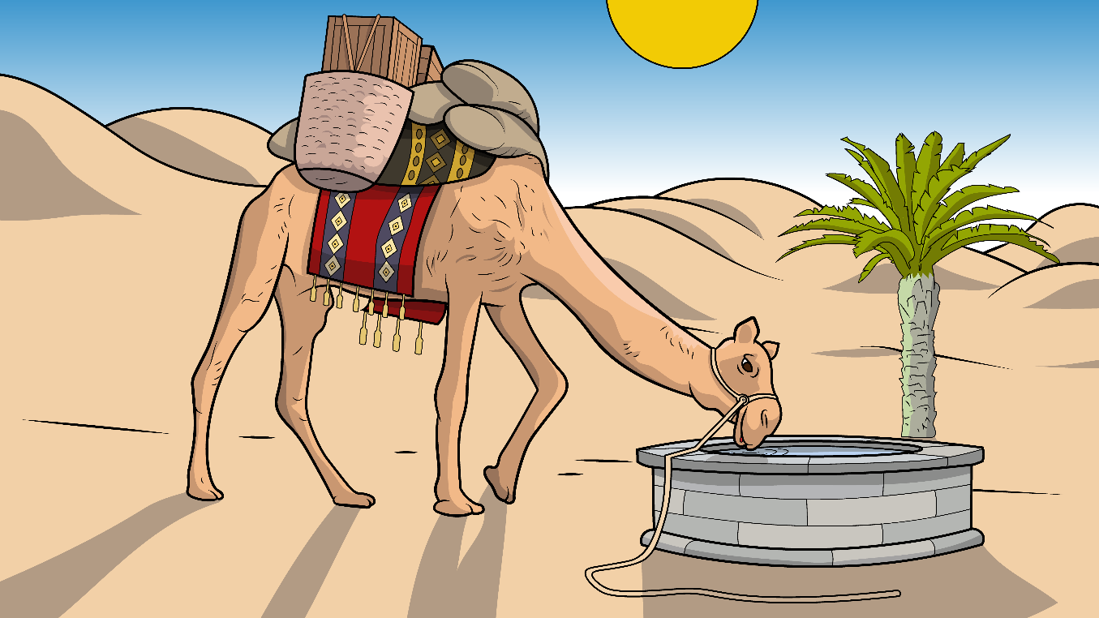
Let me drink
and my
camels too.

Slide 10
Let me drink
and my
camels too.

Slide 11
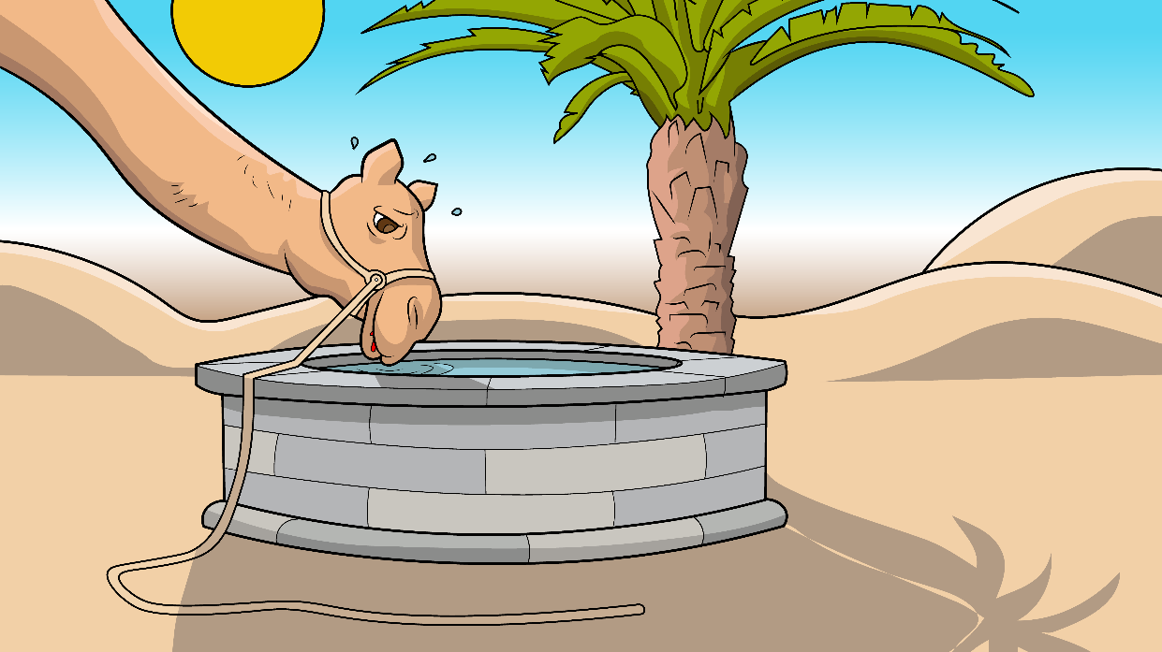
The sun
was up –
huff, huff, huff, puff.

Slide 12
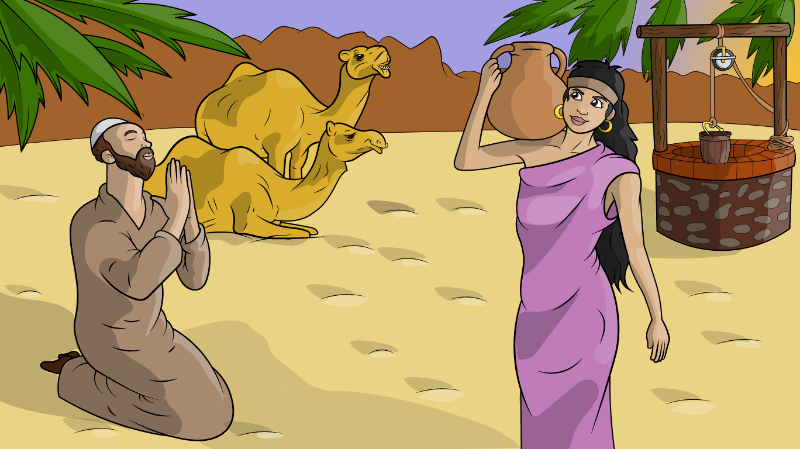
He met Rebekah
at the well.

Slide 13
He met Rebekah
at the well.

Slide 14
She got a
jug and
lug, lug,
tug.

Slide 15
She got a jug and lug, lug, tug.

Slide 16
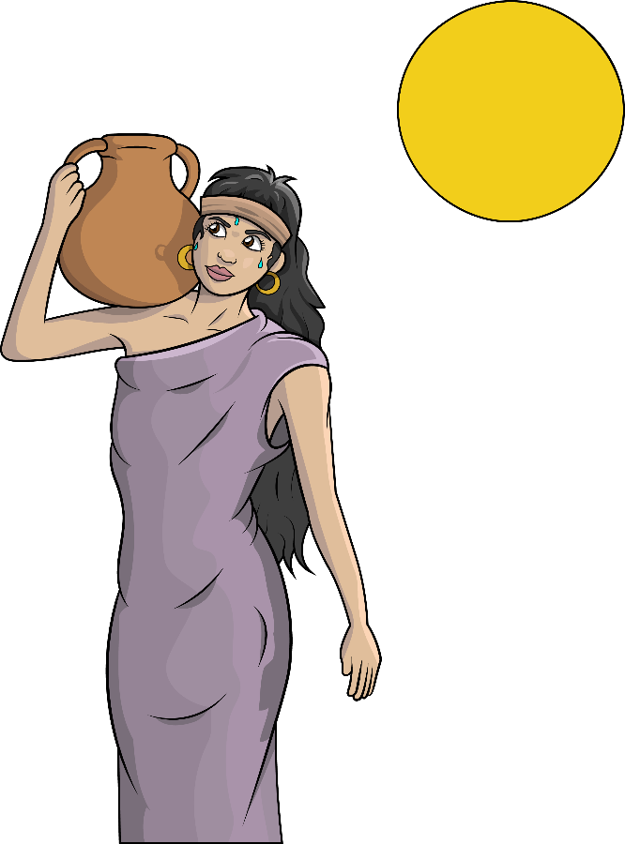
He met Rebekah
at the well.

Slide 17
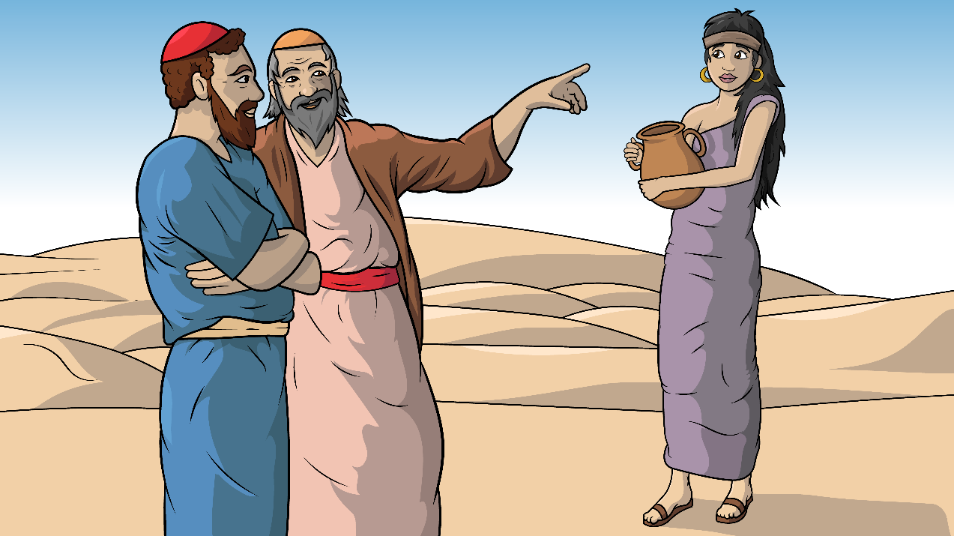
Will you trust God and go with him?

Slide 18
Will you trust God and go with him?

Slide 19
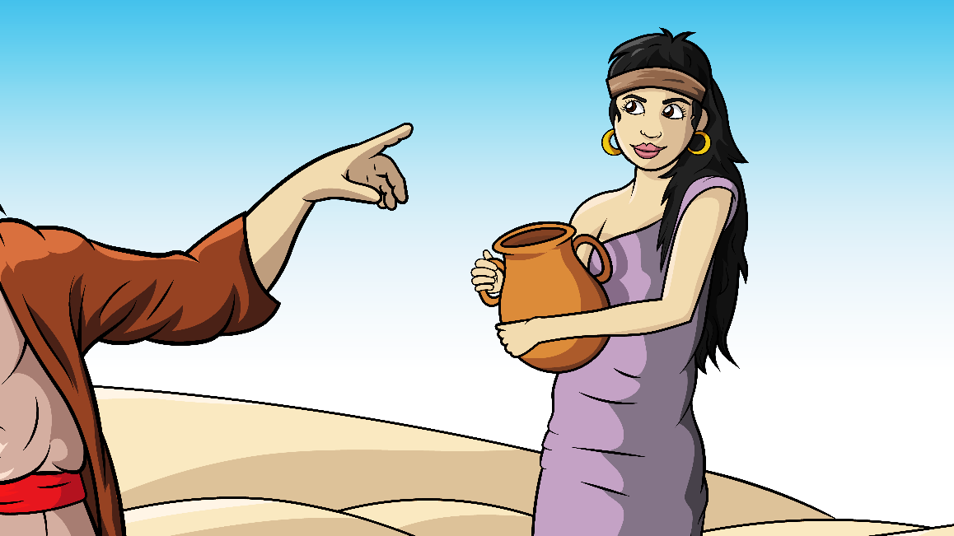
Yes, I must
just trust,
trust, trust.

Slide 20
Yes, I must
just
trust,
trust,
trust.

Slide 21
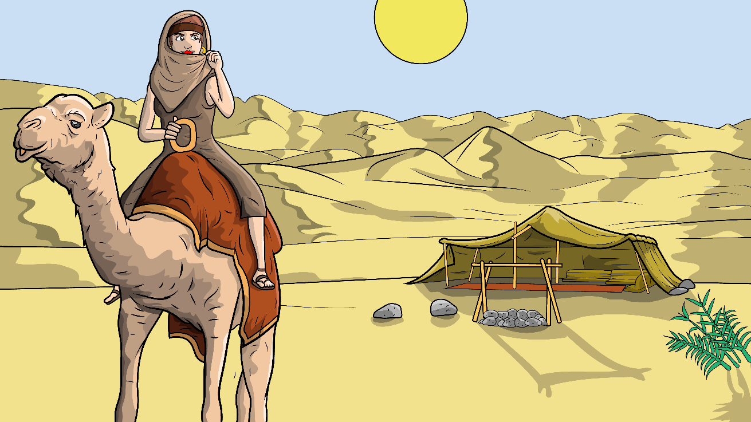
I will trust
God and go with him.

Slide 22
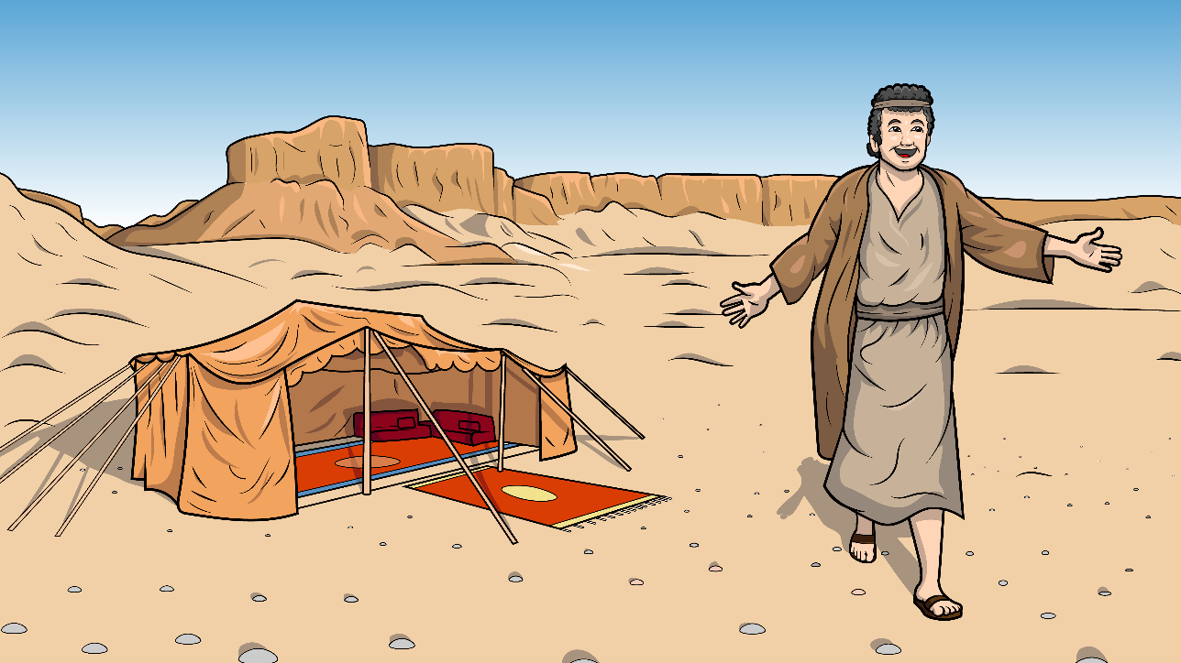
The man did run
and jump and hug.

Slide 23
The man did run and jump and hug.

Slide 24
Now I have
my wife for life.

Slide 25
Now I have my wife for life.

Slide 26
The wife and
husband
hug and
hug.

Slide 27
Song lyrics and melody: Carol Hale
Song arrangements and singer: Steffi VornBerger
Illustrations: Ivan Mader
Power Point arrangements: Steve March
www.EasyReadEnglish.com

