Slide 1
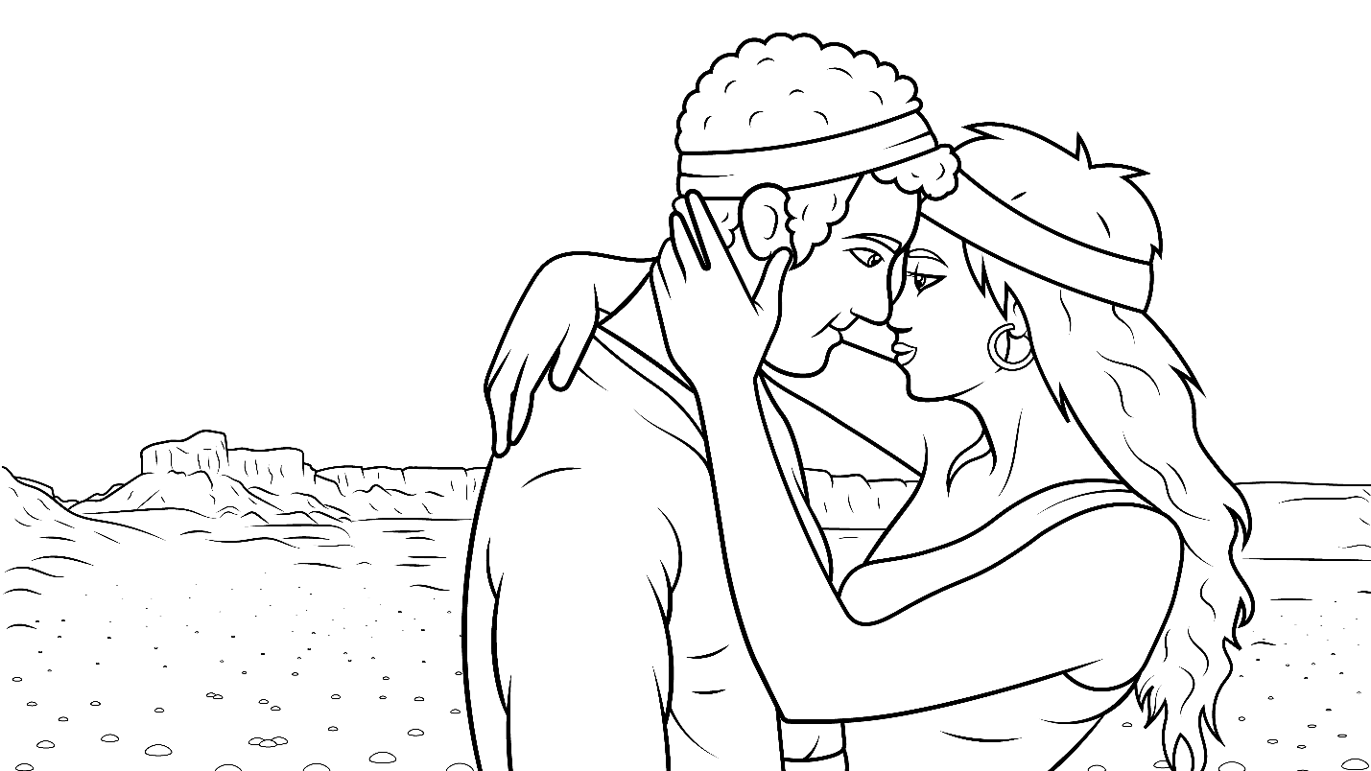
1.5 Story: You Must Just Trust
Genesis 24
(ŭ)

Slide 2
New Words to Read
up us Uz
Buz but luck
must just trust

Slide 3
jump husband
huff puff

Slide 4
fun sun run
tug rug jug
hug lug (to pull)

Slide 5
Rule Breakers (Read and Spell)
you the his is
has as was
one said have

Slide 6
Sight Words
with this asked
he be
she go

Slide 7
Sight Words
good for
Isaac Rebekah

Slide 8
1.5 Story You Must Just Trust
I Read, You Read Bible Story (ŭ)

Slide 9
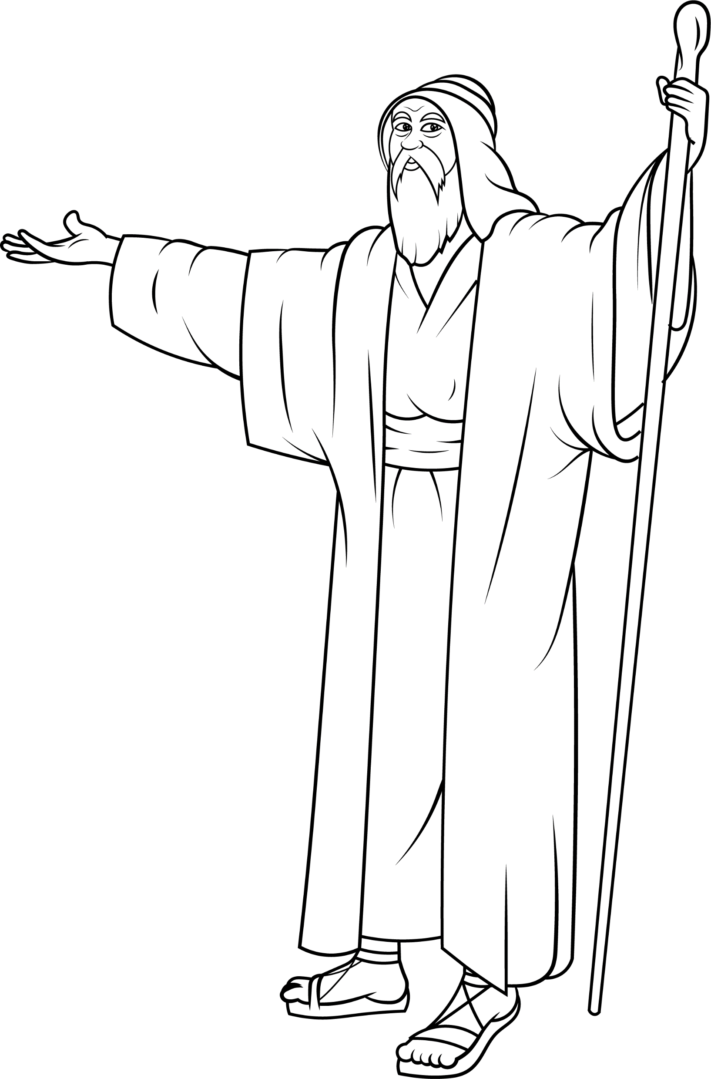
Abraham said to his servant,
“Isaac needs a wife.”

Slide 10
“Will you get up and help us?”

Slide 11
“Yes,” he said, “I must just trust God to help us.”

Slide 12
Abraham and the servant said to Isaac,

Slide 13
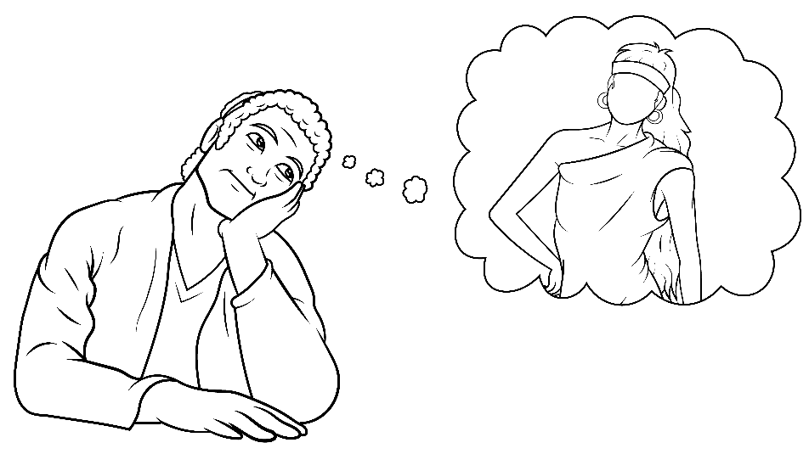
“We will find the perfect wife for you.”

Slide 14
“But, will you trust us?
You must just trust us.”

Slide 15
“Yes,” Isaac said.
“I must just trust.”

Slide 16
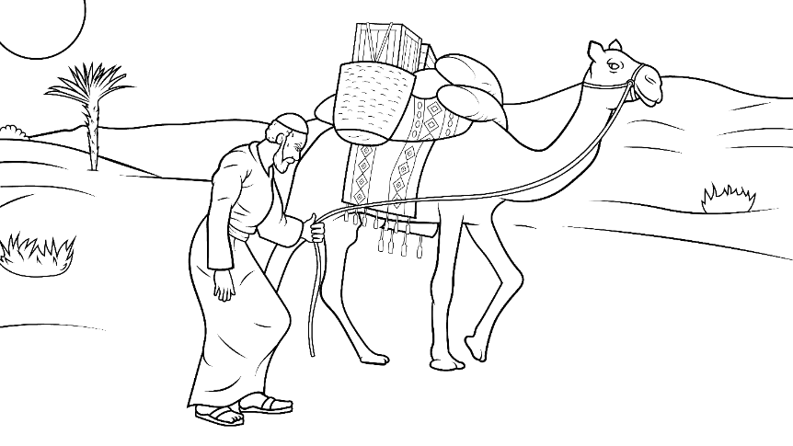
The servant and camels left on the long trip.

Slide 17
“Good luck. Have fun.”

Slide 18
The sun was up.
Huff, huff. Puff, puff.

Slide 19
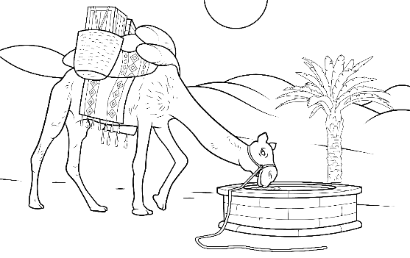
The camels got thirsty.

Slide 20
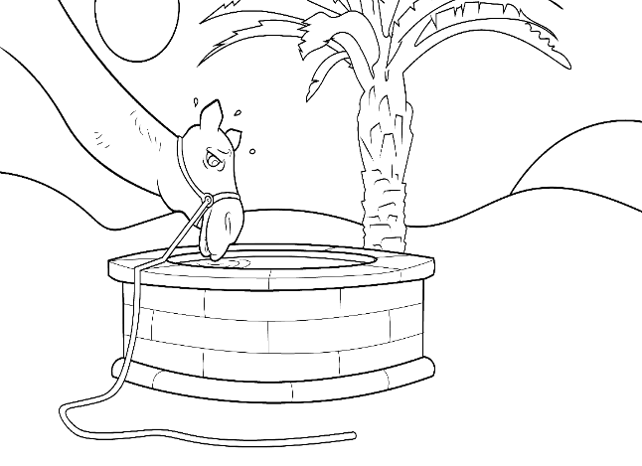
They stopped at a well for water.

Slide 21
The man met Rebekah at the well.
She got a jug –
lug, tug.

Slide 22
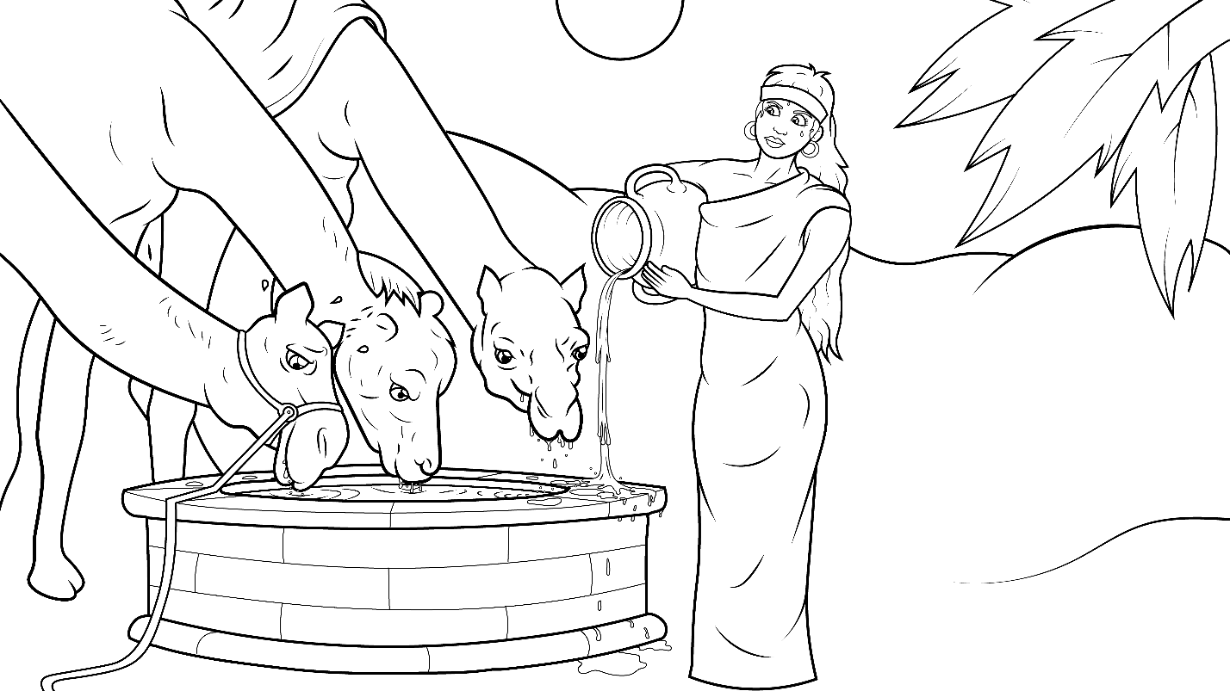
She gave him water and gave all the camels water too.

Slide 23
“This is just as I asked God!”

Slide 24
“She must be the one!” the servant thought.

Slide 25
He went to her house.

Slide 26
He met Laban, and he met Buz and Uz.

Slide 27
They all asked Rebekah,

Slide 28
“Will you go with this man?”

Slide 29
“He has a husband for you.”

Slide 30
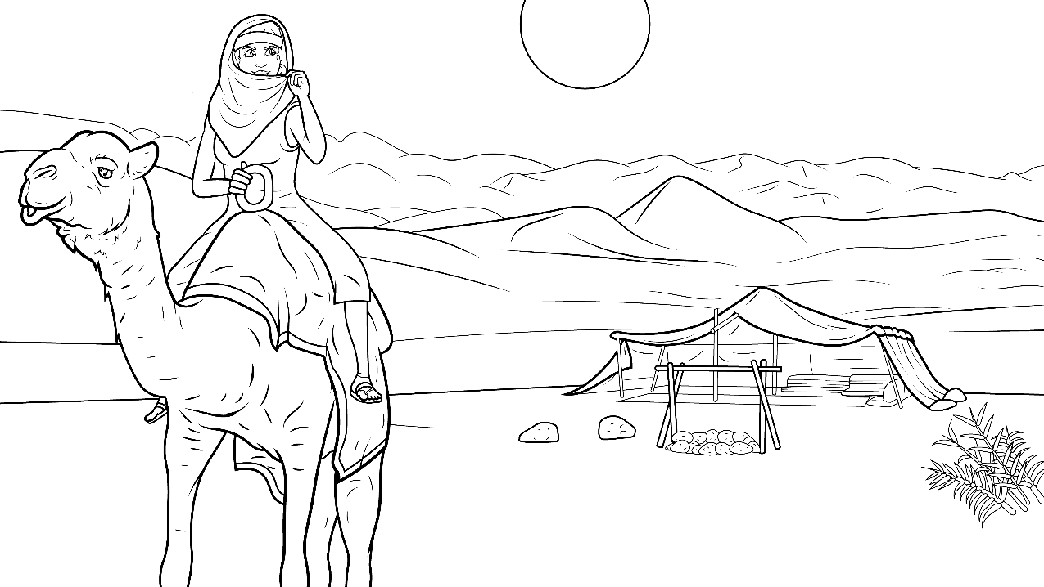
She said,
“Yes, I must just trust God.”

Slide 31
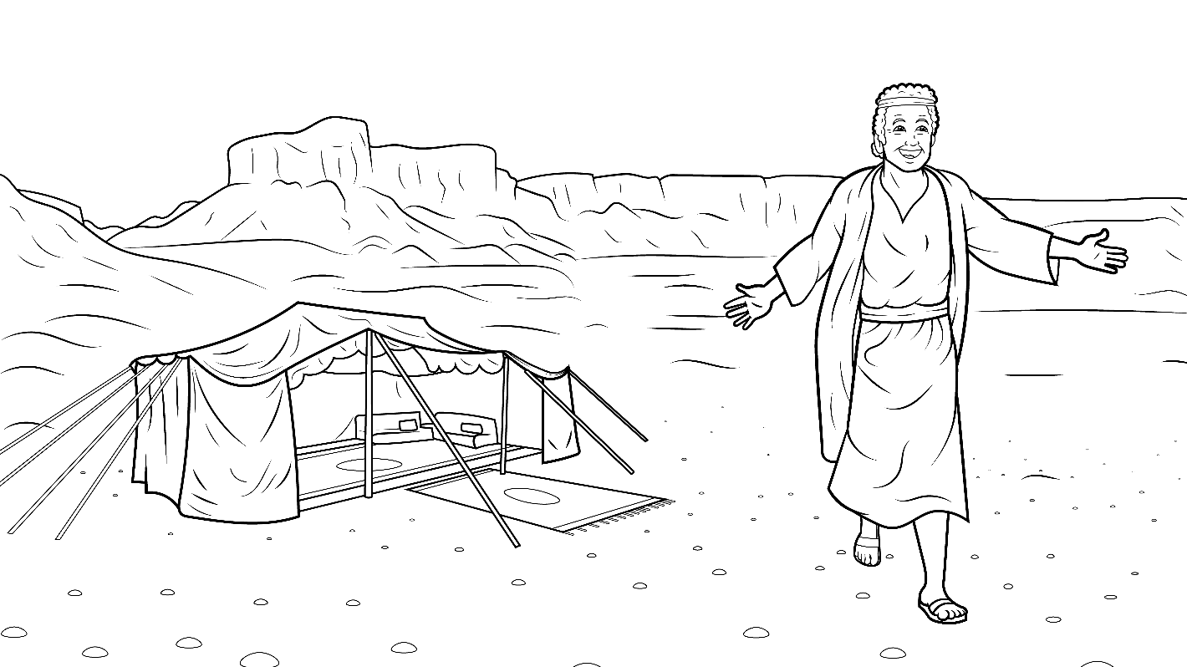
Jacob sat in his tent on the rug,
but he said,

Slide 32
“I will jump up. I will run
and hug her.”

Slide 33
And he did.

Slide 34
The End

Slide 35
1.5 Story Without Illustrations
You Must Just Trust
Genesis 24

Slide 36
Abraham said to his servant,
“Isaac needs a wife.
Will you get up and help us?”
“Yes,” he said,

Slide 37
“I must just trust God to help us.”
Abraham and the servant
said to Isaac, “We will find
the perfect wife for you."

Slide 38
“But, will you trust us?
You must just trust us.”
“Yes,” Isaac said.
“I must just trust.”

Slide 39
The servant and camels
left on the long trip.
“Good luck. Have fun.”
The sun was up.

Slide 40
Huff, huff. Puff, puff.
The camels got thirsty.
They stopped at a well for water.

Slide 41
The man met Rebekah at the well.
She got a jug - lug, tug.
She gave him water and
gave all the camels water too.

Slide 42
“This is just as I asked God!
She must be the one!”
the servant thought.
He went to her house.

Slide 43
He met Laban, and
he met Buz and Uz.
They all asked Rebekah,
“Will you go with this man?

Slide 44
He has a husband for you.”
She said, “Yes, I must just trust God.”
Jacob sat in his tent on the rug,
but he said,

Slide 45
“I will jump up.
I will run and hug her.”
And he did.

Slide 46
The End

Slide 47
Story: Carol Hale
Illustrations: Ivan Mader
Power Point arrangements: Steve March
www.EasyReadEnglish.com
www.EZReadEnglish.org/lower-levels

