Slide 1
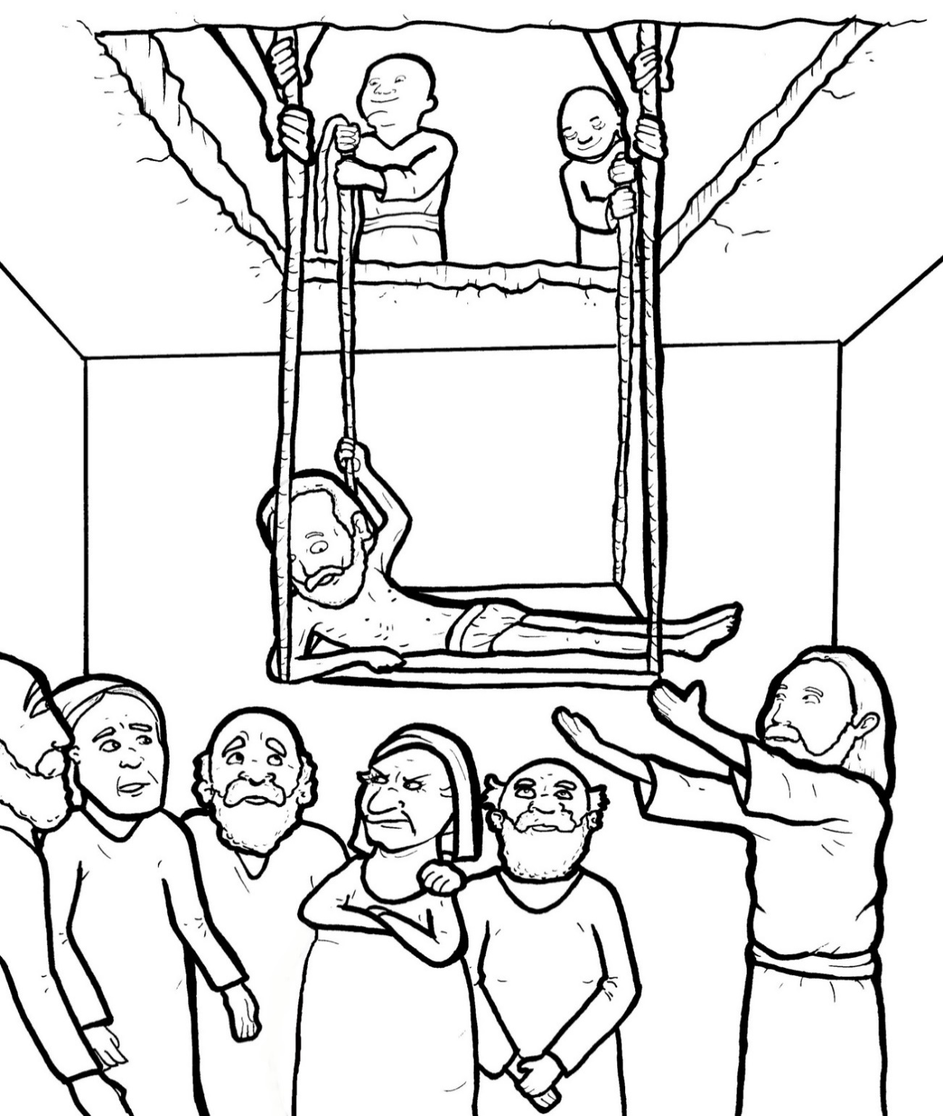
Part 2
29. Friends Bring a Crippled Man to Jesus
New Words
Rule Breakers

Slide 2
Silent letters
knew
know

Slide 3
New Words
crippled

Slide 4
Rule Breakers
Words like these do not follow phonetic patterns.
to
you
said
could
two
f
from

Slide 5
is
the
of
was
to
who

Slide 6
what
does
want
have
hearts
four

Slide 7
said
your
some
their
you
there

Slide 8
only
could
front
forgive
friend
any

Slide 9
many
great
they
son
walk

