Slide 1
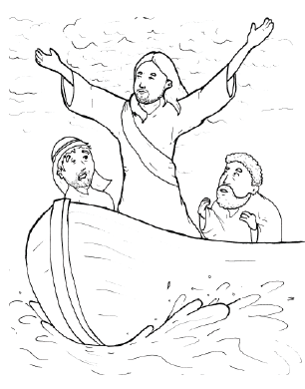
17. Jesus Stops a Storm
Part 5
Vocabulary
Original Bible Story

Slide 2
Vocabulary

Slide 3
multitude
(MUL -
ti -
tude):
a crowd

Slide 4
cushion
ion):
(CUSH -
a soft pad

Slide 5
cease
(cease):
to stop

Slide 6
stern
(stern):
the back of a boat

Slide 7
rebuked
BUKED):
(re -
scolded

Slide 8
calm
peaceful
(calm):

Slide 9
Jesus Stops a
Storm
Mark 4:35-41
World English Bible (WEB)

Slide 10
On that day, when evening had come, he said to them, “Let’s go over to the other side.”

Slide 11
Leaving the multitude, they took him with them, even as he was, in the boat. Other small boats were also with him.

Slide 12
A big wind storm arose, and the waves beat into the boat, so much that the boat was already filled.

Slide 13
He himself was in the stern, asleep on the cushion, and they woke him up, and told him, “Teacher, don’t you care that we are dying?”

Slide 14
He awoke, and rebuked the wind, and said to the sea, “Peace! Be still!” The wind ceased, and there was a great calm.

Slide 15
He said to them, “Why are you so afraid? How is it that you have no faith?”

Slide 16
They were greatly afraid, and said to one another, “Who then is this, that even the wind and the sea obey him?”

