Slide 1
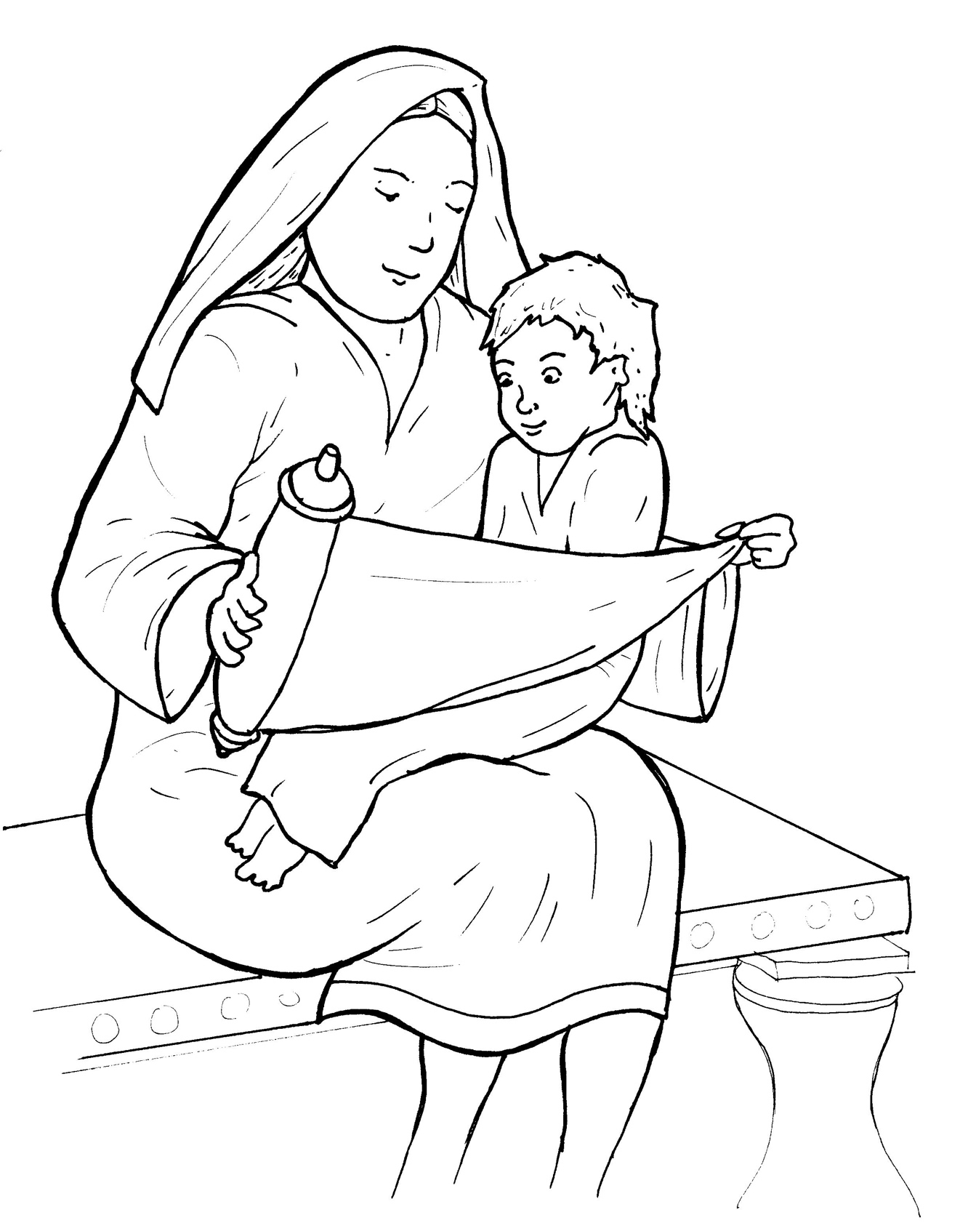
6. Jesus Grows Up
Part 4
Story in Easy Read English
Questions
Story in Phrases

Slide 2
Who was Jesus?

Slide 3
A bright star greeted him at his birth.

Slide 4
Angels sang the good news.

Slide 5
Kings bowed low.

Slide 6
They gave him gold.

Slide 7
An old man told the secret,
“He is the Messiah.”

Slide 8
His mother Mary kept all these things hidden in her heart.

Slide 9
She knew who her son was.

Slide 10
Jesus grew up in the quiet town of Nazareth.

Slide 11
Jesus helped his father, Joseph, who was a carpenter.

Slide 12
They cut wood and pounded nails.

Slide 13
We do not know much about Jesus when he was a child.

Slide 14
But, we do know he never sinned.

Slide 15
He never lied to his sisters.

Slide 16
He never hurt his brothers.

Slide 17
He was kind to everyone.

Slide 18
Jesus always obeyed his mother and father.

Slide 19
He loved the Scriptures, God’s holy word.

Slide 20
Jesus grew up strong and sweet.

Slide 21
He was filled with wisdom.

Slide 22
God loved Jesus, his son.

Slide 23
Jesus loved God and all people.

Slide 24
Jesus grew in favor with God and men.

Slide 25
Question 1
Jesus grew in wisdom. What helped him grow wise? How can you make wise choices?

Slide 26
Question 2
Jesus grew tall and strong. How can you grow healthy and strong?

Slide 27
Question 3
Jesus grew in favor with God. How can you please God as you grow?

Slide 28
Question 4
Jesus grew in favor with all people. How can you get along better with others?

Slide 29
Prayer
Dear Jesus,
I know that you want me to grow wise and tall and in favor with God and others. Please help me grow strong on the inside and outside.
Amen

Slide 30
Jesus Grows Up
Phrased for Fluency

Slide 31
Who was Jesus?

Slide 32
A bright star
greeted him
at his birth.

Slide 33
Angels
sang
the good news.

Slide 34
Kings
bowed low.

Slide 35
They
gave him gold.

Slide 36
An old man
told the secret,
”He is
the Messiah.”

Slide 37
His mother Mary
kept
all these things
hidden
in her heart.

Slide 38
She knew
who her son
was.

Slide 39
Jesus
grew up
in the quiet town
of Nazareth.

Slide 40
Jesus
helped
his father Joseph,
who was
a carpenter.

Slide 41
They
cut wood
and pounded nails.

Slide 42
We do not know
much about Jesus
when he was
a child.

Slide 43
But,
we do know
he never sinned.

Slide 44
He never lied
to his sisters.

Slide 45
He never hurt
his brothers.

Slide 46
He was kind
to everyone.

Slide 47
Jesus
always obeyed
his mother and father.

Slide 48
He
loved the Scriptures,
God’s holy word.

Slide 49
Jesus grew up
strong and sweet.

Slide 50
He was filled
with wisdom.

Slide 51
God loved Jesus,
his son.

Slide 52
Jesus loved God
and all people.

Slide 53
Jesus grew
in favor
with God and man.

