Slide 1

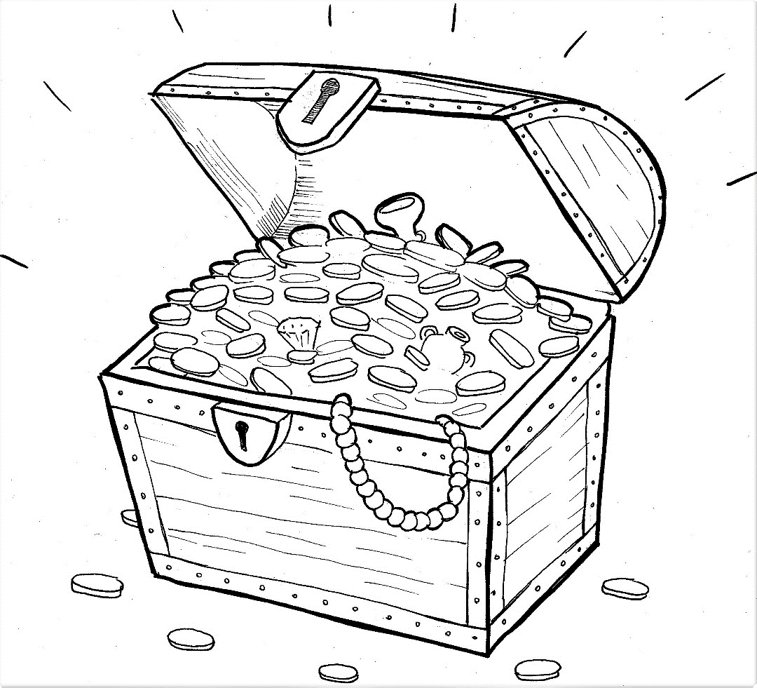
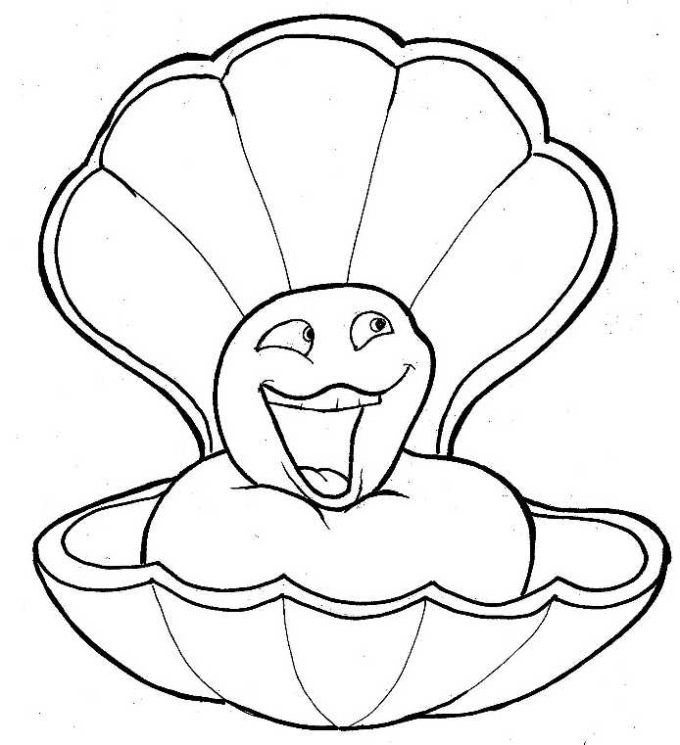
Part 3
21. Hidden Treasure and Priceless Pearl
Syllable Divisions

Slide 2
Dividing Words
Into Syllables

Slide 3
Rabbit Words
When you see two consonants
between two vowels,
divide between the consonants.
ra it
bb
rab bit

Slide 4
hid den
hidden

Slide 5
sil ver
silver

Slide 6
fur ni ture
furniture

Slide 7
un seen
unseen

Slide 8

Tiger Words
When you see one consonant
between two vowels,
divide after the first vowel.
Try this pattern first.
ti er
g
ti ger

Slide 9
Je sus
Jesus

Slide 10
Camel Words
When you see one consonant
between two vowels,
divide after the first consonant.
Try this pattern second.
ca el
m
cam el

Slide 11
ev er y
every

Slide 12
val u a ble
valuable

Slide 13
Turtle Words
When you see consonant-l-e,
count back three and divide.
tur
t
l
e
tur tle

Slide 14
val u a ble
valuable

Slide 15
Lion Words
If a word has two vowels together
that make two different sounds,
divide between the two vowels.
lion
li on

Slide 16
val u a ble
valuable

Slide 17
Hamster Words
When you see three consonants between two vowels,
divide after the first consonant.
ha
mst
er
ham ster

Slide 18
oy ster
oyster

Slide 19

Foxes Suffixes
Focus on your base word.
fox es
fox es

Slide 20
stor ies
stories

Slide 21
hid den
hidden

Slide 22
want ed
wanted

Slide 23
bur ied
buried

Slide 24
real ly
really

Slide 25
valu able
valuable

Slide 26
price less
priceless

Slide 27

Anteater Words
These compound words are made up of two smaller words.
ant
eater
1
2
ant eater

Slide 28
under stand
understand

Slide 29
can not
cannot

Slide 30
for get
forget

Slide 31
every thing
everything

Slide 32
in side
inside

Slide 33
some thing
something

Slide 34
Other Syllable Divisions
Some words don’t fit so neatly
into standard syllable division patterns.

Slide 35
a bout
about

Slide 36
fur ni ture
furniture

Slide 37
trea sure
treasure

