Slide 1

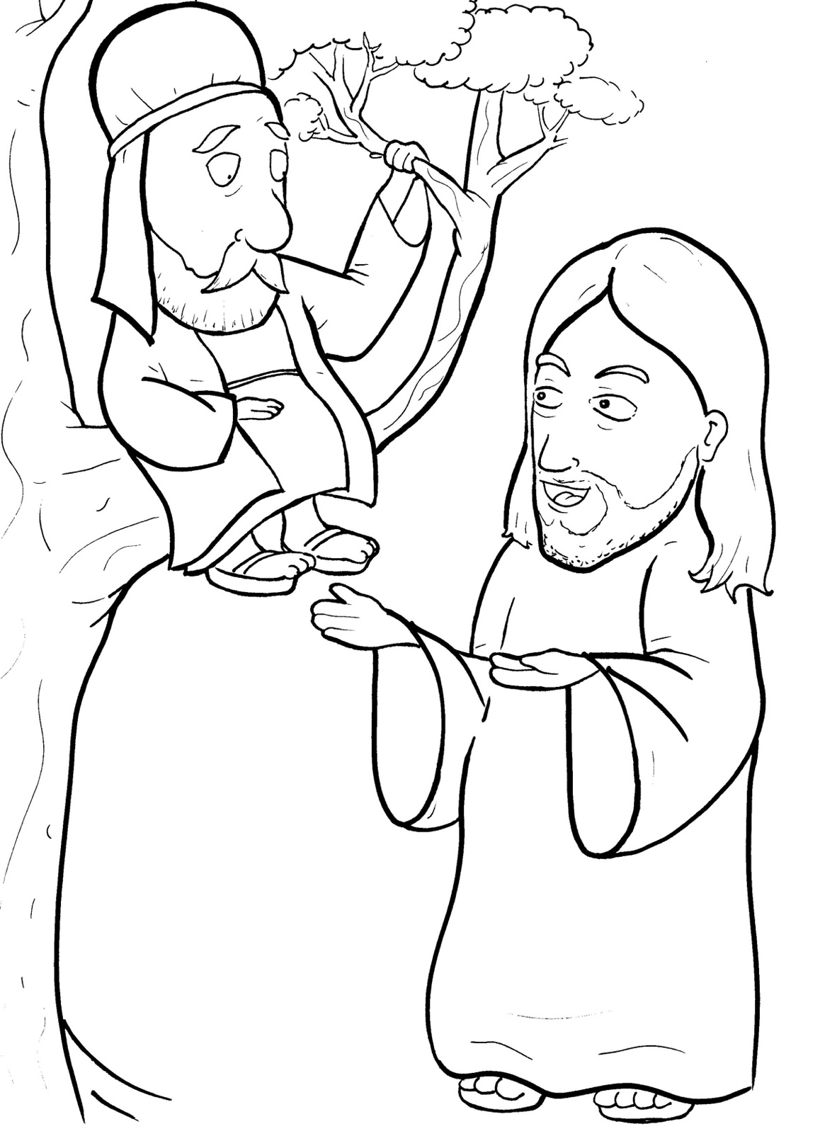
11. Jesus Loves a Short, Bad Man
Part 4
Story in Easy Read English
Questions
Story in Phrases

Slide 2

Most people in Jericho hated Zacchaeus.

Slide 3
He was in charge of the tax collectors.

Slide 4
He took more money than he should have.

Slide 5
Jesus walked into Jericho.

Slide 6
Happy crowds followed him.

Slide 7
Zacchaeus tried to see Jesus.

Slide 8
But, he could not see over the people.

Slide 9
Zacchaeus was a short man.

Slide 10
He jumped.

Slide 11
Still, he could not see.

Slide 12
He got a plan.

Slide 13
Zacchaeus ran to a tree.

Slide 14
He climbed up.

Slide 15
Now, he could see Jesus as he walked past.

Slide 16
Jesus stopped.

Slide 17
He looked up and saw Zacchaeus.

Slide 18
Jesus said, “Zacchaeus, hurry and come down.

Slide 19
Today, I must stay at your house.”

Slide 20
Zacchaeus could not believe it!

Slide 21
His selfish heart became soft.

Slide 22
He climbed down the tree quickly.

Slide 23
“Jesus at my house?” he thought with joy.

Slide 24
The people grumbled, “Jesus is going to the house of a sinner.”

Slide 25
Zacchaeus said, “Lord, I will give half of all I own to the poor.

Slide 26
If I have cheated anyone, I will pay back four times as much.”

Slide 27
He was very rich.

Slide 28
Jesus said, “Today, this lost man is saved.

Slide 29
For I have come to seek and save the lost.”

Slide 30
Question 1
What kind of man was Zaccheaus?

Slide 31
Question 2
How did Jesus change him?

Slide 32
Question 3
Jesus takes time for people who are without friends. Who is without a friend in your life? Can you try to become friends with him or her?

Slide 33
Question 4
What did Zaccheaus do to show that his heart had been changed? What can you do?

Slide 34
Prayer
Dear Jesus,
You became a friend to those whom others hated. You are a heart changer. Please change my heart, too. Help me to love the lost, the hated, the hurting. Help me to show my love for you by becoming a giver.
Amen

Slide 35
Jesus Loves a Short, Bad Man
Phrased for Fluency

Slide 36
Most people
in Jericho hated
Zacchaeus.

Slide 37
He was in charge
of the tax
collectors.

Slide 38
He
took more money
than he should have.

Slide 39
Jesus
walked
into Jericho.

Slide 40
Happy crowds
followed him.

Slide 41
Zacchaeus
tried
to see Jesus.

Slide 42
But,
he could not see
over the people.

Slide 43
Zacchaeus
was
a short man.

Slide 44
He jumped.

Slide 45
Still,
he
could not see.

Slide 46
He
got a plan.

Slide 47
Zacchaeus
ran
to a tree.

Slide 48
He climbed up.

Slide 49
Now,
he could see
Jesus
as he
walked past.

Slide 50
Jesus stopped.

Slide 51
He looked up
and saw
Zacchaeus.

Slide 52
Jesus said,
“Zaccheaus,
hurry and come down.

Slide 53
Today,
I must stay
at your house."

Slide 54
Zacchaeus
could not
believe it!

Slide 55
His selfish heart
became soft.

Slide 56
He
climbed
down the tree
quickly.

Slide 57
“Jesus
at my house?”
he thought
with joy.

Slide 58
The people
grumbled,”
“Jesus is going
to the house
of a sinner.”

Slide 59
Zacchaeus said,
“Lord,
I will give half
of all I own
to the poor.

Slide 60
If I have cheated
anyone,
I will pay back
four times
as much.”

Slide 61
He was
very rich.

Slide 62
Jesus said,
“Today,
this lost man
is saved.

Slide 63
For I have come
to seek and save
the lost.”

