Slide 1
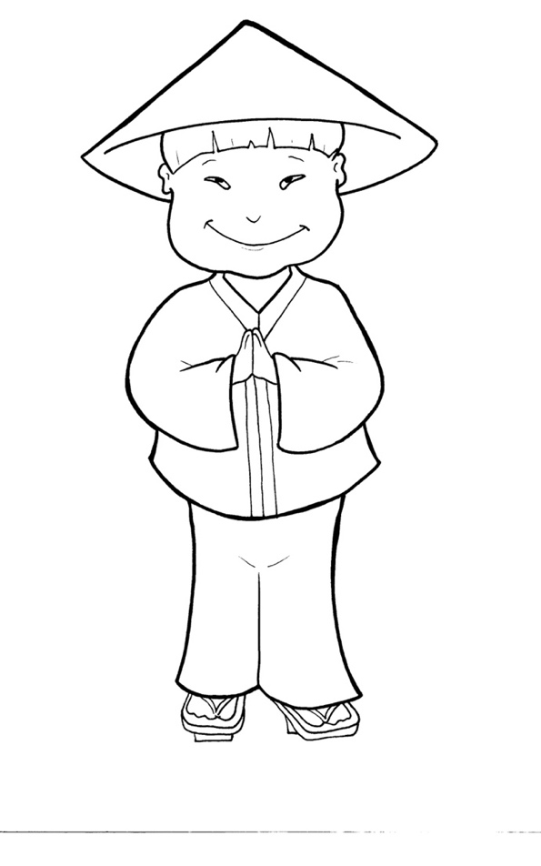
53. I Am Alive: Tell the World
Part 2
New Words
Rule Breakers

Slide 2
Other Sounds – Soft C
ce, ci, cy make the soft sound
cent
city
fancy

Slide 3
Timing
Box
disciples

Slide 4
New Words
through
obey
Holy Spirit

Slide 5
Rule Breakers
Words like these do not follow phonetic patterns.
to
you
said
could
two
f
from

Slide 6
to
his
of
has
do
you

Slide 7
put
your
who
give
said
lives

Slide 8
from
what
been
shall
were
their

Slide 9
there
sorry
Spirit
they
Father
always

Slide 10
hearts
saw
through

