Slide 1

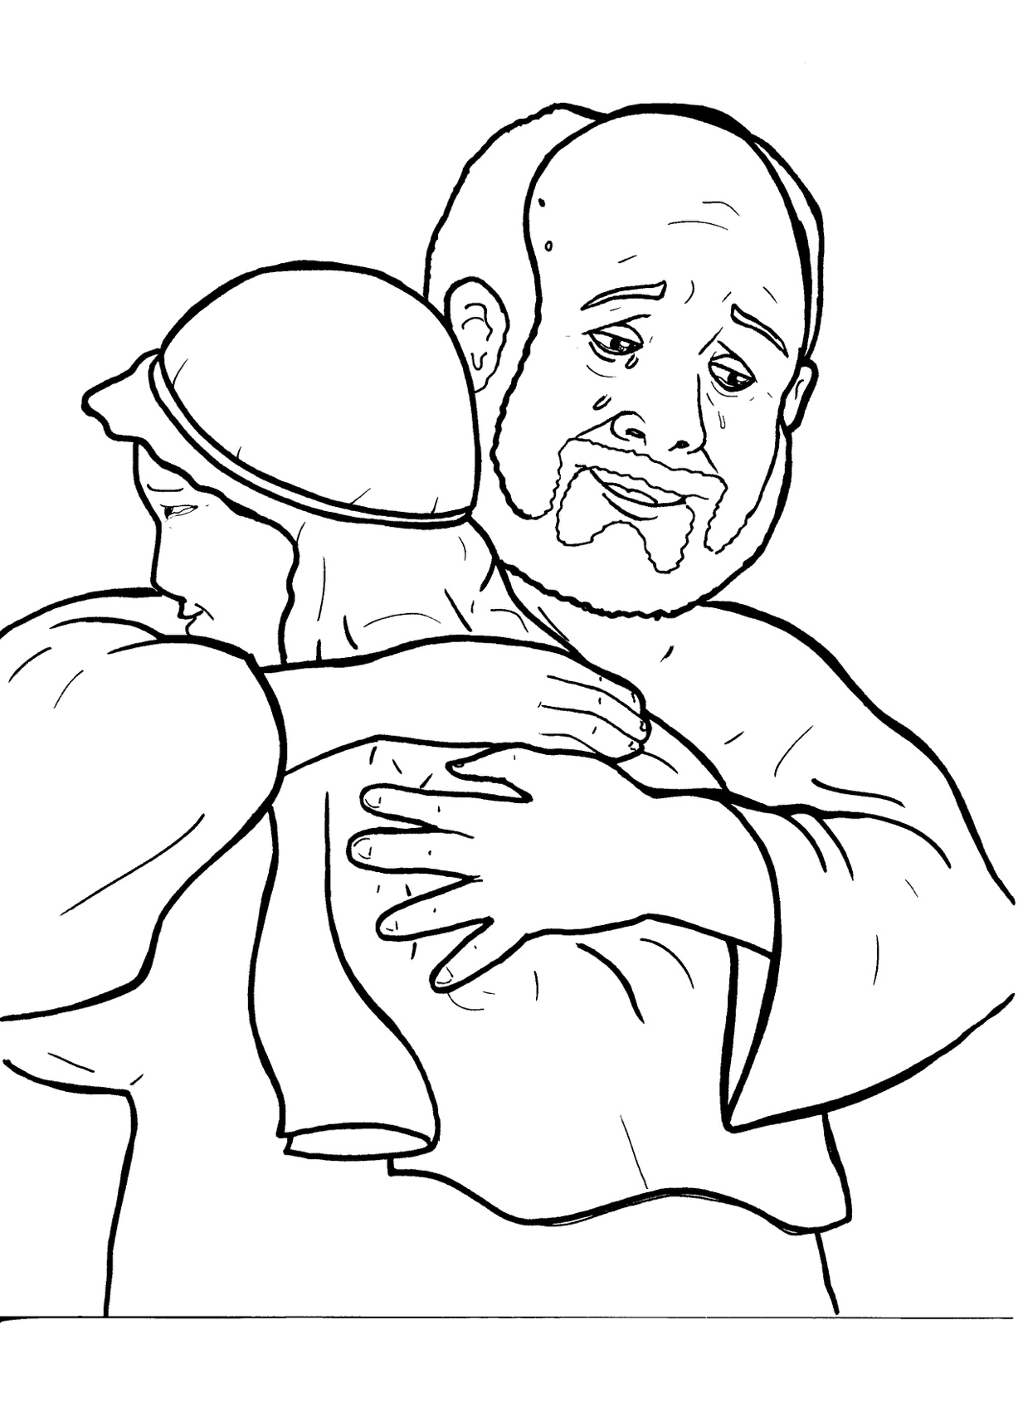
Part 2
24. The Lost Son
New Words
Rule Breakers

Slide 2

Other Sounds – Soft C
ce, ci, cy make the soft sound
cent
city
fancy

Slide 3
Timing
Box
city

Slide 4
Silent letters
thought

Slide 5
Contractions
The first word stays the same,
and the apostrophe takes the place
of the missing letters in the second word.
do
n’t
=
do
not

Slide 6
Timing
Box
it’s = it is
let’s = let us

Slide 7
Possessives
pig’s food

Slide 8
Rule Breakers
Words like these do not follow phonetic patterns.
to
you
said
could
two
f
from

Slide 9
is
two
his
of
to
the

Slide 10
was
your
one
yours
you
said

Slide 11
give
walk
gone
been
have
young

Slide 12
younger
brother
thought
money
father
women

Slide 13
coming
saw
anything
friend
were
son

