Slide 1
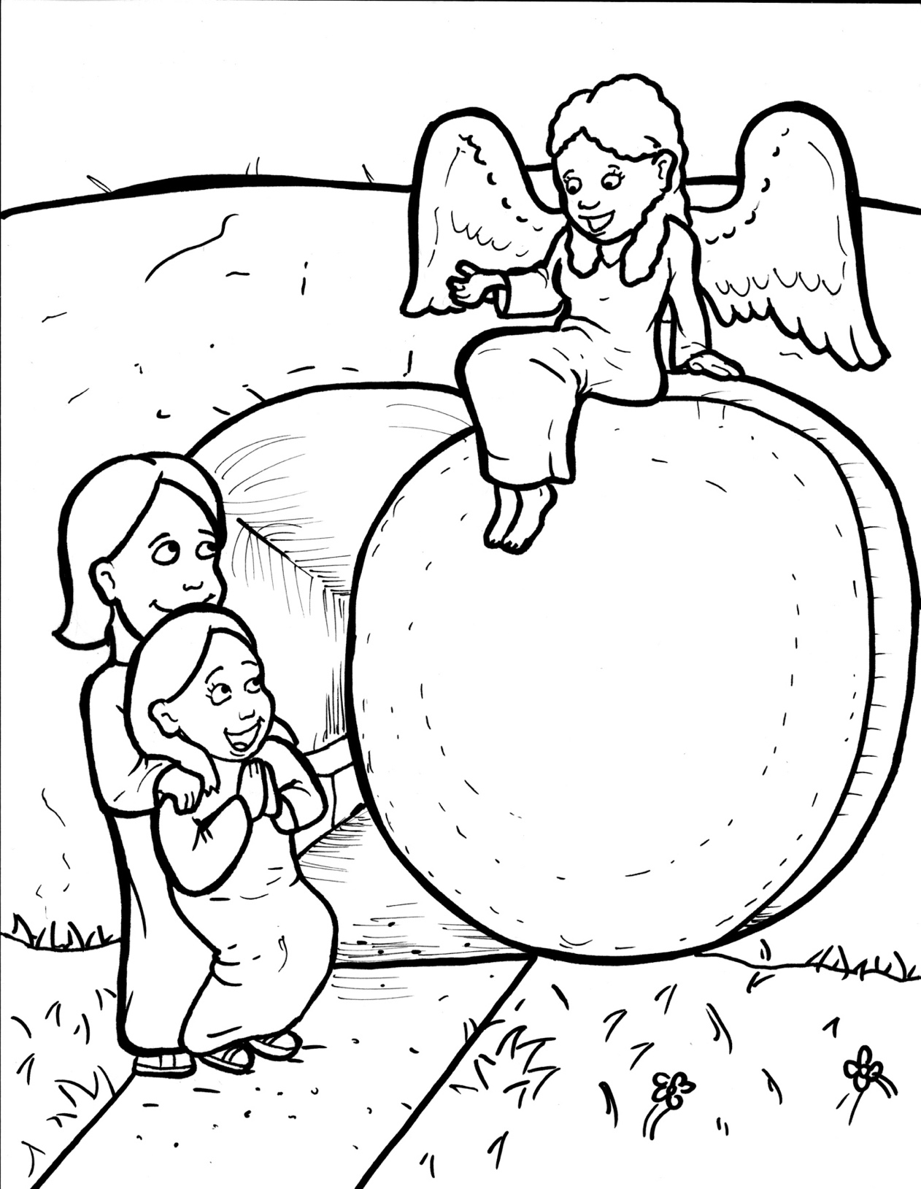
Part 4
41. Jesus is Alive!
Story in Easy Read English
Questions
Story in Phrases

Slide 2
It was the third day after
Jesus died.

Slide 3
All of a sudden, the earth shook
and rocks fell.

Slide 4
A glowing angel rolled the huge
stone away from the tomb.

Slide 5
The guards shook with fear.

Slide 6
They became like dead men.

Slide 7
The women who followed Jesus
went to his tomb.

Slide 8
They had spices to take care
of his body.

Slide 9
The stone had been rolled away.

Slide 10
They looked inside.

Slide 11
The tomb was empty!

Slide 12
The angel said to the women,
“Why do you look for the living
among the dead?

Slide 13
Jesus is not here; he has risen,
just as he said he would!

Slide 14
Don’t be afraid.

Slide 15
Go tell his disciples.”

Slide 16
They remembered that
Jesus said he would rise.

Slide 17
The women ran away.

Slide 18
They were afraid but full of joy.

Slide 19
Jesus appeared to them.

Slide 20
They fell at his feet and
worshipped.

Slide 21
“Don’t be afraid,” he said.

Slide 22
“Go tell my brothers.

Slide 23
They will also see me.”

Slide 24
The women told the disciples
the happy news.

Slide 25
They did not believe.

Slide 26
But Peter ran to the tomb.

Slide 27
Yes, it was empty!

Slide 28
He picked up the strips of linen.

Slide 29
He smelled the spices.

Slide 30
Peter thought,
“Could it really be true?

Slide 31
Could my Jesus truly be alive?”

Slide 32
Question 1
What did the women see and feel?

Slide 33
Question 2
What did they do with this happy news?

Slide 34
Question 3
How did the men react to the news?

Slide 35
Question 4
When Jesus came back to life, we call it the resurrection. Who can you tell this news to during the Easter season?

Slide 36
Prayer
Dear Jesus,
You are the king of heaven and earth. You are the Lord over life and death. You proved it by raising yourself from the dead. Help me tell this happy news of the resurrection to others, even if they don’t believe at first.
Amen

Slide 37
Jesus is
Alive!
Phrased for Fluency

Slide 38
It was the third day
after Jesus died.

Slide 39
All of a sudden,
the earth shook
and rocks fell.

Slide 40
A glowing angel
rolled
the huge stone
away
from the tomb.

Slide 41
with fear.
The guards
shook

Slide 42
They became
like dead men.

Slide 43
The women
who followed Jesus
went to his tomb.

Slide 44
They had spices
to take care
of his body.

Slide 45
The stone
had been rolled
away.

Slide 46
They looked inside.
The tomb
was empty!

Slide 47
The angel said
to the women,
“Why
do you look for the living
among the dead?

Slide 48
Jesus
is not here;
he has risen,
just as he said
he would!

Slide 49
Don’t be afraid.
Go
tell his disciples.”

Slide 50
They remembered
that Jesus
said
he would rise.

Slide 51
The women
ran away.
They were afraid
but
full of joy.

Slide 52
Jesus appeared
to them.
They fell at his feet
and worshipped.

Slide 53
“Don’t be afraid,”
he said.

Slide 54
“Go
tell my brothers.
They will also
see me.”

Slide 55
The women
told the disciples
the happy news.

Slide 56
They did not believe.
But
Peter ran
to the tomb.

Slide 57
Yes,
it was empty!

Slide 58
He picked up
the strips of linen.
He smelled
the spices.

Slide 59
Peter thought,
“Could it really
be true?

Slide 60
Could my Jesus
truly
be alive?”

