Slide 1


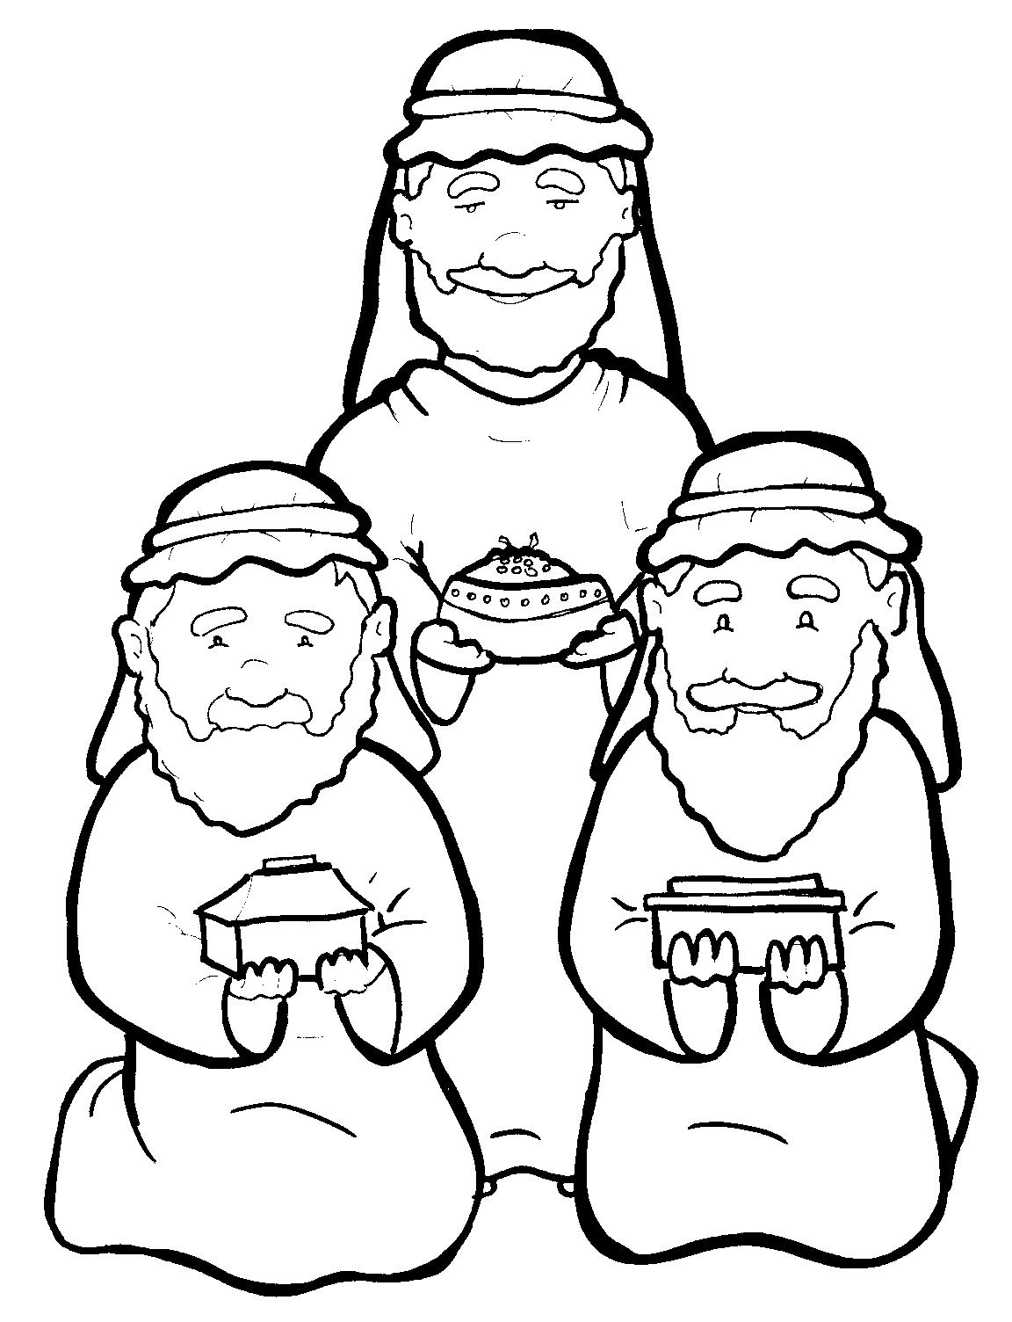
4. Wise Men Give Gifts to Jesus
Part 3
Syllable Divisions

Slide 2
Dividing Words
Into Syllables

Slide 3
Rabbit Words
When you see two consonants
between two vowels,
divide between the consonants.
ra it
bb
rab bit

Slide 4
fol low
follow

Slide 5
wel come
welcome

Slide 6
per fume
perfume

Slide 7
af ter
after

Slide 8
Tiger Words
When you see one consonant
between two vowels,
divide after the first vowel.
Try this pattern first.
ti er
g
ti ger

Slide 9
o ver
over

Slide 10
Je sus
Jesus

Slide 11
Camel Words
When you see one consonant
between two vowels,
divide after the first consonant.
Try this pattern second.
ca el
m
cam el

Slide 12
trav el
travel

Slide 13
des ert
desert

Slide 14
Jer u sa lem
Jerusalem

Slide 15
Mar y
Mary

Slide 16
treas ures
treasures

Slide 17
Hamster Words
When you see three consonants between two vowels,
divide after the first consonant.
ha
mst
er
ham ster

Slide 18
hun dreds
hundreds

Slide 19
wor ship
worship

Slide 20

Anteater Words
These compound words are made up of two smaller words.
ant
eater
1
2
ant eater

Slide 21
in deed
indeed

Slide 22
frank incense
frankincense

Slide 23

Foxes Suffixes
Focus on your base word.
fox es
fox es

Slide 24
asked
asked

Slide 25
worshipped
worshipped

Slide 26
bowed
bowed

Slide 27
might y
mighty

Slide 28
Other Syllable Divisions
Some words don’t fit so neatly
into standard syllable division patterns.
a way
away

Slide 29
emp ty
empty

Slide 30
Jer u sa lem
Jerusalem

