Slide 1

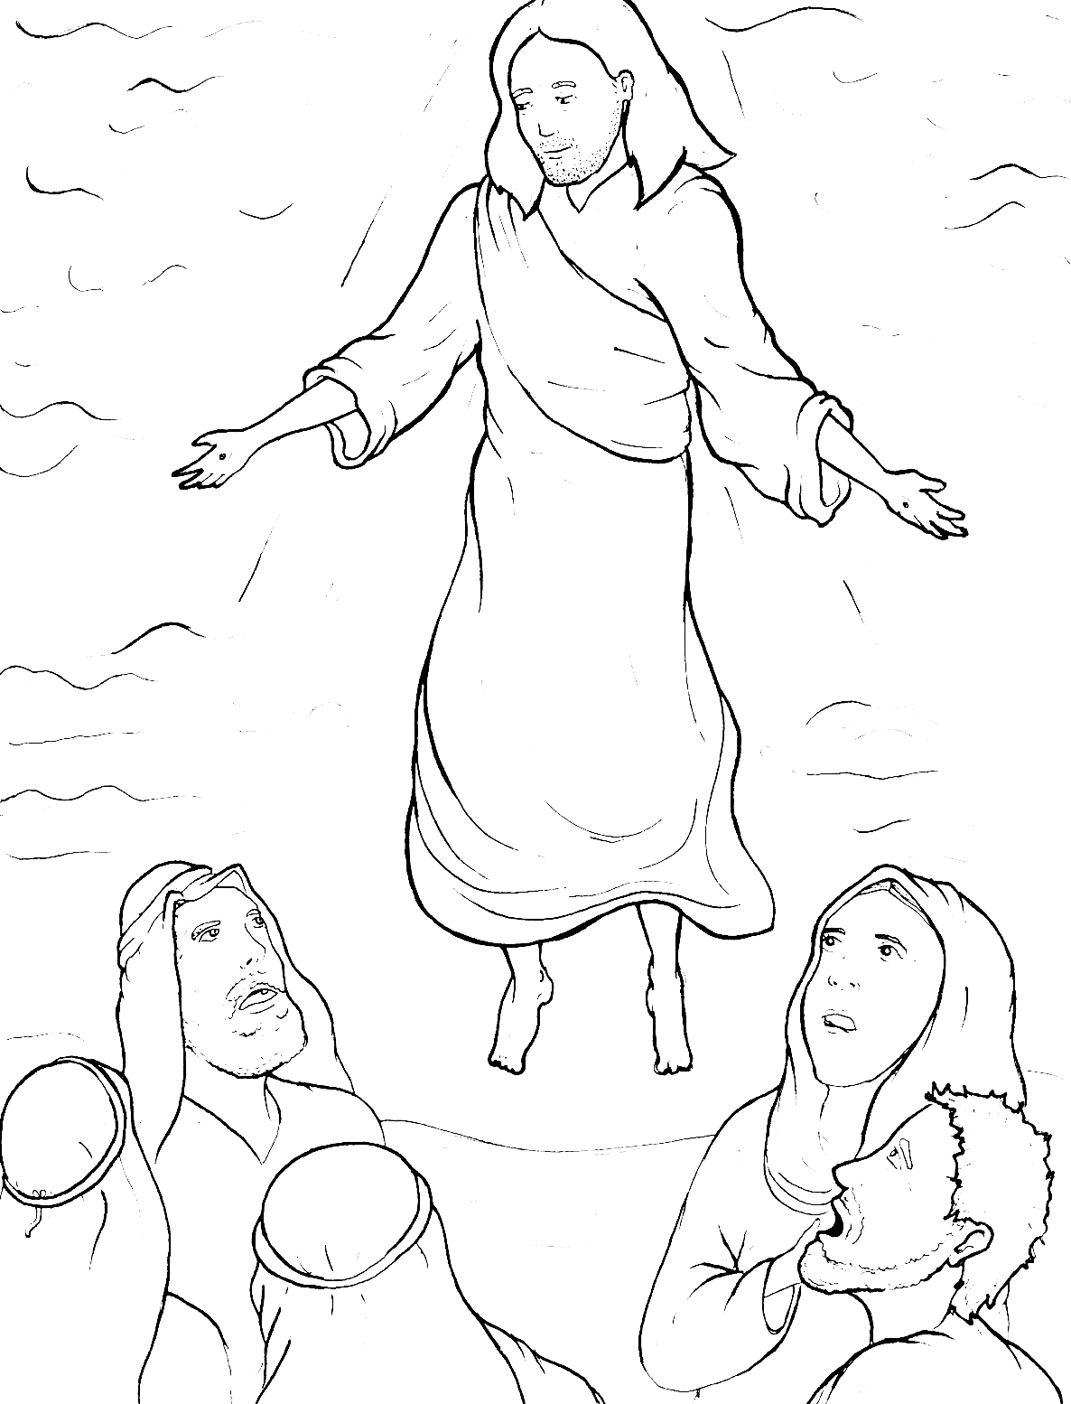
Part 2
44. Jesus Goes Back to Heaven
New Words
Rule Breakers

Slide 2

Other Sounds – Soft C
ce, ci, cy make the soft sound
cent
city
fancy

Slide 3
disciples

Slide 4
Other Sounds – Soft G
ge, gi, gy often make the soft sound
gentle
giant
gym

Slide 5
angels

Slide 6
Silent Letters
Christian
know
wrote

Slide 7
New Words
Christian
Messiah
baptize
miracles

Slide 8
Rule Breakers
Words like these do not follow phonetic patterns.
to
you
said
could
two
f
from

Slide 9
of
his
do
saw
is
the

Slide 10
you
love
was
have
two
were

Slide 11
from
other
their
again
could
angels

Slide 12
Christian
great
miracles
many
together
son

Slide 13
said
obey
come
also

