Slide 1

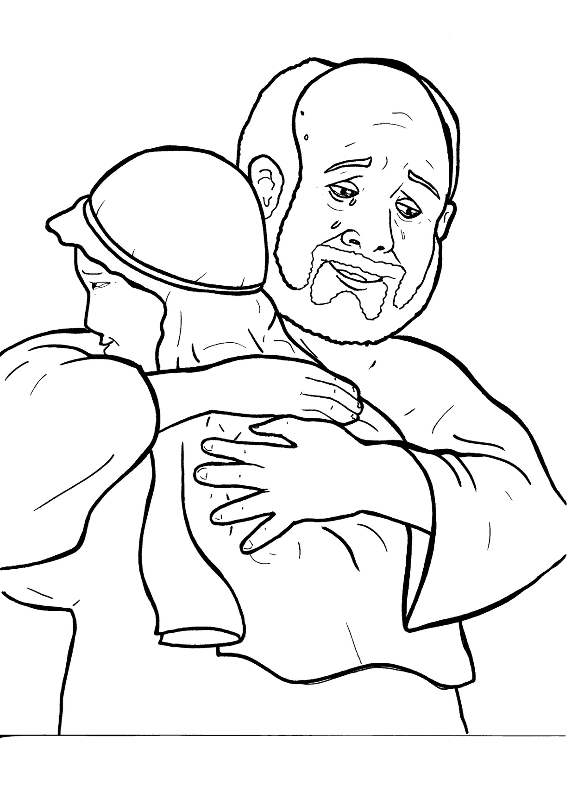
Part 5
24. The Lost Son
Vocabulary
Original Bible Story

Slide 2

Vocabulary

Slide 3
livelihood
(LIVE - li - hood)
the way a person earns money

Slide 4
famine
(FAM - ine)
a time when food is hard to get

Slide 5
compassion
(com – PAS – sion)
feeling sorry for someone and wanting to help

Slide 6
fattened calf
(FAT – tened calf)
a young cow that is ready to be eaten

Slide 7
devour
(de - VOUR)
to eat hungrily

Slide 8
appropriate
(ap – PRO – pri - ate)
what is right and proper

Slide 9
The Lost Son
Luke 15:11-32
World English Bible (WEB)

Slide 10
He said, “A certain man had
two sons.

Slide 11
The younger of them said to
his father,

Slide 12
‘Father, give me my share
of your property.’

Slide 13
So, he divided his livelihood
between them.

Slide 14
Not many days after, the younger
son gathered all of this together
and traveled into a far country.

Slide 15
There he wasted his property
with riotous living.

Slide 16
When he had spent all of it,
there arose a severe famine
in that country,

Slide 17
and he began to be in need.

Slide 18
He went and joined himself
to one of the citizens of that
country,

Slide 19
and he sent him into his fields
to feed the pigs.

Slide 20
He wanted to fill his belly
with the husks that the pigs ate,
but no one gave him any.

Slide 21
But when he came to himself
he said,

Slide 22
‘How many hired servants
of my father’s

Slide 23
have bread enough to spare,
and I’m dying with hunger!

Slide 24
I will get up and go
to my father, and will tell him,

Slide 25
“Father, I have sinned
against heaven,
and in your sight.

Slide 26
I am no more worthy
to be called your son.

Slide 27
Make me as one
of your hired servants.”

Slide 28
“He arose,
and came to his father.

Slide 29
But while he was still far off,
his father saw him,
and was moved with compassion,

Slide 30
and he ran, and fell on his neck,
and kissed him.

Slide 31
The son said to him, ‘Father,
I have sinned against heaven
and in your sight.

Slide 32
I am no longer worthy
to be called your son.’

Slide 33
“But the father said to his
servants, ‘Bring out the best robe,
and put it on him.

Slide 34
Put a ring on his hand,
and sandals on his feet.

Slide 35
Bring the fattened calf,
kill it, and let’s eat,
and celebrate;

Slide 36
for this, my son, was dead,
and is alive again.

Slide 37
He was lost,
and is found.’
Then they began to celebrate.

Slide 38
“Now his elder son
was in the field.

Slide 39
As he came near to the house,
he heard music and dancing.

Slide 40
He called
one of the servants to him,
and asked what was going on.

Slide 41
He said to him, ‘Your brother
has come, and your father
has killed the fattened calf,

Slide 42
because he has received
him back safe and healthy.’

Slide 43
But he was angry,
and would not go in.

Slide 44
Therefore, his father came out,
and begged him.

Slide 45
But he answered his father,
‘Behold, these many years
I have served you,

Slide 46
and I never disobeyed
a commandment of yours,

Slide 47
but you never gave me a goat,
that I might celebrate
with my friends.

Slide 48
But when this your son came,
who has devoured your living
with prostitutes,

Slide 49
you killed the fattened calf
for him.’

Slide 50
“He said to him, ‘Son, you
are always with me, and
all that is mine is yours.

Slide 51
But it was appropriate
to celebrate and
be glad, for this,

Slide 52
your brother, was dead,
and is alive again.
He was lost, and is found.’”

