Slide 1
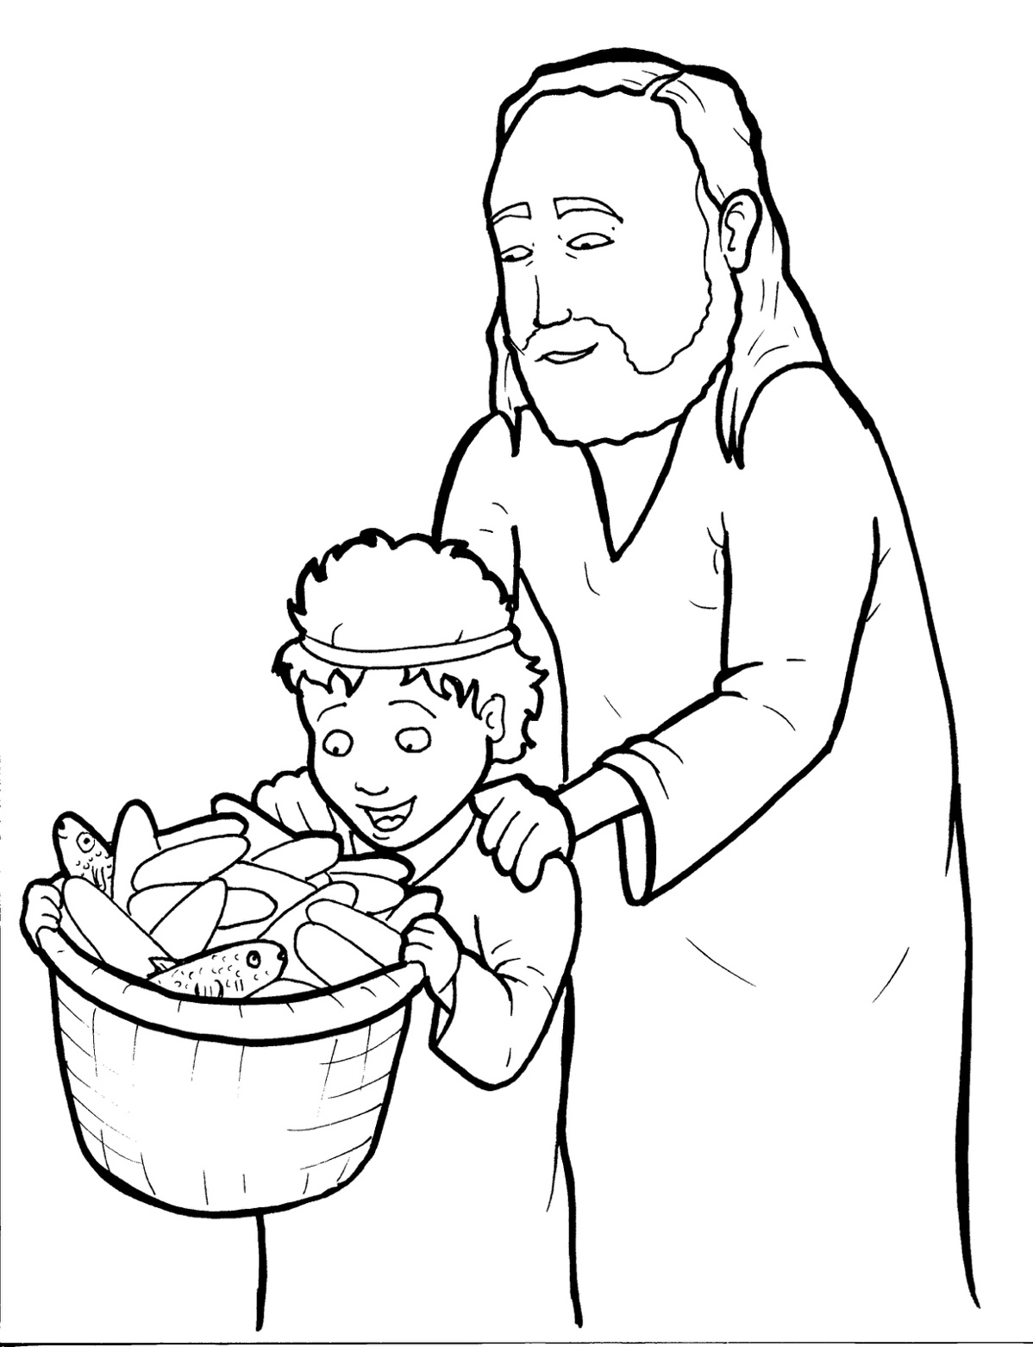
18. Jesus Feeds Five Thousand
Part 2
New Words
Rule Breakers

Slide 2
Other Sounds – Soft C
ce, ci, cy make the soft sound
cent
city
fancy

Slide 3
disciples

Slide 4
Silent Letters
listen
taught

Slide 5
Contractions
The first word stays the same,
and the apostrophe takes the place
of the missing letters in the second word.
ca
n’t
=
can
not

Slide 6
wasn't = was not

Slide 7
New Words
loaves
miracle

Slide 8
Rule Breakers
These words do not follow phonetic patterns.
the
of

Slide 9
to
who
his
heart

Slide 10
two
was
were
said
many
loved

Slide 11
some
sorry
coming
there
miracle
another

