Slide 1
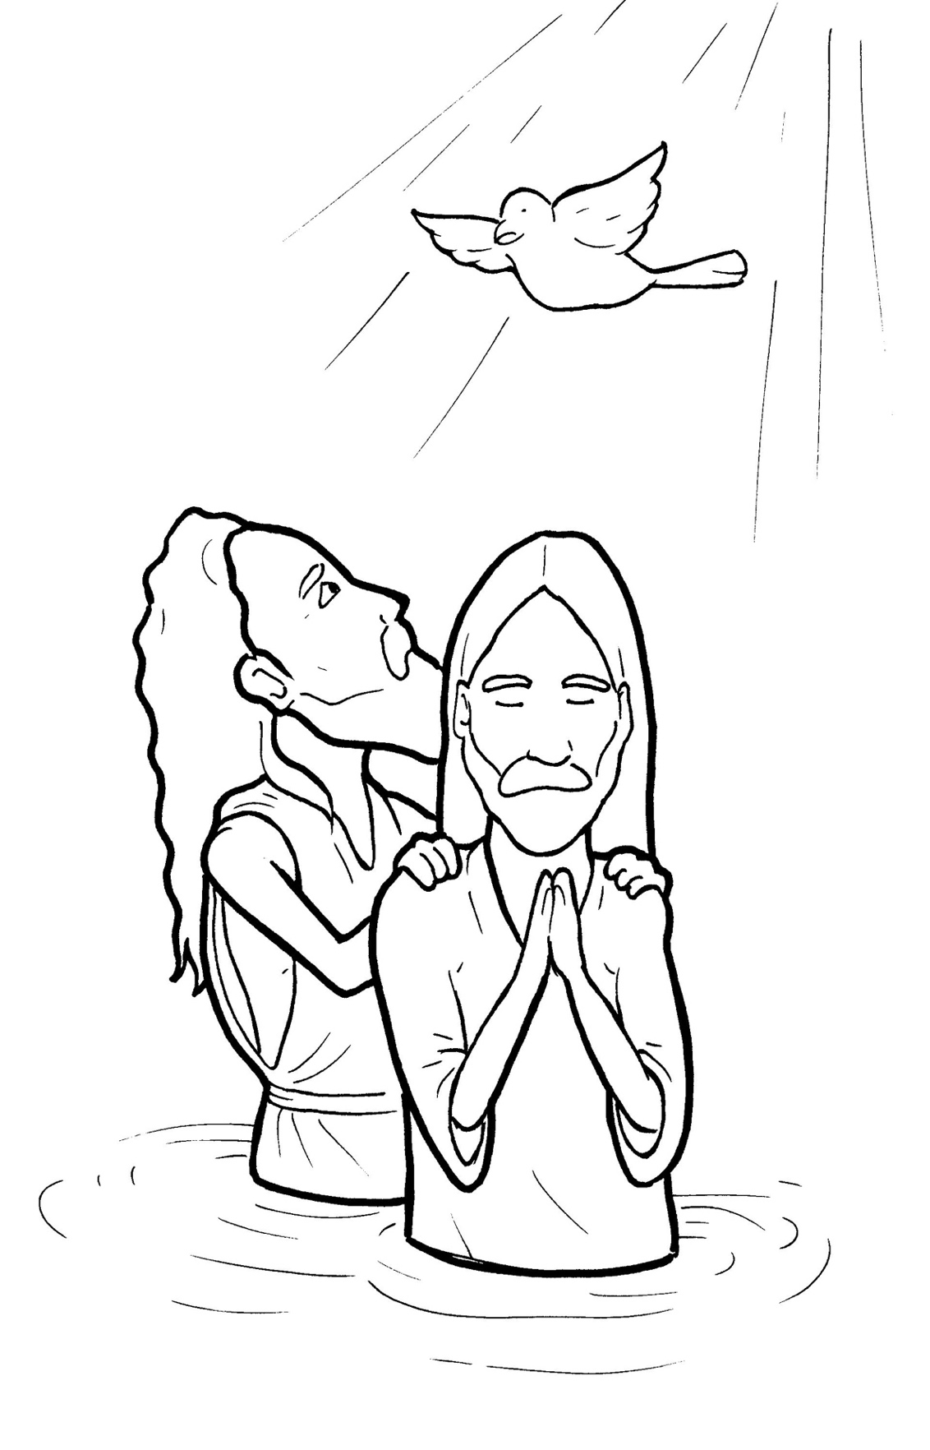
9. Jesus Gets Baptized
Part 4
Story in Easy Read English
Questions
Story in Phrases

Slide 2
Jesus grew up.

Slide 3
At 30 years old, he began his mission.

Slide 4
Jesus walked to the Jordan River.

Slide 5
When John saw him, he stopped.

Slide 6
John said, “Look, the Lamb of God!

Slide 7
He takes away the sins of the world.”

Slide 8
Jesus asked to be baptized.

Slide 9
But John said, “I need to be baptized by you.”

Slide 10
“Let us do so,” Jesus said, to fulfill God’s plan.

Slide 11
John agreed.

Slide 12
He lowered Jesus into the river.

Slide 13
The water covered Jesus.

Slide 14
Jesus rose, fresh and dripping wet.

Slide 15
The sky parted.

Slide 16
It was like a present torn open.

Slide 17
They saw the Spirit of God.

Slide 18
It looked like a bird coming down.

Slide 19
The dove stayed on Jesus.

Slide 20
A voice from heaven rang out, “You are my Son, whom I love.

Slide 21
With you, I am well pleased.”

Slide 22
This was proof that Jesus is God’s Chosen One.

Slide 23
The time had come.

Slide 24
Jesus was ready.

Slide 25
The people were ready.

Slide 26
God’s greatest work was about to begin.

Slide 27
Question 1
What happened when Jesus got baptized?

Slide 28
Question 2
Baptism is a new beginning. Have you seen anyone get baptized?

Slide 29
Question 3
Baptism does not wash away sin. Baptism shows the world you want to follow Jesus. Do you want to follow Jesus?

Slide 30
Question 4
Have you been baptized? When?
Would you like to get baptized?

Slide 31
Prayer
Dear Jesus,
Thank you for setting a good example for me when you got baptized. Thank you for fresh beginnings. I always want to follow your plan
for me.
Amen

Slide 32
Jesus Gets Baptized
Phrased for Fluency

Slide 33
Jesus grew up.

Slide 34
At 30 years old,
he began
his mission.

Slide 35
Jesus walked
to the Jordan River.

Slide 36
When John saw him,
he stopped.

Slide 37
John said,
“Look,
the Lamb of God!

Slide 38
He takes away
the sins
of the world.”

Slide 39
Jesus asked
to be baptized.

Slide 40
But John said,
“I need
to be baptized
by you.”

Slide 41
“Let us do so,”
Jesus said,
“to fulfill
God’s plan."

Slide 42
John agreed.

Slide 43
He lowered Jesus
into the river.

Slide 44
The water covered Jesus.

Slide 45
Jesus rose,
fresh and dripping wet.

Slide 46
The sky
parted.

Slide 47
It was like
a present
torn open.

Slide 48
They saw
the Spirit of God.

Slide 49
It looked
like a bird
coming down.

Slide 50
The dove
stayed on Jesus.

Slide 51
A voice
from heaven
rang out,
“You
are my Son,
whom I love.

Slide 52
With you,
I am
well pleased.”

Slide 53
This was proof
that Jesus is
God’s Chosen One.

Slide 54
The time had come.

Slide 55
Jesus was ready.

Slide 56
The people were ready.

Slide 57
God’s greatest work
was about
to begin.

