Slide 1
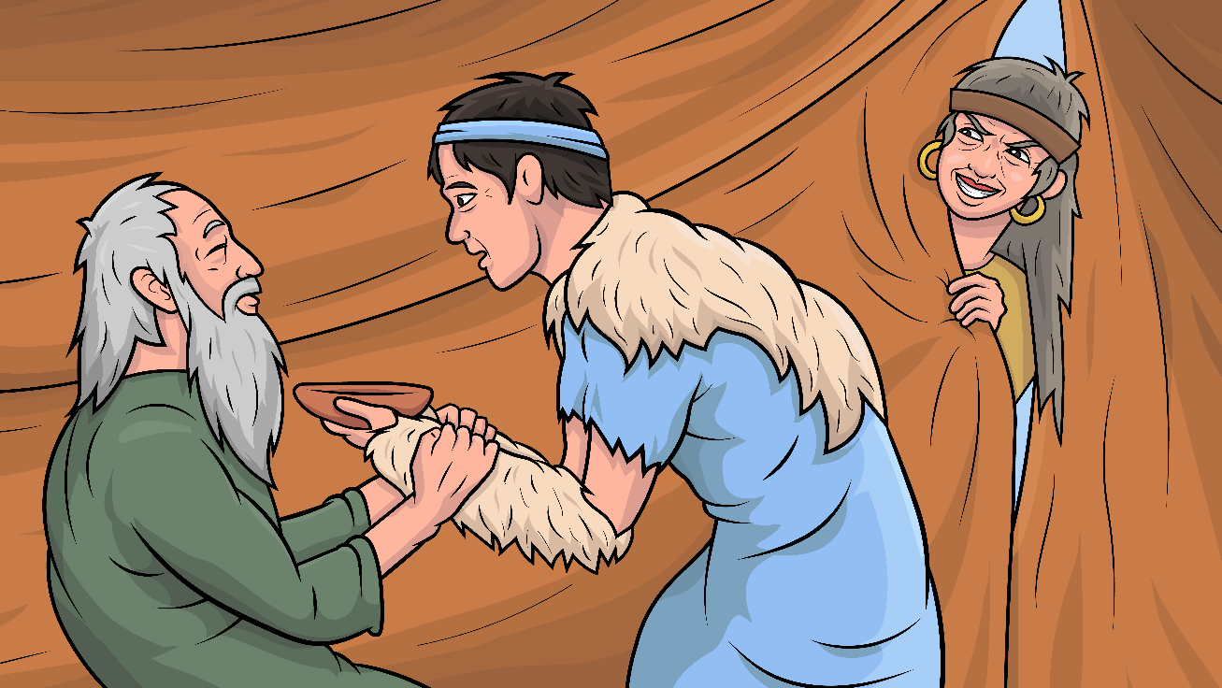
Song 1.13 The Big Switch
Story of Jacob, Rebekah, Esau, and Isaac- Genesis 27
( -tch )
www.EasyReadEnglish.com

Slide 2
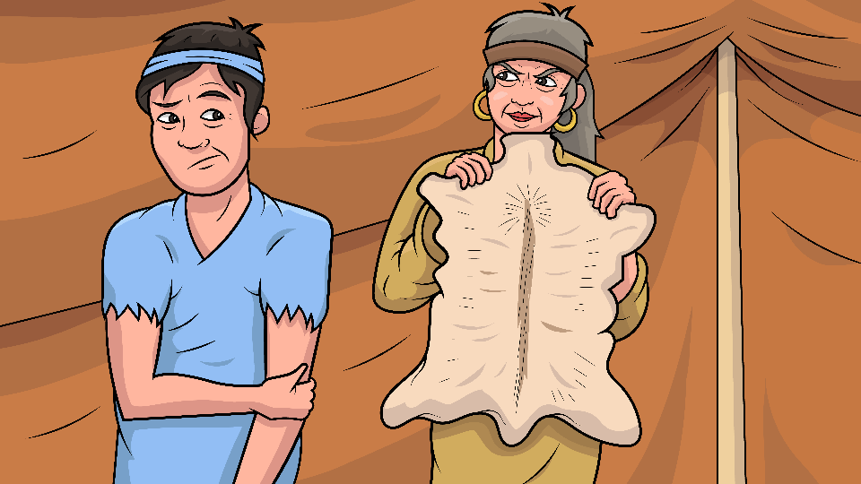
You must switch. Mom will stitch…

Slide 3
…your twin’s clothes and do not snitch.

Slide 4
With a patch of skin to match his twin…

Slide 5
…their dad did not catch this sin.

Slide 6
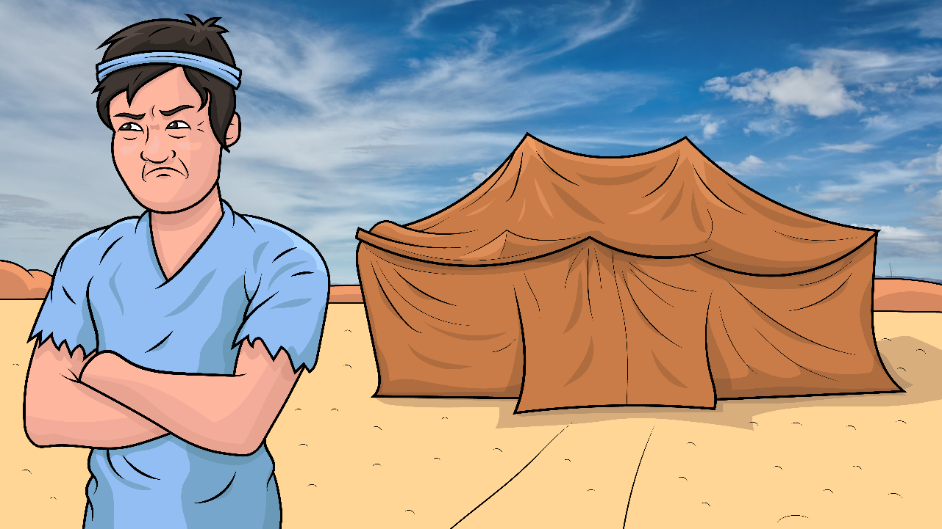
We don’t match. Dad will catch.

Slide 7
I don’t like this plan you hatched.

Slide 8
With a patch of skin to match his twin…

Slide 9
…their dad did not catch this sin.

Slide 10
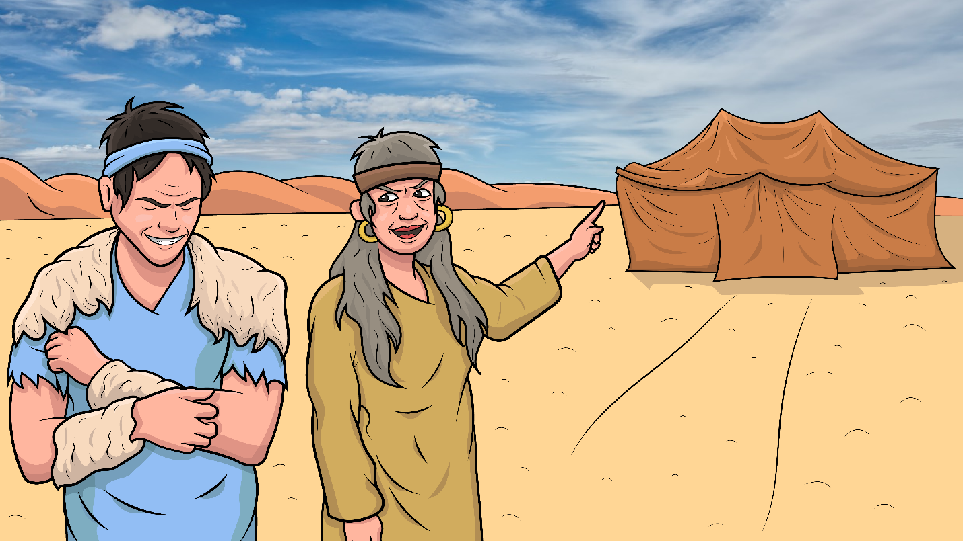
These clothes itch, every stitch.

Slide 11
Go in there and make the switch!

Slide 12
With a patch of skin to match his twin…

Slide 13
…their dad did not catch this sin.

Slide 14
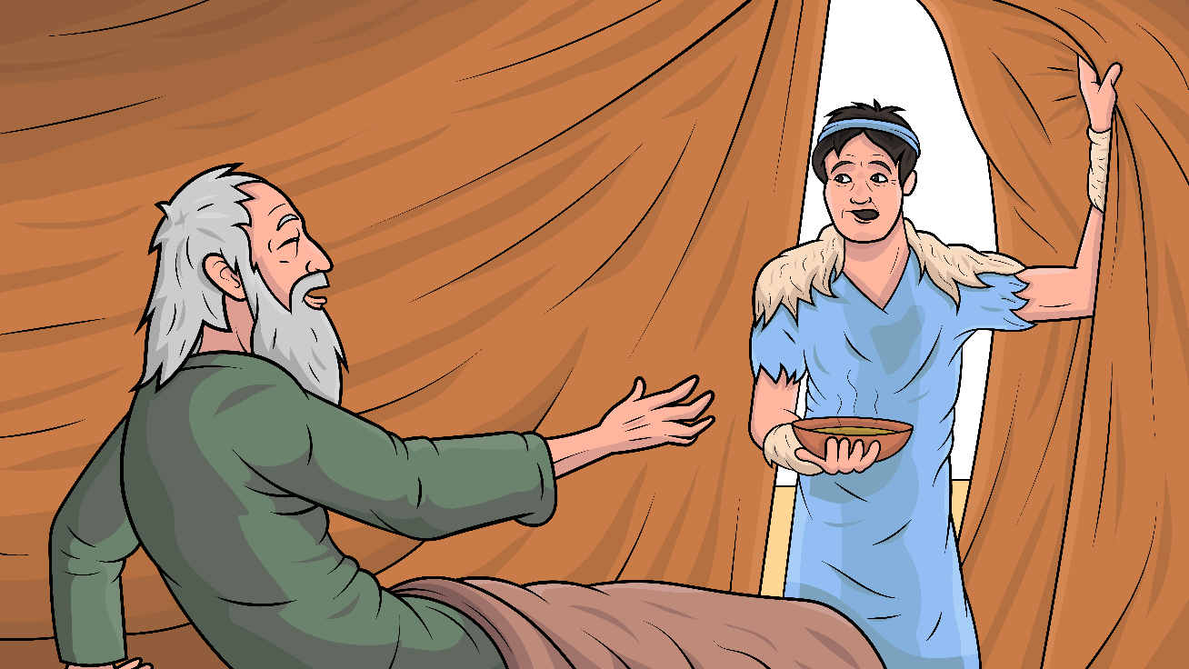
Stretch to tell.
I can smell.

Slide 15
Yes, you fetched and made it well.

Slide 16
With a patch of skin to match his twin…

Slide 17
…their dad did not catch this sin.

Slide 18
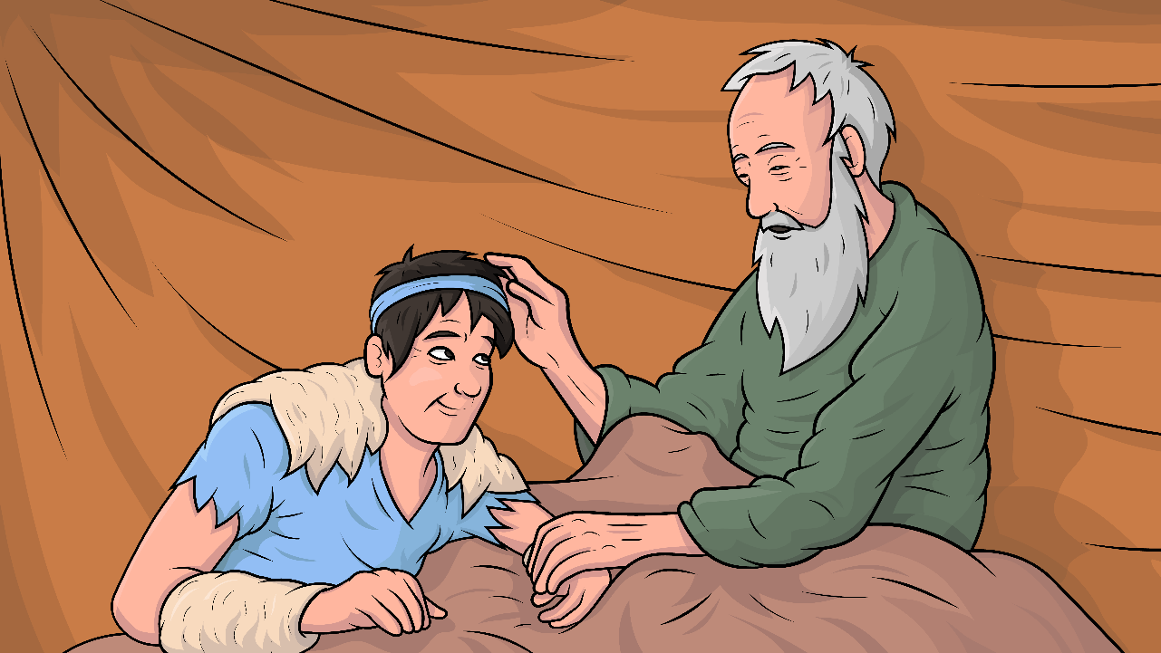
I confess,
I had to guess.

Slide 19
You are the twin that I will bless.

Slide 20
With a patch of skin to match his twin…

Slide 21
…their dad did not catch this sin.

Slide 22
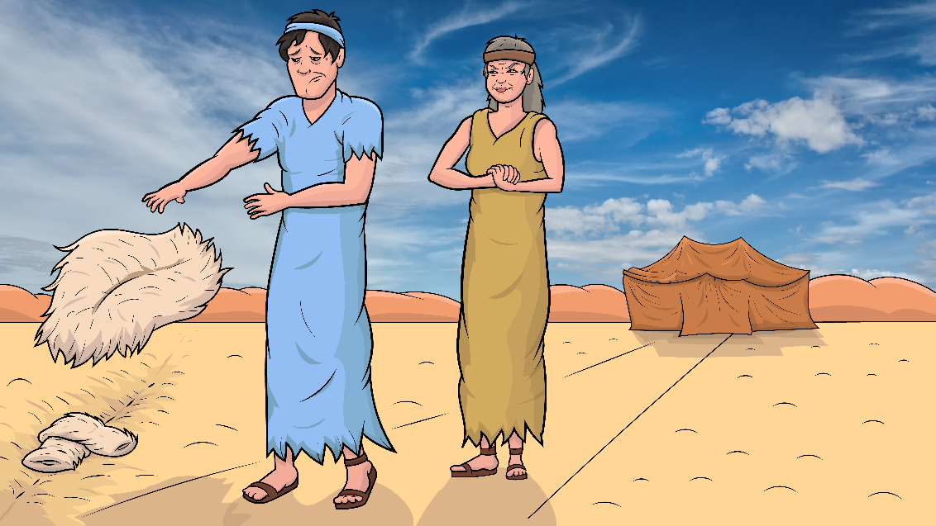
Not a hitch,
went the
switch.

Slide 23
Hid his twin’s clothes in
the ditch.

Slide 24
With a patch of skin to match his twin…

Slide 25
…their dad did not catch this sin.

Slide 26
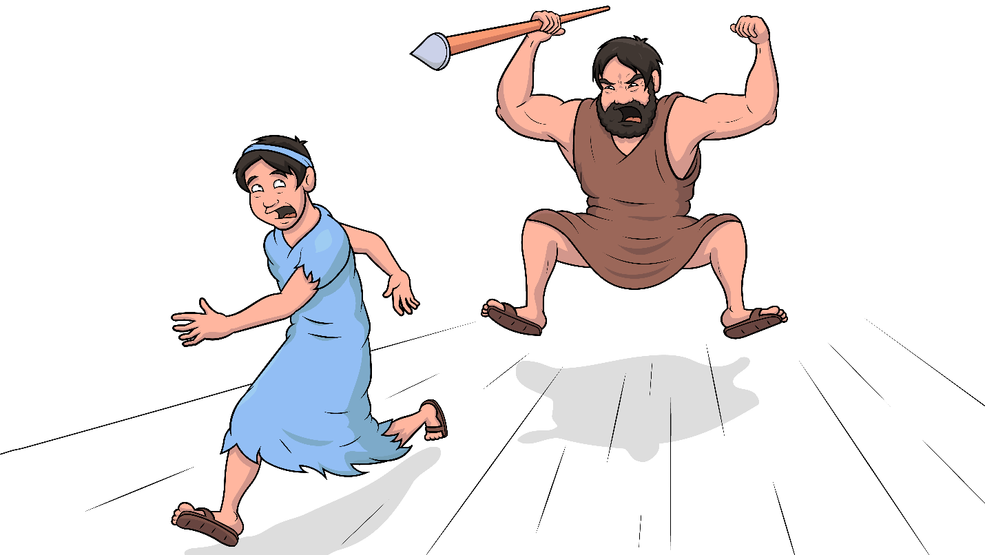
To save her son,
he had to run.

Slide 27
Sin makes what
we do NO FUN.

Slide 28
With a patch of skin to match his twin…

Slide 29
…their dad did not catch this sin.

Slide 30
The End

Slide 31
Song lyrics: Carol Hale
Song arrangements and singer: Michael Bannon
Illustrations: Ivan Mader
Power Point arrangements: Steve March
www.EasyReadEnglish.com
www.EZReadEnglish.org/Lower-Levels

Slide 32
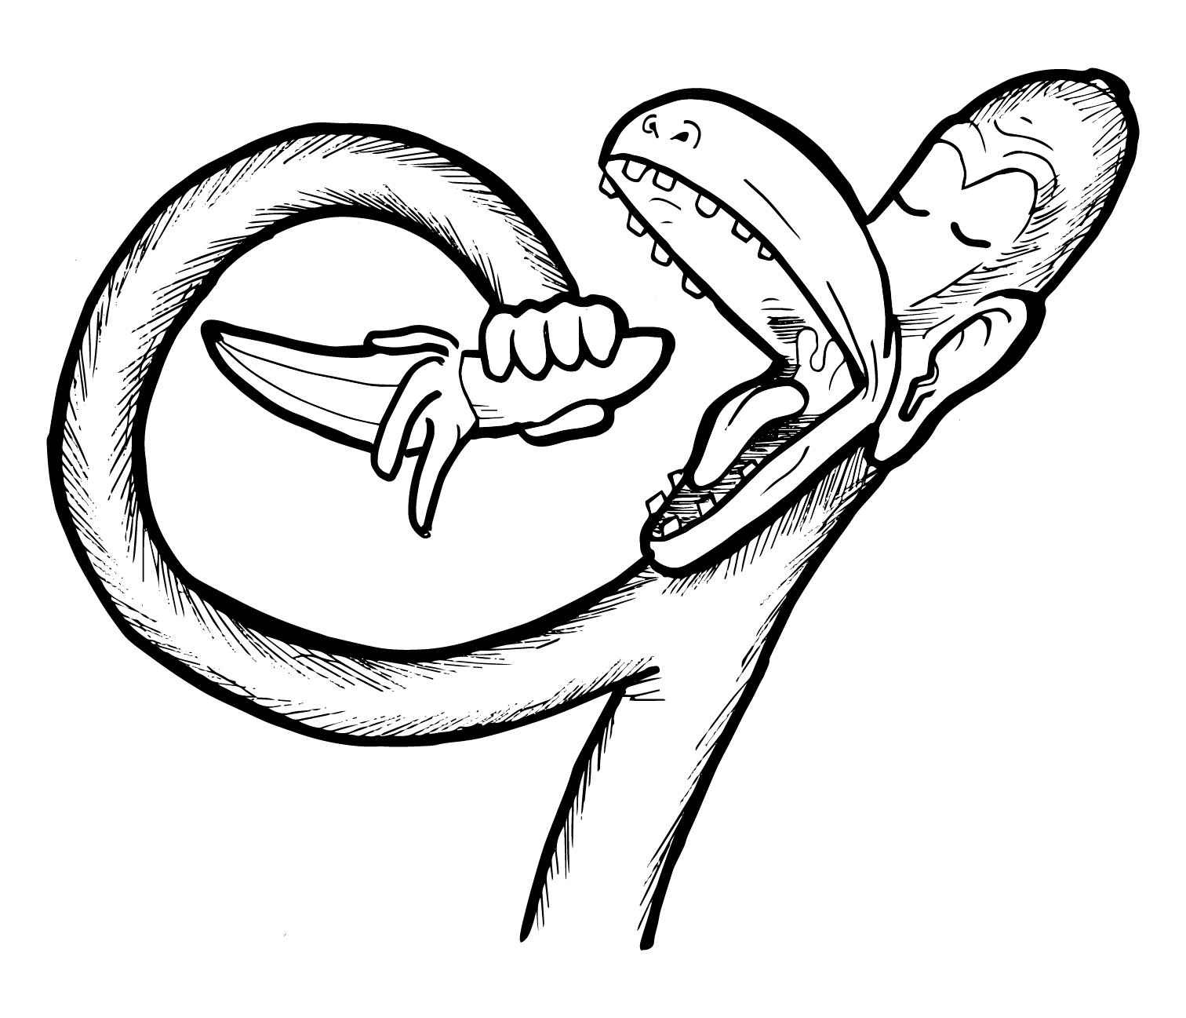
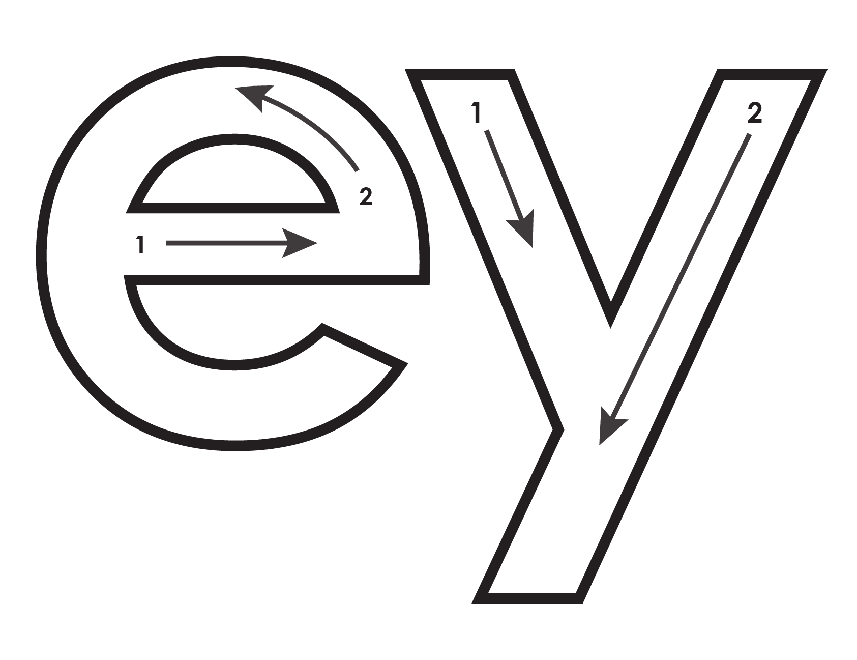
Another important teaching tool…
Easy Breezy Reading (https://www.easybreezyreading.com)
Designed to help new, struggling, and especially dyslexic learners, Easy Breezy Reading is broken up into Laughing Letters and Funny Phonograms. Both tools use illustrated patterns that mimic the shapes of the letters to give your students one more sense to link the phonetic sound of the letters.
ey
monk
Our scope and sequence matches Easy Read English Lower Levels. Progressing through the Easy Breezy Reading curriculum is sure to accelerate your students’ comprehension of the written English language.
You can procure Laughing Letters or Funny Phonograms through our website.
https://www.easybreezyreading.com/curriculum

