Slide 1

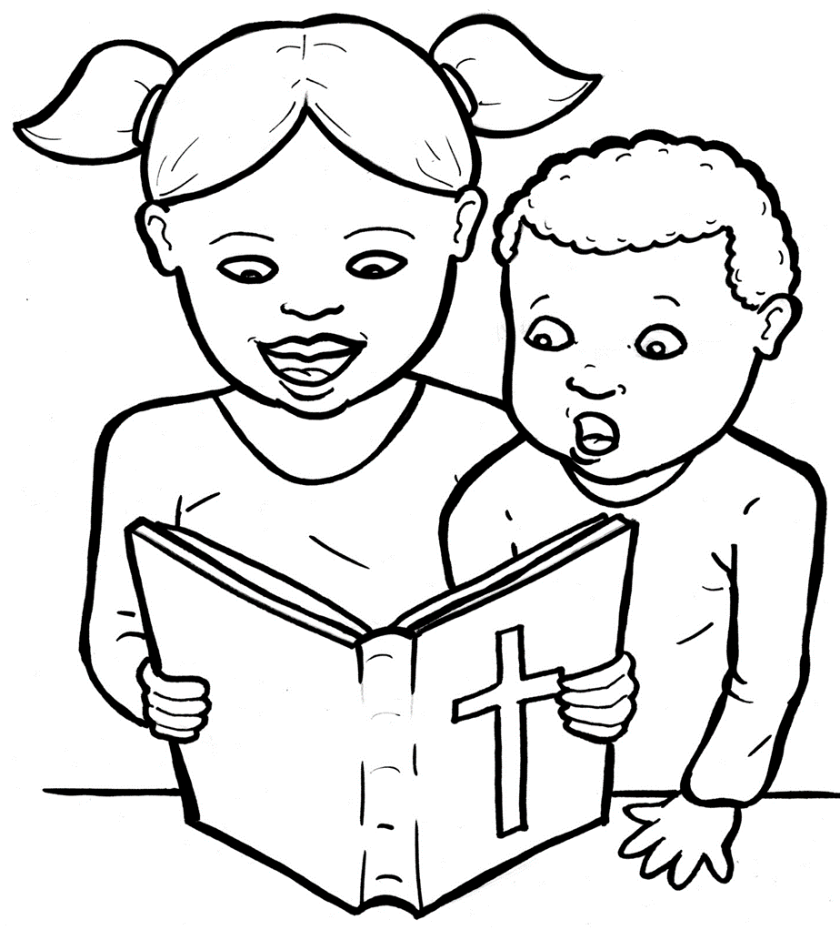
51. I am Alive:
the Bible
Part 3
Syllable Divisions

Slide 2
Dividing Words
Into Syllables

Slide 3
Rabbit Words
When you see two consonants
between two vowels,
divide between the consonants.
ra it
bb
rab bit

Slide 4
fun ny
funny

Slide 5
writ ten
written

Slide 6
let ters
letters

Slide 7
in vites
invites

Slide 8
gos pels
gospels

Slide 9
Is ra el
Israel

Slide 10
Tes ta ment
Testament

Slide 11

Tiger Words
When you see one consonant
between two vowels,
divide after the first vowel.
Try this pattern first.
ti er
g
ti ger

Slide 12
Je sus
Jesus

Slide 13
ho ly
holy

Slide 14
o bey
obey

Slide 15
Camel Words
When you see one consonant
between two vowels,
divide after the first consonant.
Try this pattern second.
ca el
m
cam el

Slide 16
ev er y
every

Slide 17
stor y
story

Slide 18
fam il y
family

Slide 19
Turtle Words
When you see consonant-le,
count back three and divide.
tur
t
l
e
tur tle

Slide 20
Bi ble
Bible

Slide 21
peo ple
people

Slide 22
Hamster Words
When you see three consonants between two vowels,
divide after the first consonant.
ha
mst
er
ham ster

Slide 23
ex plains
explains

Slide 24
in cludes
includes

Slide 25
Foxes Suffixes
Keep the base word together.
smelly
smell y

Slide 26
pray er
prayer

Slide 27
church es
churches

Slide 28
look ing
looking

Slide 29
Jew ish
Jewish

Slide 30
say ings
sayings

Slide 31
lov ing
loving

Slide 32
com ing
coming

Slide 33
call ing
calling

Slide 34
creat ing
creating

Slide 35
a ma zing
amazing

Slide 36
start ed
started

Slide 37
ask ed
asked

Slide 38
fail ed
failed

Slide 39
call ed
called

Slide 40
Anteater Words
These compound words are made up of two smaller words.
ant
eater
1
2
ant eater

Slide 41
him self
himself

Slide 42
for gave
forgave

Slide 43
on going
ongoing

Slide 44
Other Syllable Divisions
Some words don’t fit so neatly
into standard syllable division patterns.

Slide 45
a bout
about

Slide 46
a live
alive

Slide 47
a ma zing
amazing

