Slide 1
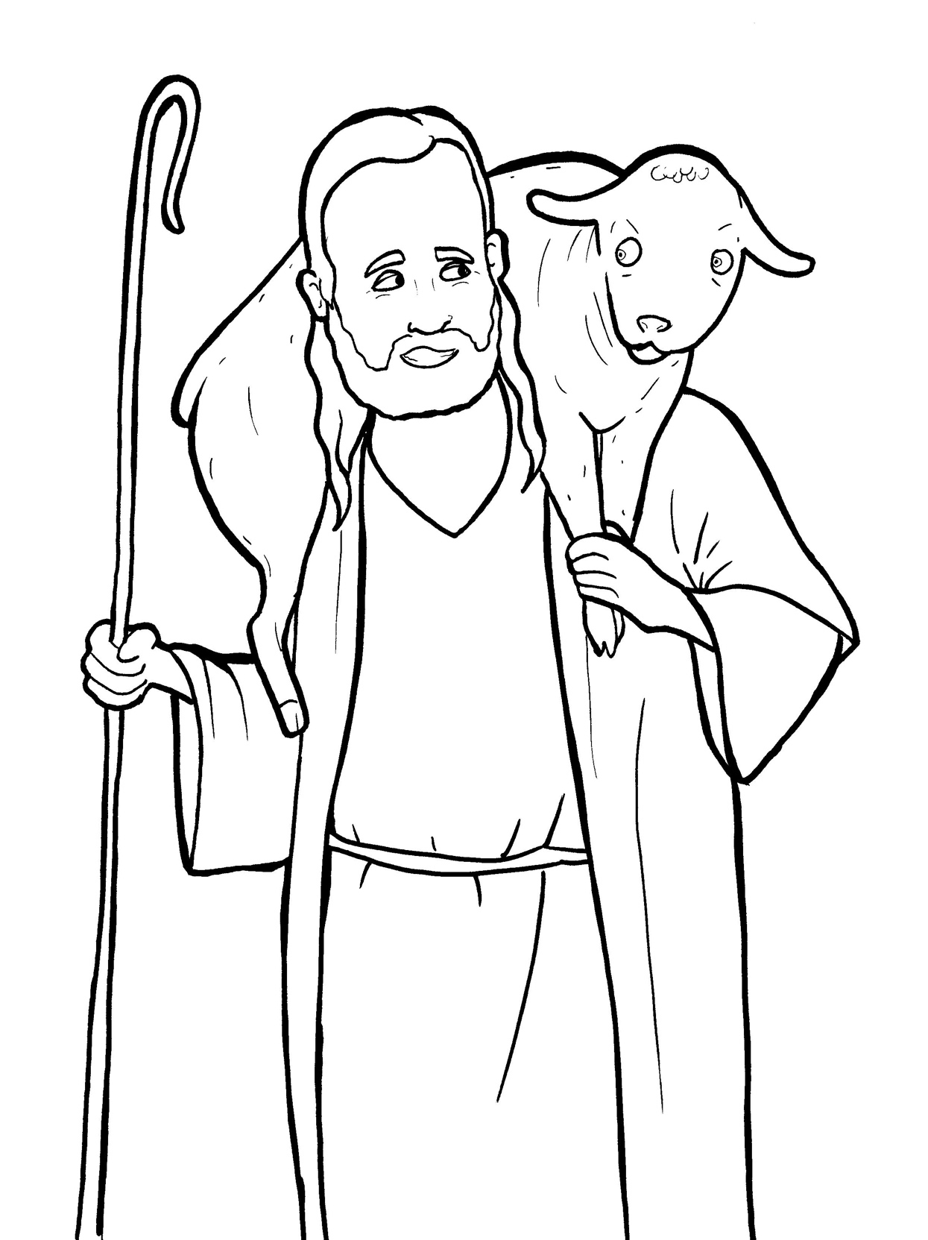
Part 4
22. The Lost Sheep
Story in Easy Read English
Questions
Story in Phrases

Slide 2
Some Jewish leaders were mad at
Jesus.

Slide 3
They didn’t understand why he
welcomed sinners.

Slide 4
They grumbled and said, “He even
eats with sinners.”

Slide 5
So, Jesus told them a story: “Let’s say
a man has 100 sheep, and one sheep
gets lost.

Slide 6
Will he leave the 99 sheep to go look
for the lost sheep?
Yes.

Slide 7
“The shepherd will call the sheep by
name.

Slide 8
He will climb up and down mountains.

Slide 9
He will look until he finds that lost
sheep.

Slide 10
When he finds the sheep, he will pick
it up and carry it home with joy.

Slide 11
He will call all his friends and
neighbors and shout,

Slide 12
‘Rejoice with me!
I have found my sheep that was lost!’

Slide 13
“I tell you, it is the same in heaven.

Slide 14
There is happiness in heaven when
one sinner says he is sorry for his sins.

Slide 15
There is joy with the angels when
one sinner comes home to God.”

Slide 16
Jesus is the Good Shepherd.

Slide 17
Jesus does not want one little sheep
to wander away from him.

Slide 18
Question 1
What does the shepherd do when one of his sheep goes missing?

Slide 19
Question 2
How does the good shepherd feel when he finds his lost sheep?

Slide 20
Question 3
How are people like the sheep in this story?

Slide 21
Question 4
How can you stay close to your good shepherd, Jesus?

Slide 22
Prayer
Dear Jesus,
I know that I am a sinner. Still, you found me and welcomed me home. Please help me to stay close to you.
Amen

Slide 23
The Lost Sheep
Phrased for Fluency

Slide 24
Some Jewish leaders
were mad
at Jesus.

Slide 25
They
didn’t understand
why he
welcomed sinners.

Slide 26
They grumbled
and said,
“He even
eats with sinners.”

Slide 27
So,
Jesus
told them
a story:

Slide 28
“Let’s say
a man has
100 sheep
and one sheep
gets lost.

Slide 29
Will he leave
the 99 sheep
to go look
for the lost sheep?
Yes.

Slide 30
“The shepherd
will call
the sheep by name.

Slide 31
He will
climb up and down
mountains.

Slide 32
He
will look
until he finds
that lost sheep.

Slide 33
When he finds
the sheep,
he will
pick it up
and carry
it home
with joy.

Slide 34
He will call
all his friends
and neighbors
and shout,
‘Rejoice
with me!

Slide 35
my sheep
I have found
that was lost!’

Slide 36
“I tell you,
it is the same
in heaven.

Slide 37
There is happiness
in heaven
when one sinner
says he is sorry
for his sins.

Slide 38
There is joy
with the angels
when one sinner
comes home
to God.”

Slide 39
Jesus is
the Good Shepherd.

Slide 40
Jesus
does not want
one little sheep
to wander
away from him.

