Slide 1
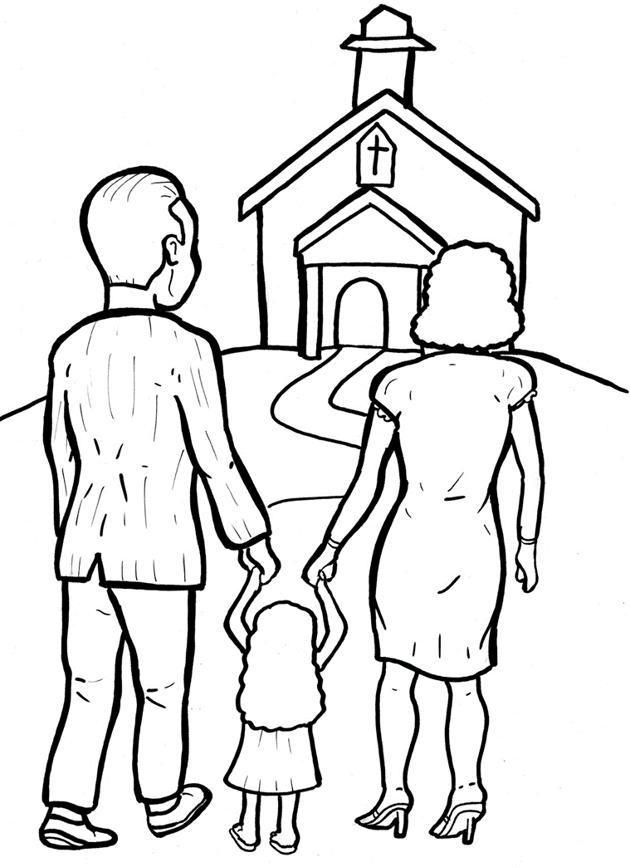
Timing
Box
52. I Am Alive: Church
Part 4
Story in Easy Read English
Questions
Story in Phrases

Slide 2
Timing
Box
The early believers were
very excited about their
new faith.

Slide 3
Timing
Box
They got together every day.

Slide 4
Timing
Box
These Christians met in
homes or at the temple.

Slide 5
Timing
Box
They could not stay away
from each other.

Slide 6
Timing
Box
Their love became like a
magnet.

Slide 7
Timing
Box
They shared bread as Jesus
did at the Last Supper.

Slide 8
Timing
Box
They sang, prayed, and
listened to teachings from
God’s Word.

Slide 9
Timing
Box
They shared everything
with each other.

Slide 10
Timing
Box
And God blessed these
new followers.

Slide 11
Timing
Box
He sent miracles.

Slide 12
Timing
Box
Every day, more people
became believers.

Slide 13
Timing
Box
It was the beautiful birth
of the Christian church.

Slide 14
Timing
Box
All over the world, the church
of Jesus Christ is still growing.

Slide 15
Timing
Box
Most Christians meet in
churches.

Slide 16
Timing
Box
Sadly, in some countries,
Christians are not allowed
to meet.

Slide 17
Timing
Box
But they keep meeting to
obey God.

Slide 18
Timing
Box
They gather secretly in
homes, fields, or caves.

Slide 19
Timing
Box
When you became a
believer, you became
part of God’s family.

Slide 20
Timing
Box
This is the worldwide church.

Slide 21
Timing
Box
All Christians need each
other to grow strong.

Slide 22
Timing
Box
Jesus promised to be with
us where two or more
gather in his name.

Slide 23
Timing
Box
He said, “I will build my church.

Slide 24
Timing
Box
Even the gates of hell itself
will not destroy it.”

Slide 25
Timing
Box
Jesus is keeping that promise.

Slide 26
Question 1
Timing
Box
What was the early Christian church like?

Slide 27
Question 2
Timing
Box
What is the Christian church like today?

Slide 28
Question 3
Timing
Box
Do you go to church each week?
If not, would you like to?

Slide 29
Question 4
Timing
Box
How can you become an important part of your church?

Slide 30
Prayer
Timing
Box
Dear Lord Jesus,
You are the head of the church all over
the world. Thank you for freedoms to go to
church. Please help those who share my
faith but not my freedom. Please help me
to go to church each week.
Amen

Slide 31
Timing
Box
I am Alive: Church
Phrased for Fluency

Slide 32
Timing
Box
The early believers
were very excited
about their
new faith.

Slide 33
Timing
Box
They
got together
every day.

Slide 34
Timing
Box
These Christians
met in homes
or at
the temple.

Slide 35
Timing
Box
They could not
stay away
from each other.

Slide 36
Timing
Box
Their love
became
like a magnet.

Slide 37
Timing
Box
They shared bread
as Jesus did
at the
Last Supper.

Slide 38
Timing
Box
They sang,
prayed,
and listened
to teachings
from God’s Word.

Slide 39
Timing
Box
They shared
everything
with each other.

Slide 40
Timing
Box
And God blessed
these new followers.

Slide 41
Timing
Box
He sent miracles.

Slide 42
Timing
Box
Every day,
more people
became believers.

Slide 43
Timing
Box
It was
the beautiful birth
of the Christian church.

Slide 44
Timing
Box
All over the world,
the church
of Jesus Christ
is still growing.

Slide 45
Timing
Box
Most Christians
meet in churches.

Slide 46
Timing
Box
Sadly,
in some countries,
Christians
are not allowed
to meet.

Slide 47
Timing
Box
But
they keep meeting
to obey God.

Slide 48
Timing
Box
They gather secretly
in homes,
fields,
or caves.

Slide 49
Timing
Box
When you became
a believer,
you
became part
of God’s family.

Slide 50
Timing
Box
This is
the worldwide church.

Slide 51
Timing
Box
All Christians
need each other
to grow strong.

Slide 52
Timing
Box
Jesus promised
to be with us
where
two or more gather
in his name.

Slide 53
Timing
Box
He said,
“I will build
my church.

Slide 54
Timing
Box
Even
of hell itself
the gates
will not
destroy it.”

Slide 55
Timing
Box
Jesus
is keeping
that promise.

